Slide 1

Science: electricity
Use Seneca learning online with the code: ow0q7tt10a
Or have a look at BBC bitesize, follow the link below
https://www.bbc.co.uk/bitesize/guides/zwfgmnb/revision/1
Recap
Explain what is meant by geothermal energy
What are the energy transfers in solar panel?
Name 3 forces
Compare a wind turbine to a coal power station
The energy transfers in a coal power station are:
Chemical _________ + _________ + __________
The energy transfers in wind turbine are:
 | Advantages | Disadvantages
Coal power station
Wind turbine
Which of there is a renewable energy resource?
Why?

Slide 2
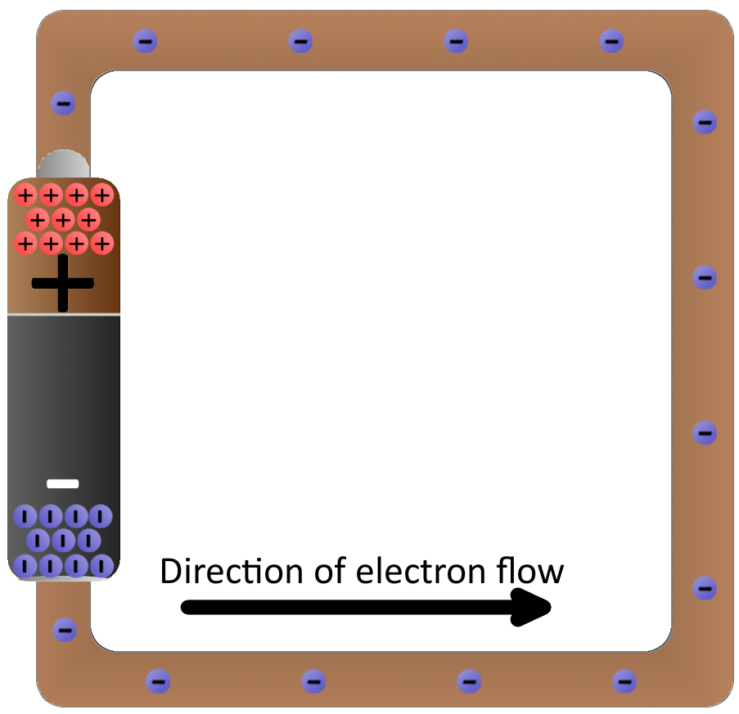
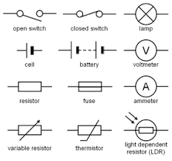
What is electricity?
Electricity is the flow of electrons
It flows through conductors such as copper
When drawing electrical circuits we use these symbols to represent parts of a circuit
An ammeter measures the current (I) in a circuit this is measured in amps.
A voltmeter measures the potential difference/voltage (V) in a circuit in volts

Slide 3






Match the symbol to it’s name and what it does. The first one has been done for you
Variable resistor |  | Glows when a circuit is complete
Resistor |  | Measures the voltage produced by a power supply
Cell |  | Measures the flow of electrons in a circuit, which is known as current
Voltmeter |  | It slows down the flow of electrons in a circuit.
Bulb |  | It slows down the flow of electrons in a circuit. The resistance can be changed
Ammeter |  | Transforms chemical energy into electrical energy

Slide 4
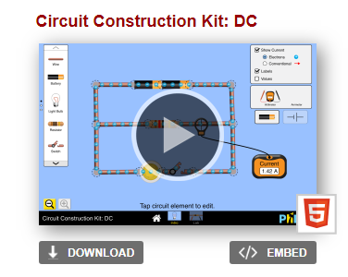
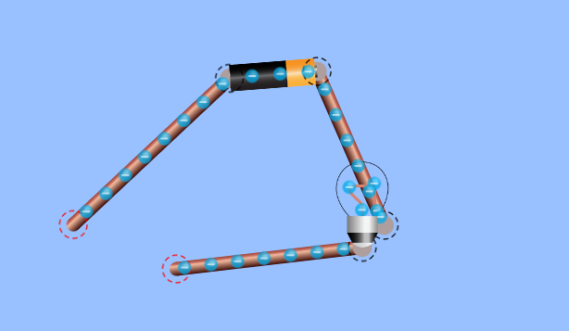
Conductor or insulator?
Type in this link and then download the simulator.
https://phet.colorado.edu/en/simulation/circuit-construction-kit-dc
Once downloaded open it and click on intro
Create a circuit that looks like this
Click on this
If you want to delete something double click on it
Add in the following items and see if electricity flows and the light bulb lights up.
If it is a conductor it lets electricity travel through it. If something is an insulator it does not let electricity pass.
Fill in the table below.
Item | Light bulb on? | Conductor or insulator?
Rubber
paperclip
Coin
pencil
Name as many electrical conductors as you can think of:

Slide 5
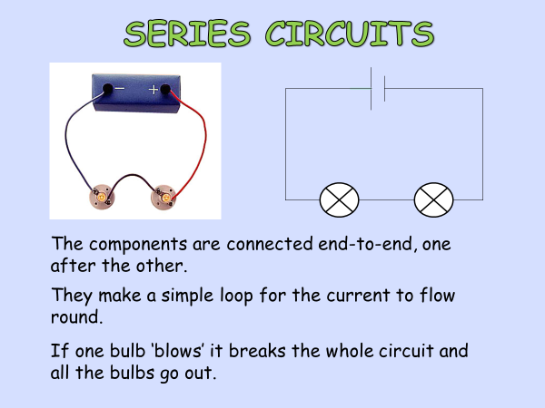
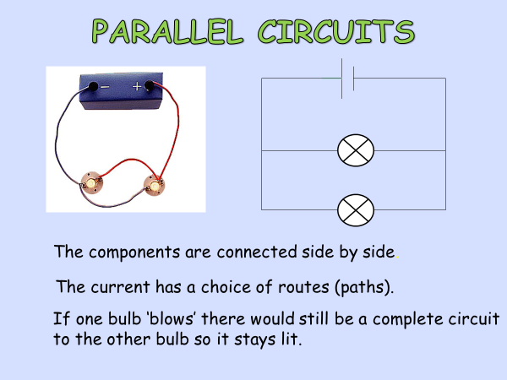

Slide 6
Have a go at creating the circuits below using this link:
https://phet.colorado.edu/en/simulation/circuit-construction-kit-dc
Series Circuits
Build a simple series circuit that consists of 6 pieces of wire, 2 light bulb, and 1 battery. In order to complete the circuit, the red circles at the end of each must overlap. Please note that the light bulb also has TWO circles. Your circuit is complete and working when the light comes on and the blue dots begin moving.
Draw a picture of your circuit here.
What do you think that the moving blue dots represent?
Use the tools at the side to get a voltmeter and a Non-contact ammeter. Put the voltmeter near the battery and place the red tab at one end and the black at the other.
What is the voltage? __________
Place the ammeter cross over the moving blue dots. What is the reading? _______
What does this tell us about the circuit?
Click the lab button. On the right side change the resistance of the battery. Make observations on how this changes the readings on the voltmeter and ammeter. Record your observations below.
Click the advanced tab and alter the resistivity of the wire. Record your observations.

Slide 7
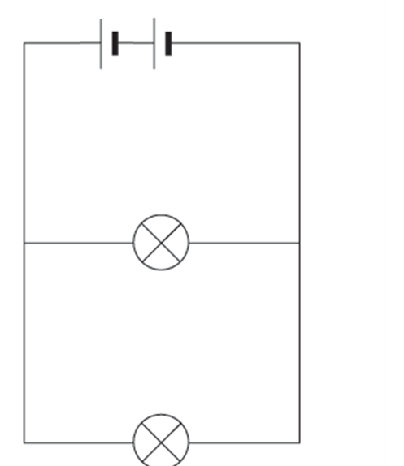
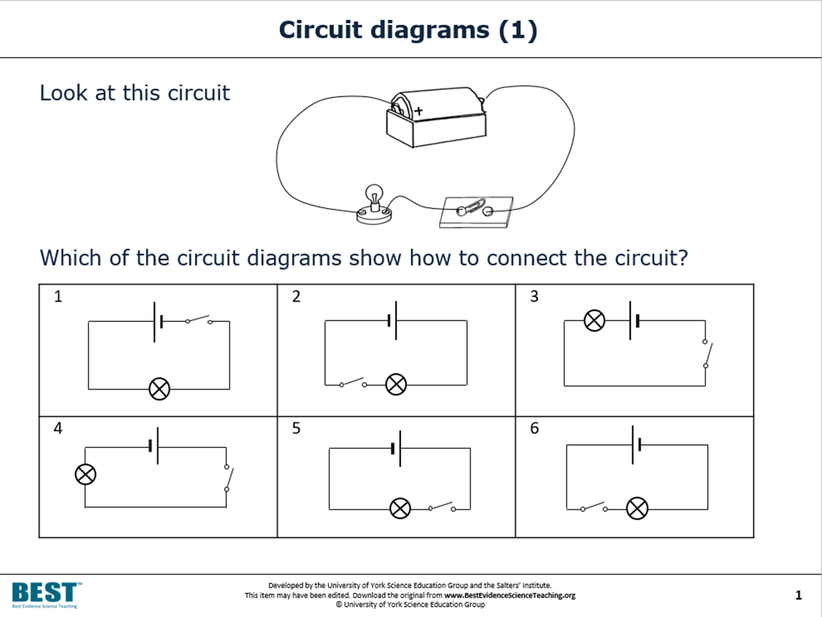
Parallel Circuits
Parallel circuits provide more than one path for electrons to move create a circuit with 2 light bulbs and 1 battery.
The blue dots will be moving and both lights will be on once the circuit is complete.
Use the voltmeter and ammeter to measure electron flow and push.
Voltage:______ Ammeter:______
How does this compare with your observations in the series circuit?
Is this same? WHY or WHY NOT?

Slide 8
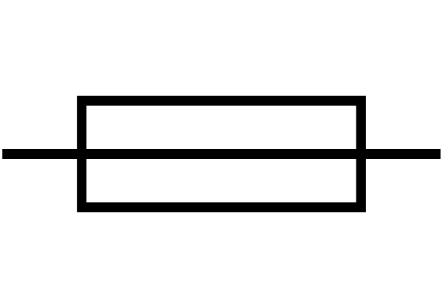
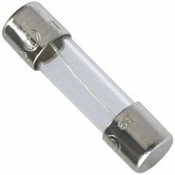
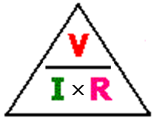
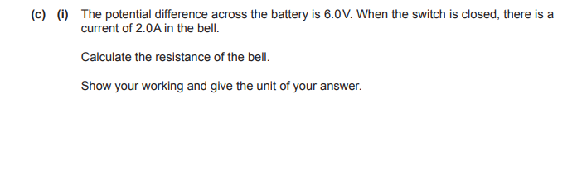
Resistors
A resistor controls the size of the current, if you increase the resistance, the current moves slower and the bulb will be dimmer. This is how dimmer switches work
What is a fuse?
fuse is a thin piece of wire (high resistance) that has a low melting point, if there is too large a current it get hot and melt and the circuit is incomplete.
Why are fuses important?
We can calculate resistance, voltage or current using this triangle
Calculate the resistance if a circuit has a voltage of 10V and a current of 5amps.
Calculate the voltage of a circuit what has a resistance of 20 Ω and a current of 3amps.
Resistance = voltage ÷ current
This is when:
potential difference (V) is measured in volts (V)
current (I) is measured in amps (A)
resistance (R) is measured in ohms (Ω)

Slide 9
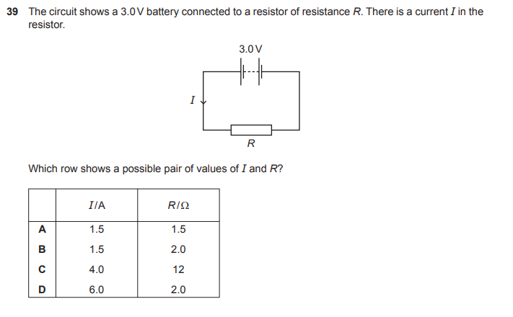
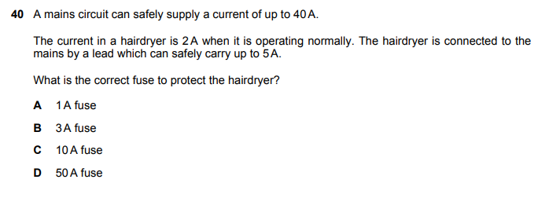
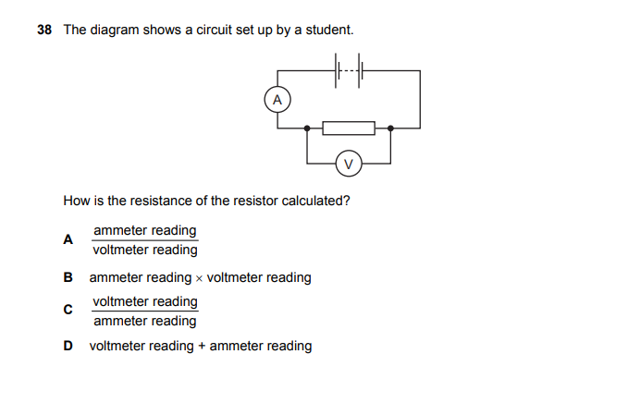

Slide 10
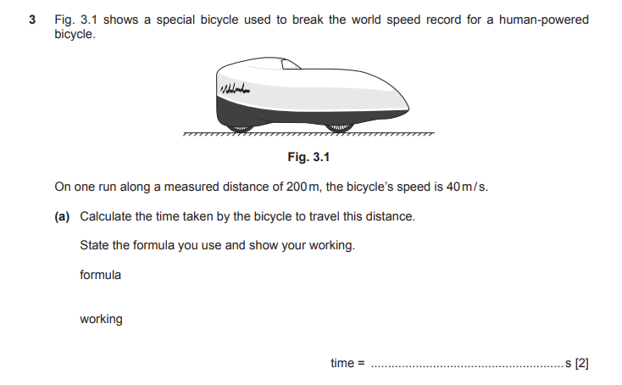
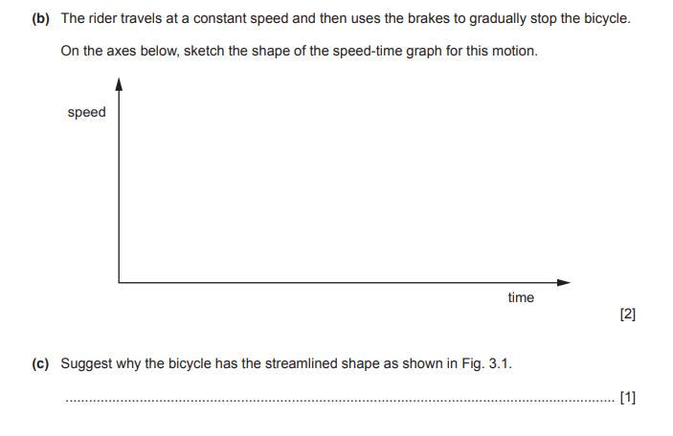
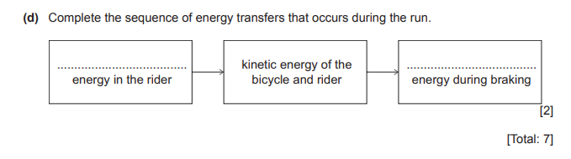

Slide 11
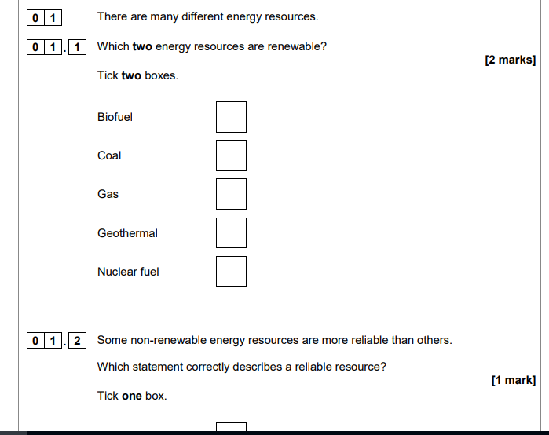
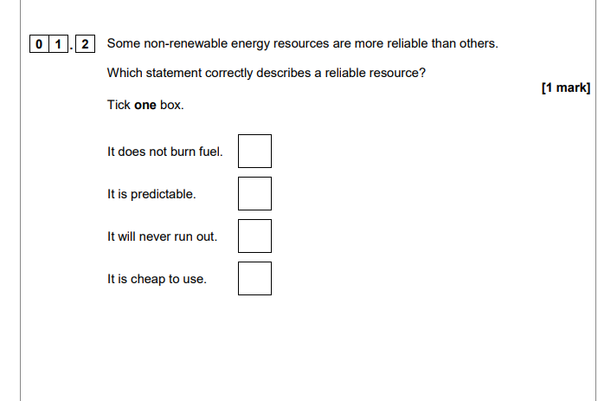
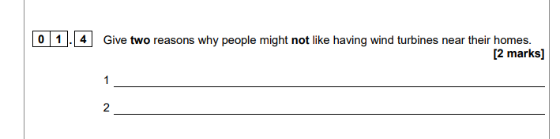

Slide 12
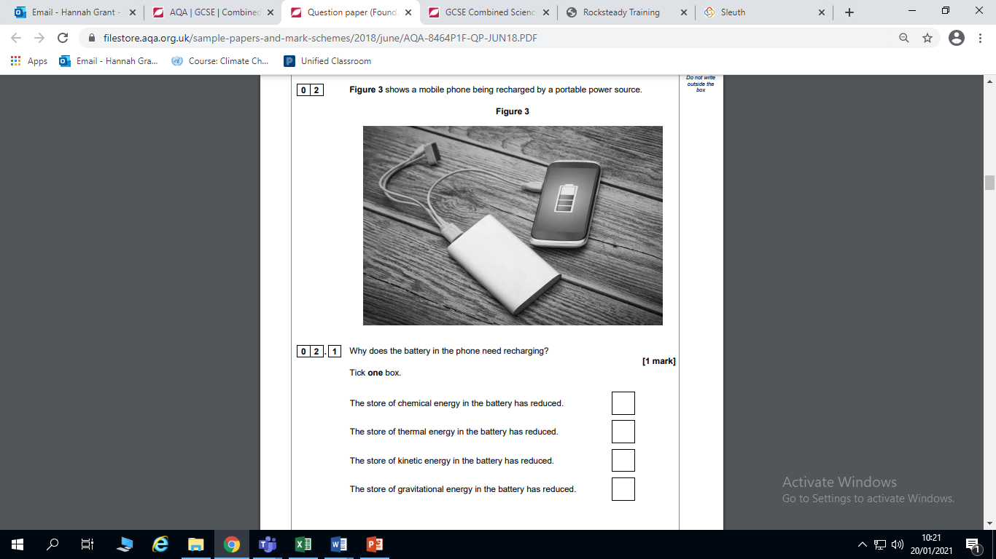
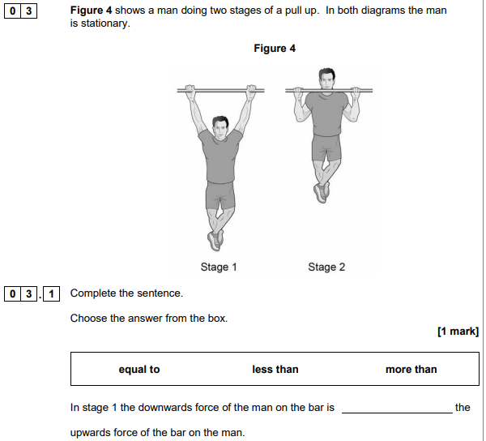

Slide 13


