Slide 1
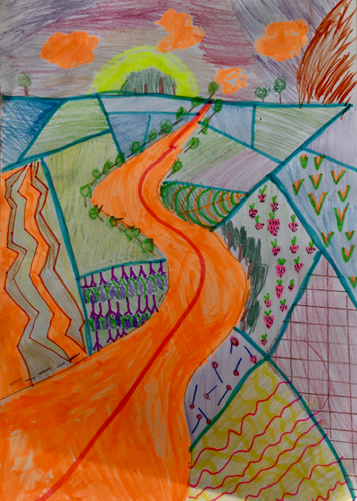

KEYWORDS
Identity landscape portrait colours style shapes
Learning objective
Learning about the work of David Hockney
Developing creative ability/observational drawing skills.
Success criteria
Discuss the art of David Hockney using art terms.
PRESENT a landscape inspired by the work of Hockney

Slide 2
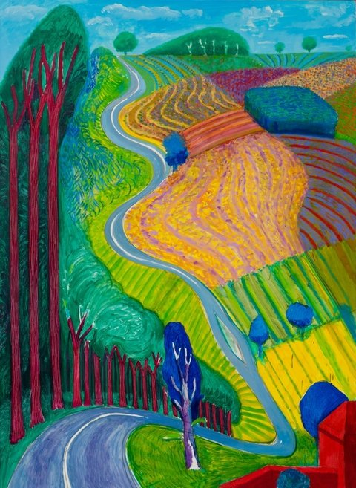
Art@stmatthias
Name
Date
Identity and David Hockney
GO TO: https://www.tate.org.uk/kids/explore/who-is/who-david-hockney
David Hockney is one of the most important painters of the 20th century
Born in Bradford in 1937, Hockney was one of the big artists involved in the pop art movement in the 1960s.
Facts on the artist
What is identity?

Slide 3

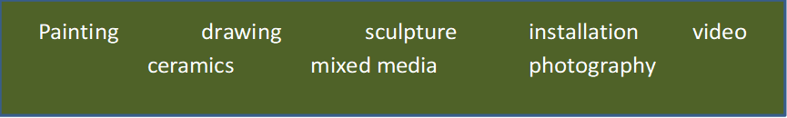
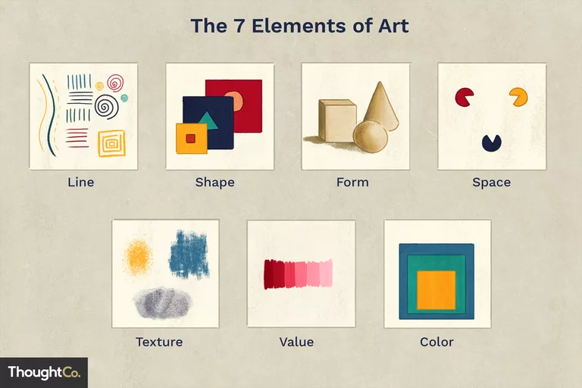
art@stmatthias
IDENTITY Artist Research
https://www.tate.org.uk/kids/explore/who-is/who-david-hockney
Read the information and answer the following:
Name of artist: David Hockney
What is Hockney famous for?
2. What art form does he use to produce art ?
3. How would you describe the style and colours that he uses?
What visual elements are in the work Going Up Garrowby Hill 2000 ?
5. What do you like/dislike about the art and why?
6.Explain how his work represents his IDENTITY?

Slide 4
David Hockney Landscape
Choose 2 of the following tasks
Task 1: watch the clip
https://www.youtube.com/watch?v=4pFEZulNAEc&feature=emb_rel_end
Follow the step by step guide to draw your own Hockney landscape.
Choose one of the Hockney outlines and draw.
Add colour using your medium of choice.
Choose one of the Bristol Landscape and draw/add colour inspired by Hockney’s landscape.

Slide 5
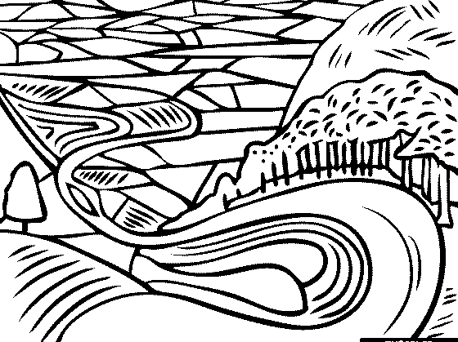

Slide 6
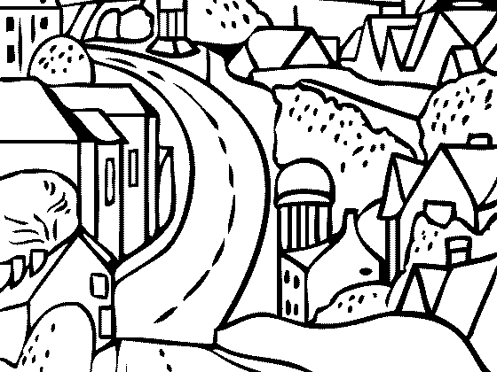

Slide 7
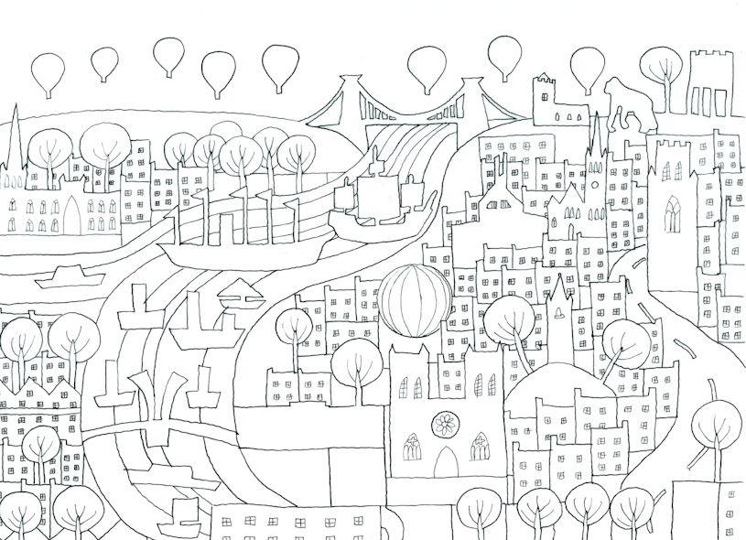

Slide 8
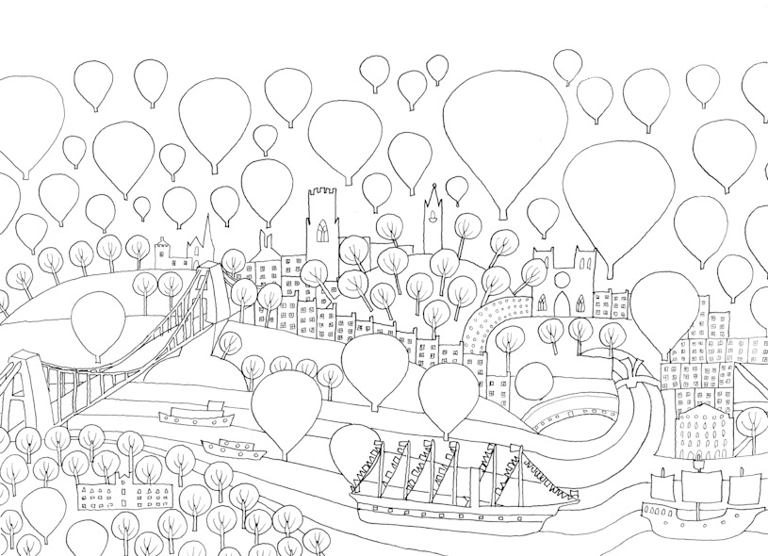

Slide 9
Grades
Grade 1
Discussing of art using a few art basic art terms. Very basic landscape an use of medium.
Grade 2
Discussing of art using a basic art terms. Identity art using tracing/add to outline. Landscape with Basic creativity.
Grade 3
Discussing of art using a different art terms with clear understanding. Landscape with some creativity
Grade 4
Discussing of art using more complex art terms with clear understanding. Landscape with creative use of meduim.

