Slide 1
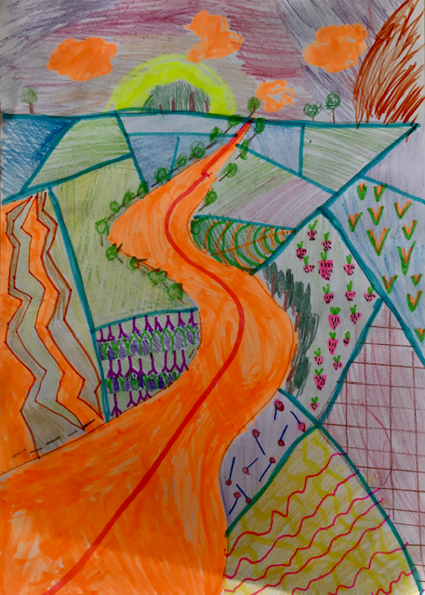

KEYWORDS
Identity landscape portrait colours style shapes
Learning objective
Learning about the work of David Hockney
Developing creative ability/observational drawing skills.
Success criteria
Discuss the art of David Hockney using art terms.
PRESENT a landscape inspired by the work of Hockney

Slide 2
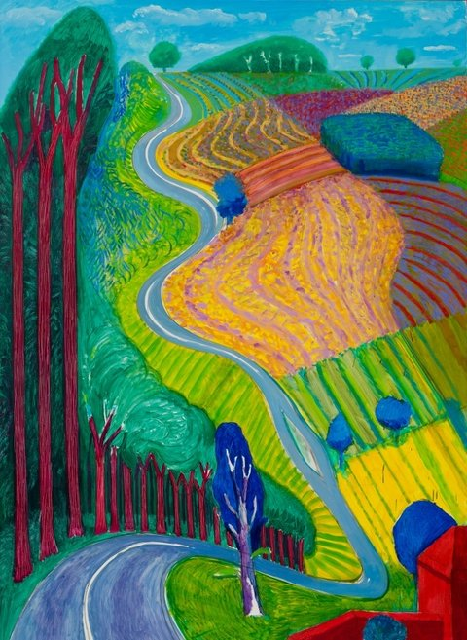
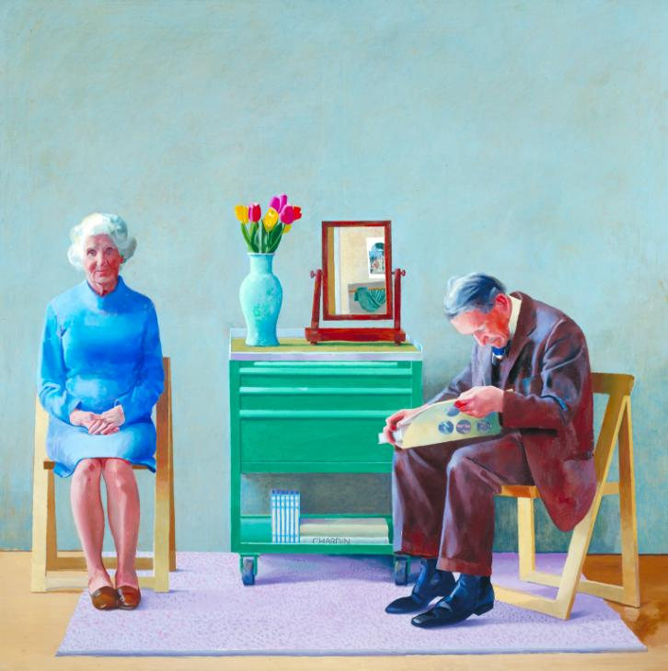
Art@stmatthias
Name
Date
Identity and David Hockney
David Hockney is one of the most important painters of the 20th century
Born in Bradford in 1937, Hockney was one of the big artists involved in the pop art movement in the 1960s.
Hockney lives in London, but owns two other homes in California. When painting in England, Hockney likes to paint the seasons. In Going Up Garrowby Hill, Hockney has painted a canvas of the landscape in Yorkshire, where he was brought up.
What is identity?
Lots of Hockney’s work involves painting people he loves. This is usually pairs of people. My Parents (1977) is a painting of his mum and dad and is probably one of his most famous.

Slide 3

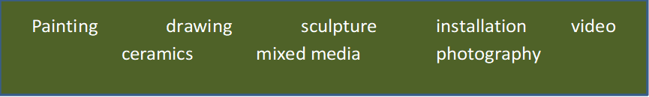
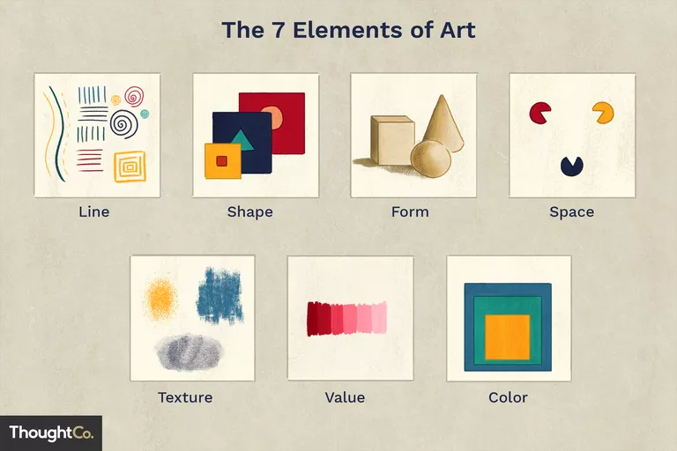
art@stmatthias
IDENTITY Artist Research
Name of artist: David Hockney
What things do you see in the work of art?
2. What art form is it?
3. How would you describe the style and colours?
What visual elements are in the work?
5. What do you like/dislike about the art?
6.How does this artwork relate to IDENTITY?
Keywords
Colour
pattern
People
Identity
Bright
Vibrant
Fields
Trees
Road
Sky
clouds

Slide 4
David Hockney Landscape
Choose one of the following tasks
Task 1: watch the clip
https://www.youtube.com/watch?v=4pFEZulNAEc&feature=emb_rel_end
Follow the step by step guide to draw your own Hockney landscape.
Choose one of the Hockney outlines and draw.
Add colour using your medium of choice.
Choose one of the Bristol Landscape and draw/add colour inspired by Hockney’s landscape.

Slide 5
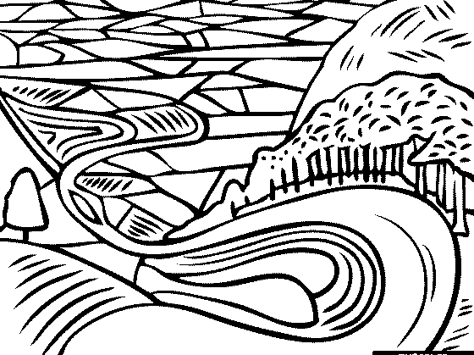

Slide 6
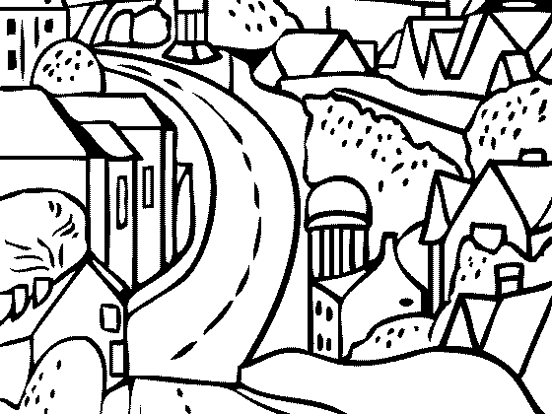

Slide 7
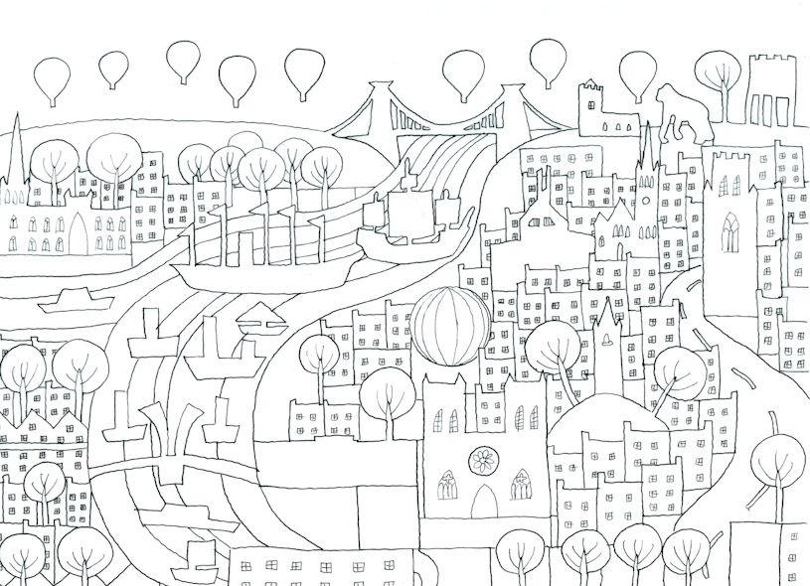

Slide 8
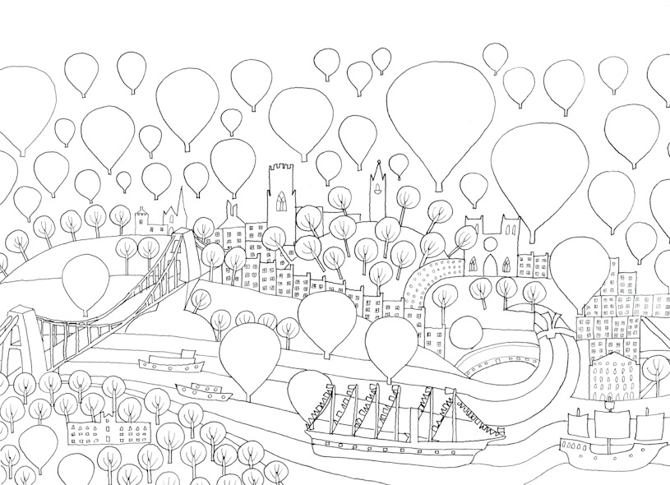

Slide 9
Grades
Grade 1
Discussing of art using a few art basic art terms. Very basic landscape an use of medium.
Grade 2
Discussing of art using a basic art terms. Identity art using tracing/add to outline. Landscape with Basic creativity.
Grade 3
Discussing of art using a different art terms with clear understanding. Landscape with some creativity
Grade 4
Discussing of art using more complex art terms with clear understanding. Landscape with creative use of meduim.

