Slide 1
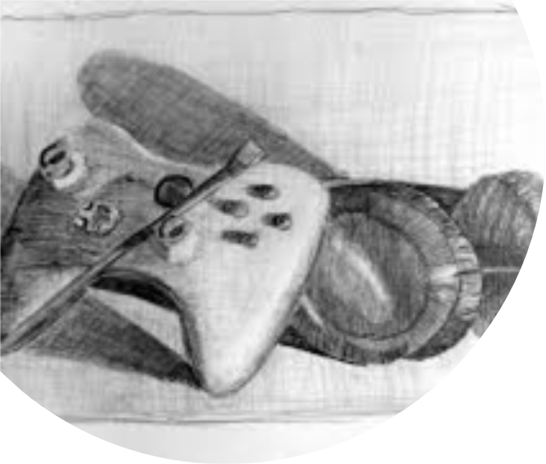
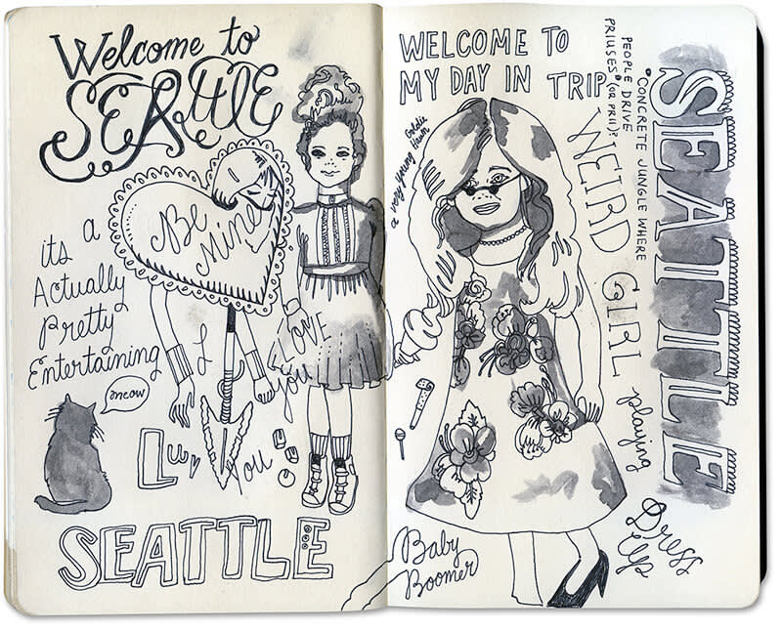
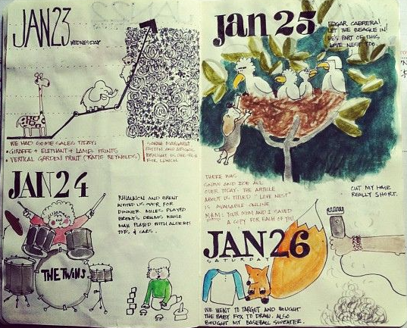
Life and Death part three-still life as a self portrait
Throughout this term, you will fill in your sketchbook on your experiences and your life. The sketchbook can contain words, song lyrics, poems, cut out images from magazines and newspapers, doodles, sketches, photographs, paintings and drawings. The aim is for the sketchbook to be filled with anything relevant about YOU and YOUR LIFE. It could be a visual diary of your time this year/during lockdown, a reflection on your life or your hopes for the future.
MAKE SURE you stick any written work into your sketchbook
art@stmatthias

Slide 2
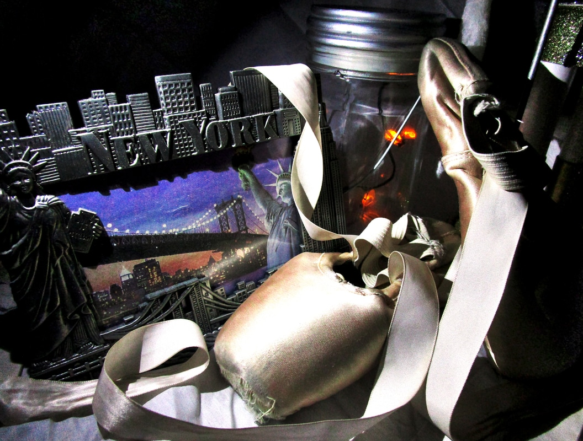
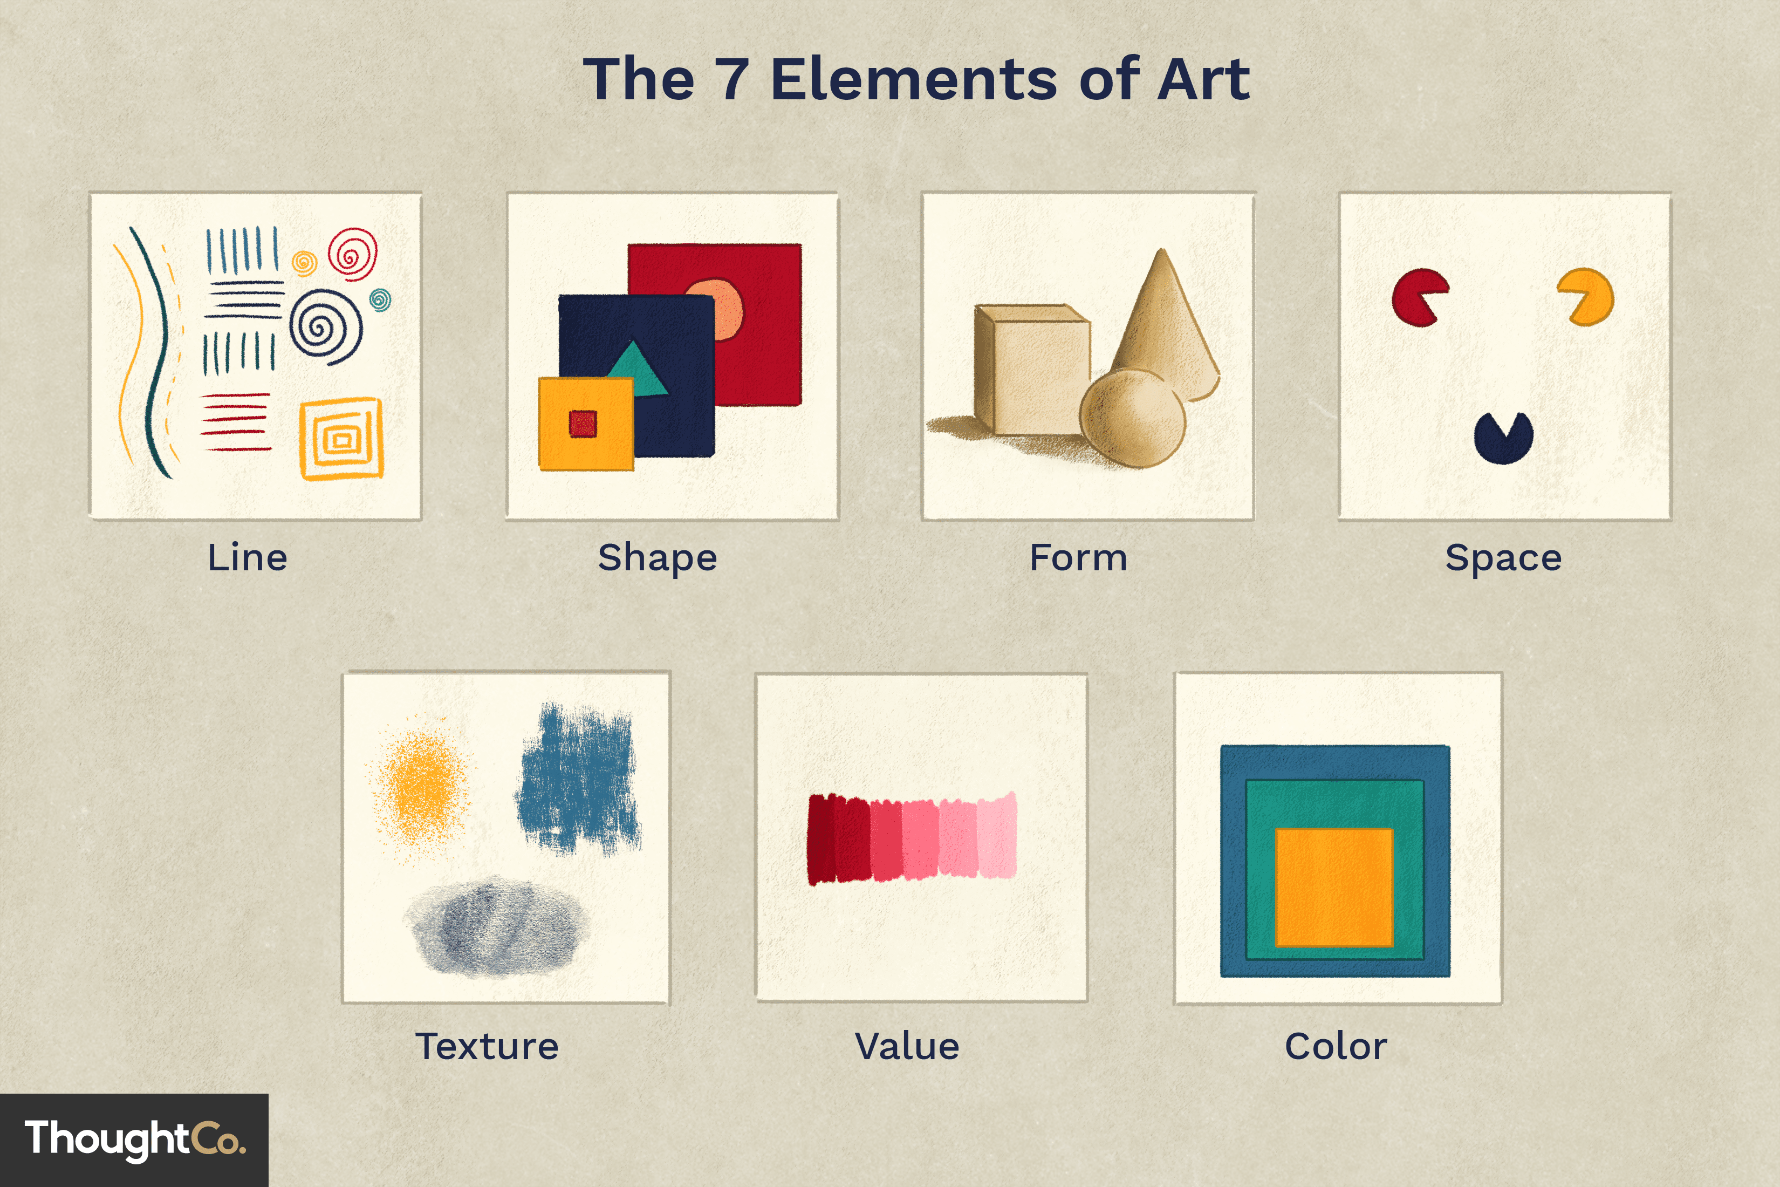
Analysing-self portrait as a still life
What is the medium used to produce the still life?
Discuss the use of light and shadow. How does this effect the artwork?
Look closely at the objects. What do these tell you about the artist? What sex are they, where do they live? What may they do for a living? How old are they?
What elements can you see in the photograph?
Use full sentences

Slide 3

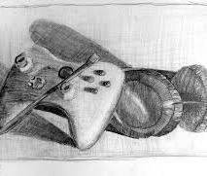
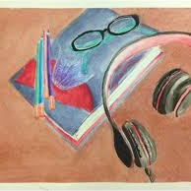
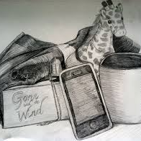
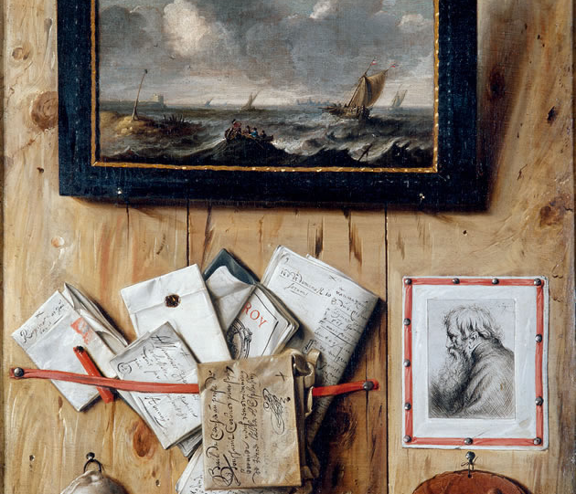
Your task for this week still life as a self portrait
STILL LIFE-an arrangement of objects
SELF PORTRAIT-a portrait that an artist produces of themselves
Arrange objects that represent you.
Observe and draw the still life.
Produce at least 4 studies and use a different MEDIUM on each.
You don’t have to draw the whole thing-take sections, draw from different angles.
You can use you phones to take photographs of the still life and use different effects on your phone to edit colours, light, style etc. If you choose this option you should complete at least 8 images and send these to my email to print them out
julie.caswell@stmatthias.learnmat.uk
MAKE IT CREATIVE AND USE DIFFERENT MEDIA AND TECHNIQUES/EFFECTS (ART MATERIALS)

Slide 4
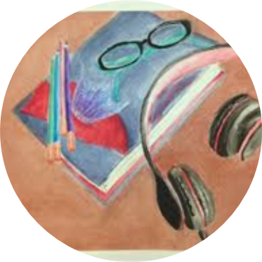

Grade boundaries
KEYWORDS
Medium self portrait techniques effects edit photography observational studies angles
GCSE assessment objective A02/3:Record and develop ideas using a range of media
.Observations and insights relevant to intentions
Grade 2-simple observations . Basic use of materials.
Grade 3- observations which are linked to the topic. Competent use of appropriate materials.
Grade 4- observations which are linked to the topic with creativity. Control of appropriate materials.
Grade 5- observations which are clearly linked to the topic. Creative use of appropriate materials.
Objectives
To develop ability to record focused observations.
To develop observational drawing skills
Success Criteria
PRESENT a range of studies using a range of media/techniques

