Slide 1
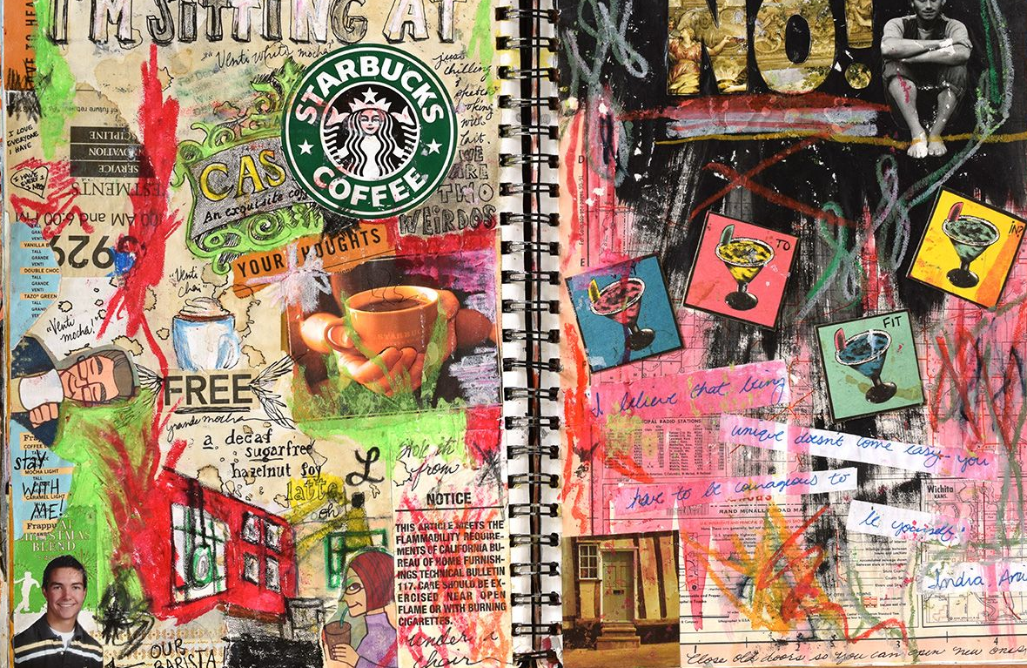
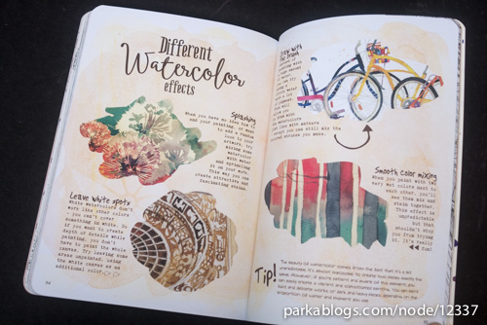
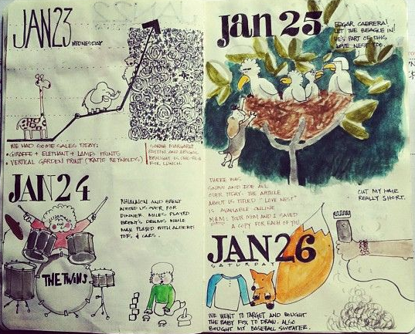
Life and Death part four-using different media and I’m the artist of my life, so I shall paint it well.
Throughout this term, you will continue to fill in your sketchbook on your experiences and your life. Fill it with sketchbook words, song lyrics, poems, images from magazines and newspapers, doodles, sketches, photographs, paintings and drawings. The aim is for the sketchbook to be filled with anything relevant about YOU and YOUR LIFE. It could be a visual diary of your time this year/during lockdown, a reflection on your life or your hopes for the future. Remember to use a variety of media (different materials and techniques)
art@stmatthias

Slide 2
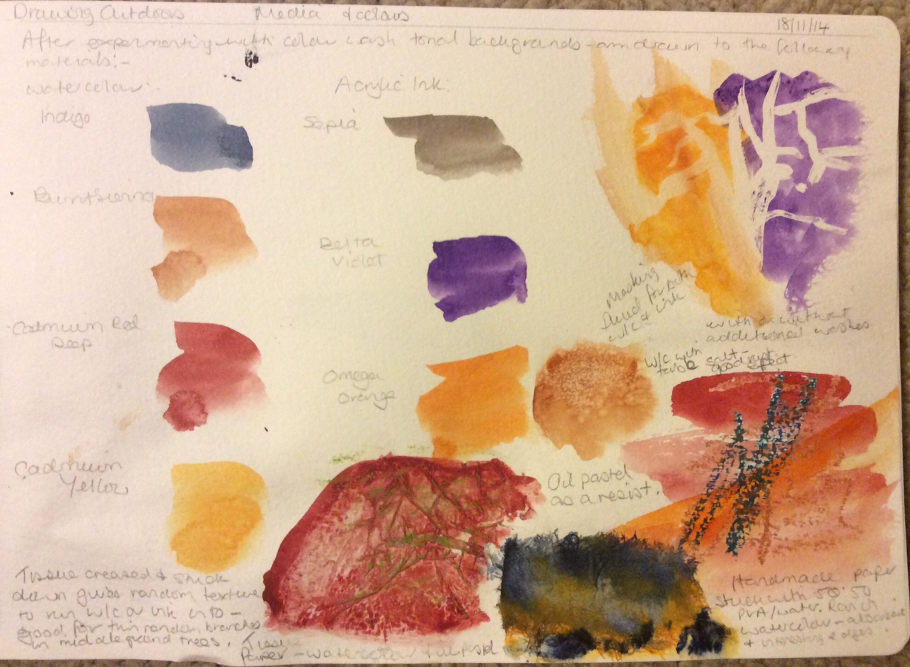
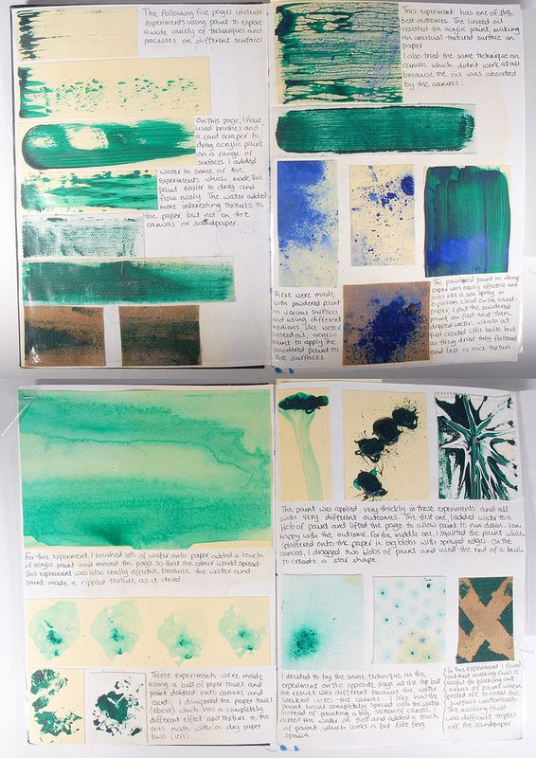
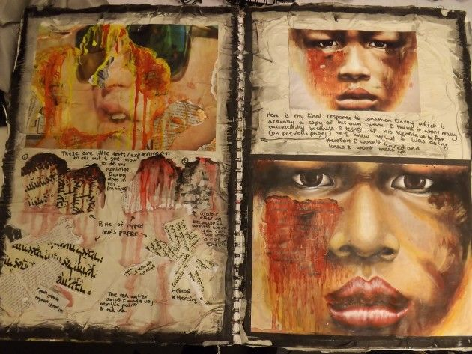
Using different media
TASK
Use several pages of your sketchbook to explore different media and effects. For example: watercolour. Try using a wash (brush water on a page and then apply watercolour paint on top), dry brushing (applying a tiny amount of water to brush and applying watercolour onto page so you're almost dragging), layering (apply watercolour and allow it to dry before applying another colour on top). Label your experiments. What techniques did you like and why?
IDEAS
OIL PASTELS-apply thickly, thinly, layer and blend.
COLOURED PENCILS-blend, smudge, layer.
FELT PEN-add water on top with a brush.
PENCIL-blend, dark to light, smudge.

Slide 3

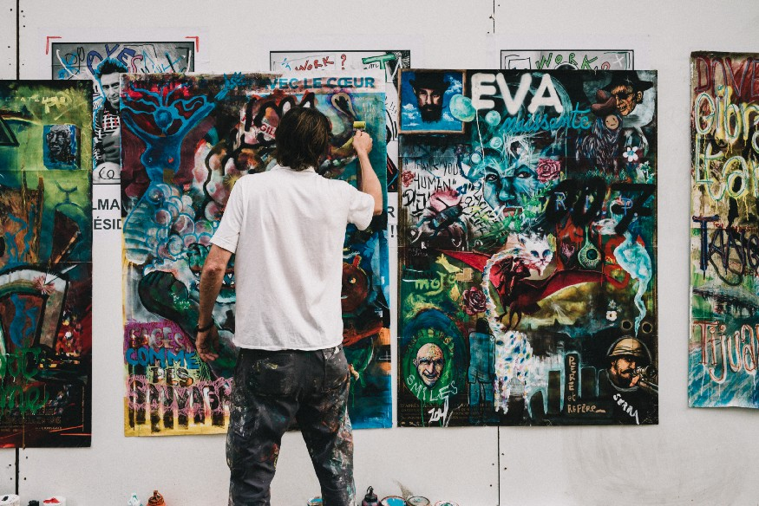
Task 2
I’m the Artist of My Life, so I Will Paint It Well’
Many tried to control my life
telling me not to get my hopes up
whispering to me day and night:
You can’t do it
just follow the wind and rest your mind
just be a member with us
in our failure’s community.
But I will not listen to them,
as I know they are not friends.
I will keep my hopes up
and nothing would get it down
I will always think
everything will work out
even if it didn’t
because from every fail I gain
knowledge and awareness
of what should I do
in the next time.
I will stop procrastinating
and start planning
because life passes
without you even notice,
she doesn’t take your permission — she keeps going
no matter how much you call
she will never respond.
She’s like a train that if you missed its stopping time
it won’t open the door for you again
people who miss it
are the ones who lost their souls
and their lives as well.
And when the moment came
I looked around to make sure no one sees me
got my notebook out and let go of my creativity
held the brush in one hand and put my goals beside me
painting the life I want will not be a luxury
I’m the artist of my life, so I will paint it well.
I will change the routine into adventures
and the boring into interesting
putting the life into pictures and music to move silence
spreading the hope along desperate moments
and the light to cover dark reflections.
I will make the borders out of my traits
and the lines out of my personality.
I will draw experiences as the heroic stories
where the last scene is — the hero saving the situation
proud of his accomplishments and ready for the next mission,
I’m the hero of my story, so I will draw myself well.
I will increase lighting on my lovely side,
so it attracts the eye
and cover on my dark secrets
so no one can know
any clue about them.
I won’t forget haters and their components
I will draw them as a weak beast
who doesn’t hurt anyone but his soul,
he keeps thinking
how would he destroy me
while he doesn’t know
his words mean nothing to me.
I liked what someone once said
before you try to fail
think of all the people
who would be happy
to see you break.
After I finished the painting
with lighting and beautiful shaping
I can say one thing is missing — my signature
to tell everyone — I’m the artist who painted his life well.
Read the poem and use it to inspire your own art piece. Use the medium and techniques you liked from the previous task. You could use your own poem, song lyrics or use a paragraph from this poem. Create an art piece combining images and words in your style.

Slide 4
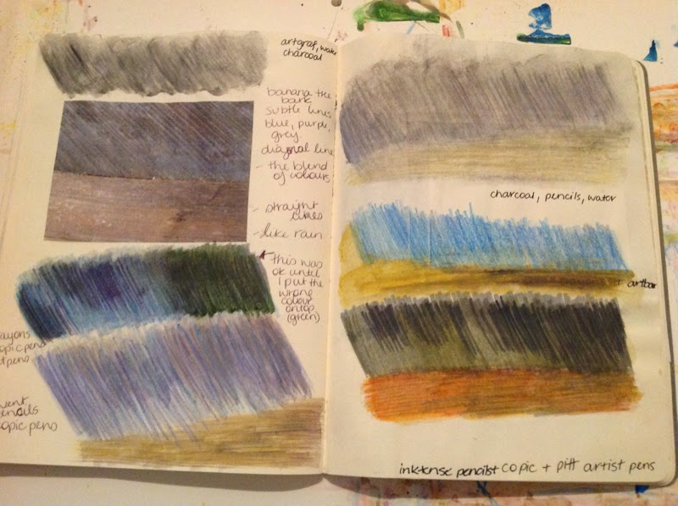

Grade boundaries
KEYWORDS
Words images explore medium techniques
GCSE assessment objective A02/3:Record and develop ideas using a range of media
.Observations and insights relevant to intentions
Grade 2-Basic use of materials with some basic explorations. Basic artpiece.
Grade 3- Competent use of appropriate materials showing some techniques. Art piece showing some creativity.
Grade 4- Control of appropriate materials exploring different techniques-labelled. Art piece showing creativity.
Grade 5- Creative use of appropriate materials and techniques-labelled and discussed. Creative artpiece.
Objectives
To develop ability explore and control a range of media.
To develop creative skills
Success Criteria
Use a range of media to PRESENT a range of explorations.
PRESENT an art piece based on your combining words and images.

