Slide 1
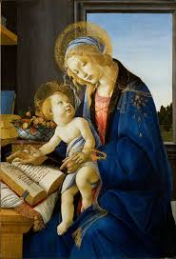
English Skills
Home Learning Booklet
A Mother in a Refugee Camp
Name: ___________

Slide 2
Key Words
Write down or look up the definitions for these key English terms. Then write an example for each.
Key Word | Definition
Emotive Language
Connotations
Refugee
Mother
Metaphor
Simile

Slide 3
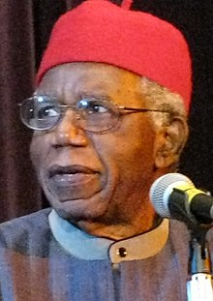
Background
Chinua Achebe
Chinua Achebe was a Nigerian novelist. He was born in 1930 and died in 2013 when he was 82 years old.
His first novel, Things Fall Apart, is the most widely read book in modern African literature. He was greatly interested in African politics.
Achebe wrote this poem to make use aware of the life refugees had to live.
Where was Chinua Achebe born?
______________________________________________________
2. How old was he when he died?
______________________________________________________
3. What is the name of his most famous novel?
______________________________________________________
4. Why did he write this poem?
______________________________________________________

Slide 4
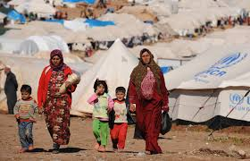
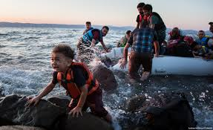
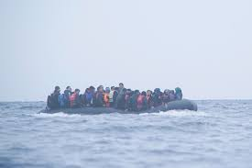
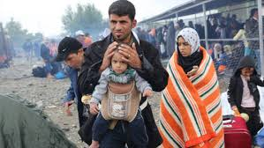
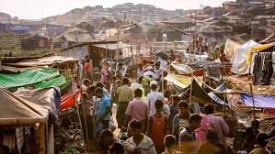
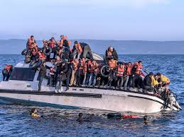
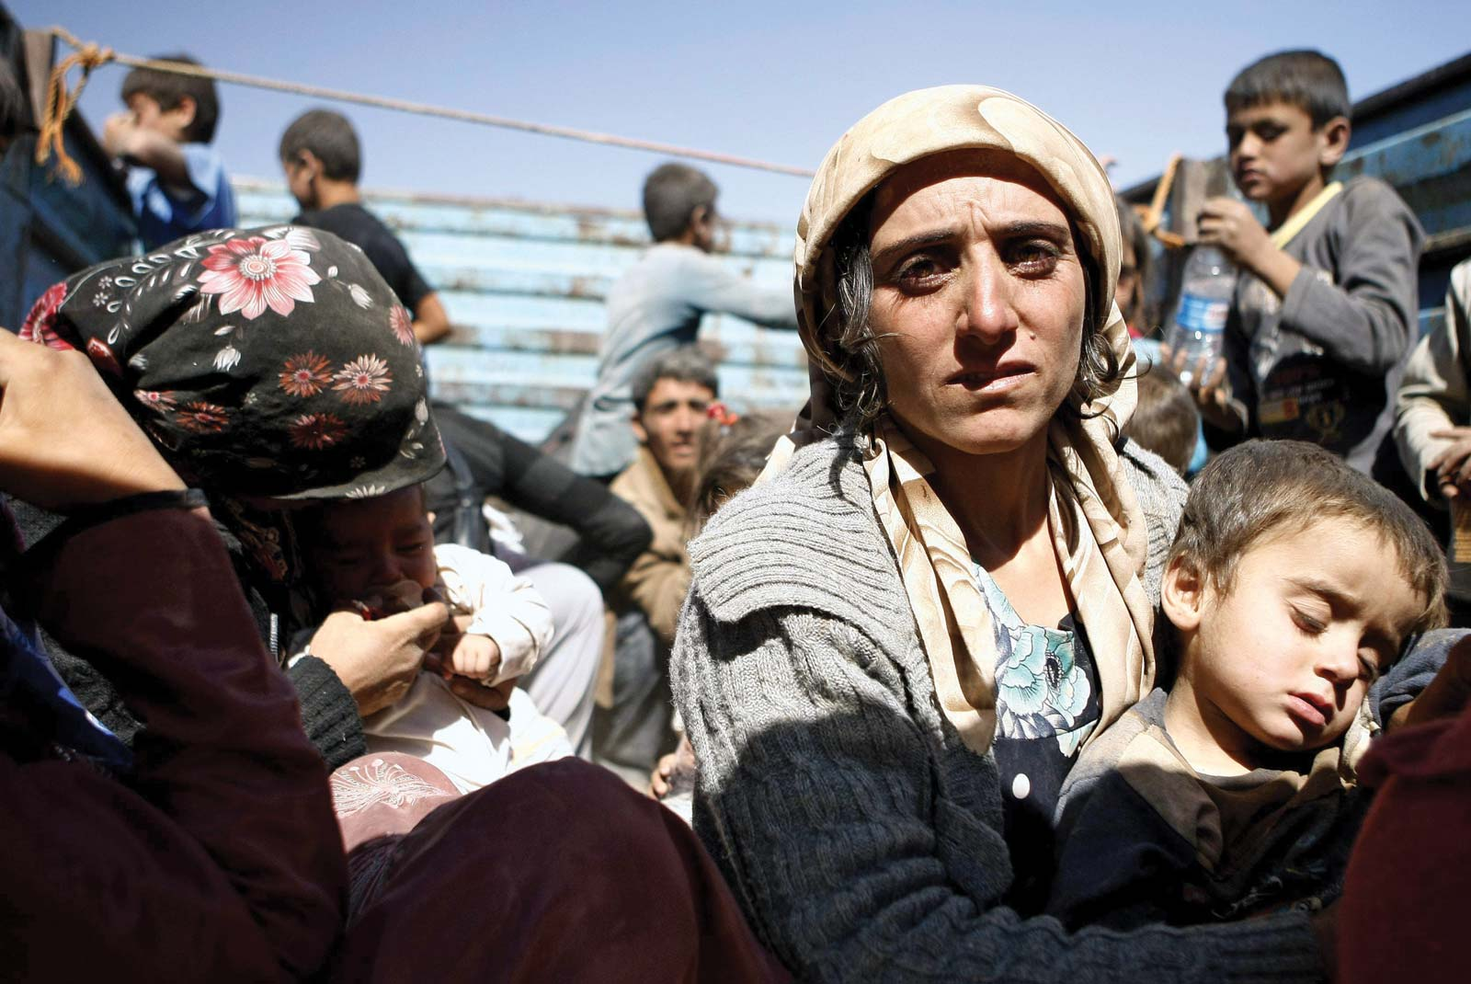
Refugees
Look at the following images and complete the task over the page.
Watch these videos to help:
https://www.youtube.com/watch?v=vsvBqtg2RM0
https://www.youtube.com/watch?v=q6msUKyiYic
https://www.savethechildren.org/us/what-we-do/emergency-response/refugee-children-crisis/refugee-stories

Slide 5
Refugees
A refugee is someone who has had to leave their country because of war.
A refugee camp is a temporary place that many refugees are forced to live in when they flee their country.
Complete the mind-map:
Emerging: Describe the images and videos
Developing: Include the different emotions
Secure: Think about how they would feel on different parts of the journey
Mastered: What do you think would be the worst part of being a refugee?
Refugees

Slide 7
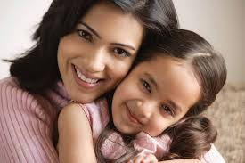
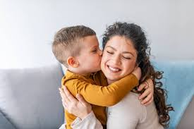
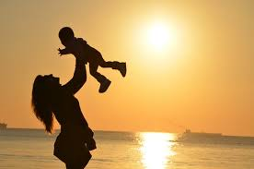
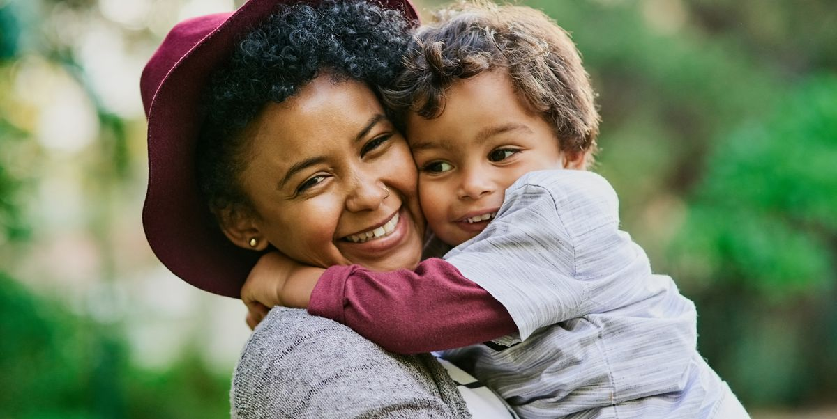
Motherhood
Connotations are what you think of when you hear a word.
Look at these images then complete the mind-map with the connotations of the word ‘mother’.
Mother

Slide 8
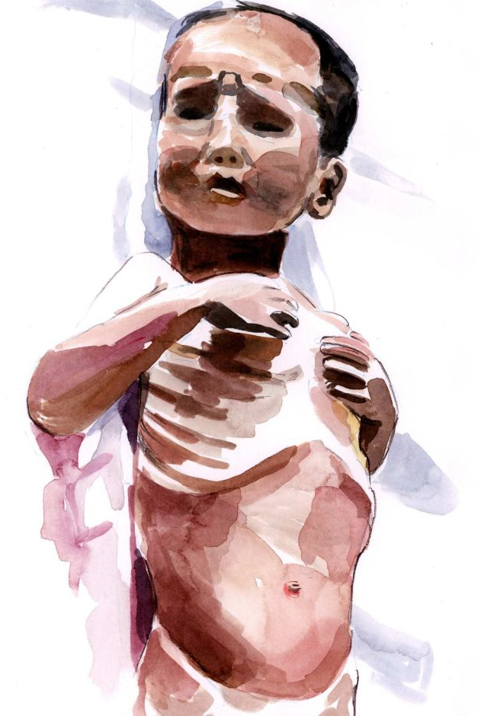

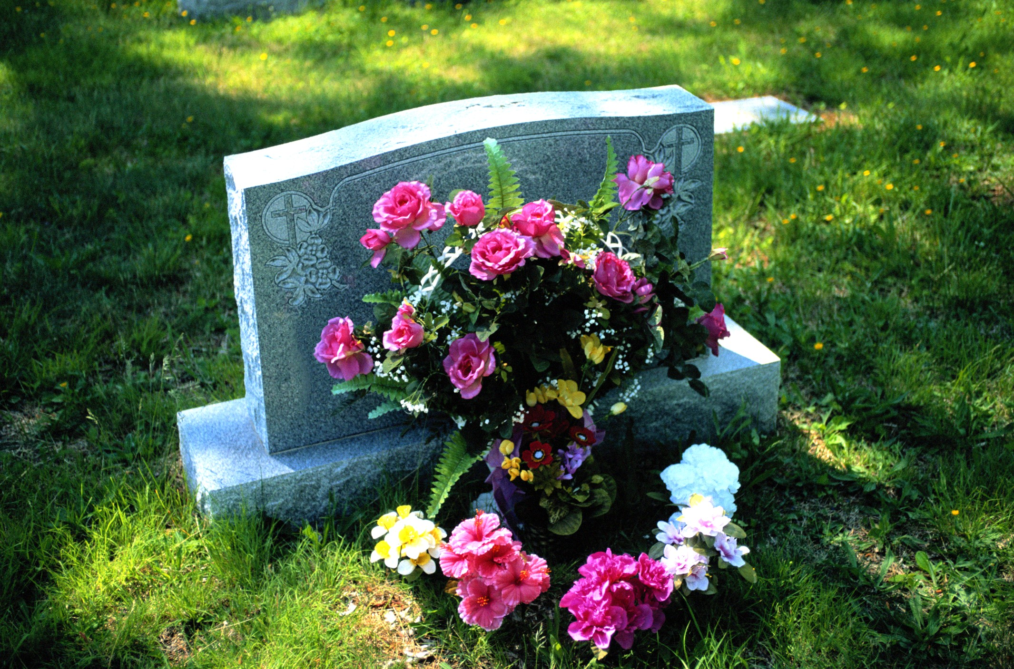
A Mother in a Refugee Camp
No Madonna and Child could touch
Her tenderness for a son
She soon would have to forget. . . .
The air was heavy with odors of diarrhea,
Of unwashed children with washed-out ribs
And dried-up bottoms waddling in labored steps
Behind blown-empty bellies. Other mothers there
Had long ceased to care, but not this one:
She held a ghost-smile between her teeth,
And in her eyes the memory
Of a mother’s pride. . . . She had bathed him
And rubbed him down with bare palms.
She took from their bundle of possessions
A broken comb and combed
The rust-colored hair left on his skull
And then—humming in her eyes—began carefully to part it.
In their former life this was perhaps
A little daily act of no consequence
Before his breakfast and school; now she did it
Like putting flowers on a tiny grave.

Slide 9
A Mother in a Refugee Camp
1. What is the Madonna and Child? Look on the internet if you don’t know.
______________________________________________________
______________________________________________________
2. What can she smell?
______________________________________________________
3. Which two clues show you that her son doesn’t have enough food?
______________________________________________________
______________________________________________________
4. What makes her different to the other mothers?
_____________________________________________________
5. What does she remember?
______________________________________________________
6. How do you know she cares for him?
_____________________________________________________
_____________________________________________________
7. What is the final line?
_____________________________________________________
8. What does this suggest is going to happen?
_____________________________________________________

Slide 11
A Mother in A Refugee Camp
Choose three emotions that you think are shown in the poem. For each one put quotes in this table.
Love
“Her tenderness for her son”
Extension: Highlight the three most powerful quotes.

Slide 12
Annotation
You are now going to create a key and annotate the poem. There is a blank copy over the page.
Highlight or underline each item in a different colour (or if you only have one pen, with a different pattern!)
Colour or Pattern | Technique
 | Simile
 | Metaphor
 | Emotive Language

Slide 13

A Mother in a Refugee Camp
How does the poet explore the conditions the mother must face when caring for her son in the refugee camp?
Part 1: Identify quotes and plan response.
You will need to look at a minimum of three quotes in three paragraphs, but you can look at more or make links.
Emerging: Complete table with quotations from the poem & name techniques the writer has used
Developing: Comment on how they show her love
Secure: Explain how they show her love, referring in detail to your quote
Mastered: Consider which words are most effective in your quote
Technique | Quote | Why it’s used
Emotive Language | “No Madonna and child could touch her tenderness for her son.” | This implies that she really loves her son because it compares her with Jesus’ mother. The Madonna is a famous symbol of perfect motherhood. She is being compared to this mother despite the conditions in the refugee camp. “Tenderness” shows how much she cares.

Slide 14
A Mother in a Refugee Camp
How does the poet explore the conditions the mother must face when caring for her son in the refugee camp?
Technique | Quote | Why it’s used

Slide 15
A Mother in a Refugee Camp
How does the poet explore the conditions the mother must face when caring for her son in the refugee camp?
Part 2: Write out your paragraphs. Use the sentence starters if they help for each paragraph.
Emerging: Include a quote, technique and comment on why they are used.
Developing: Explain using because and look at the effect on the reader
Secure: Explain the effect of a word from your quote
Mastered: Consider a second word or another interpretation
Dahl uses… to develop atmosphere in this extract. He says “...”
This suggests… because…
The reader might think… because..
The word “…” is effective because…
Another word which is effective is “…” because…
OR
Another interpretation could be…

Slide 16
A Mother in a Refugee Camp
______________________________________________________
______________________________________________________
______________________________________________________
______________________________________________________
______________________________________________________
______________________________________________________
______________________________________________________
______________________________________________________
______________________________________________________
______________________________________________________
______________________________________________________
______________________________________________________
______________________________________________________
______________________________________________________
______________________________________________________
______________________________________________________
______________________________________________________
______________________________________________________
______________________________________________________

Slide 17
A Mother in a Refugee Camp
______________________________________________________
______________________________________________________
______________________________________________________
______________________________________________________
______________________________________________________
______________________________________________________
______________________________________________________
______________________________________________________
______________________________________________________
______________________________________________________
______________________________________________________
______________________________________________________
______________________________________________________
______________________________________________________
______________________________________________________
______________________________________________________
______________________________________________________
______________________________________________________
______________________________________________________

Slide 18

Self Assessment
Well done! You completed the tasks on A Mother in a Refugee Camp
List three things you have learnt:
_________________________________________
_________________________________________
_________________________________________
What went well this week?
My best piece of work is…
_________________________
because…
_________________________
_________________________

