Slide 1
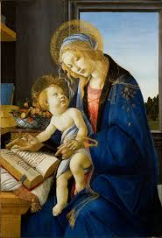
English
Home Learning Booklet
A Mother in a Refugee Camp
Name: ___________

Slide 2
Key Words
Match up your definitions with the key words.
Use Google or a dictionary to check your answers
Key Words
Emotive Language
Refugee
Simile
Verbs
Definitions
Someone who is forced to leave their country due to war.
When you compare two things using like or as.
Words which appeal to the emotions.
A word for an action.

Slide 3
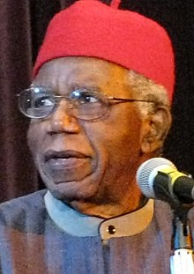
Background
Chinua Achebe
Chinua Achebe was a Nigerian novelist. He was born in 1930 and died in 2013 when he was 82 years old.
His first novel, Things Fall Apart, is the most widely read book in modern African literature. He was greatly interested in African politics.
Achebe wrote this poem to make us aware of the life refugees had to live.
Fill in the gaps
Chinua _________________ was born in __________________. He died when he was ___________________ years old. His most famous novel is called Things _____________ Apart. He was interested in _____________ politics. He wrote the poem Mother in a Refugee Camp to make readers think about the ___________ of refugees.
Achebe African life
Fall Nigeria 82

Slide 4
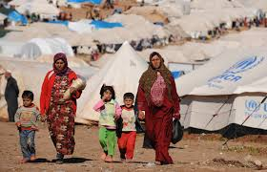
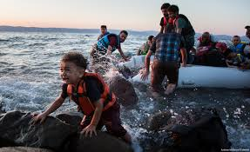
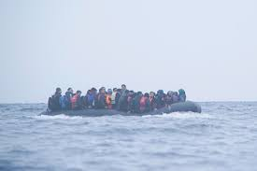
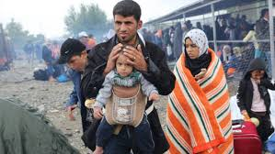
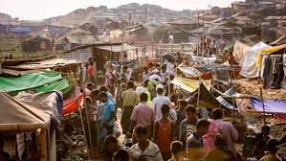
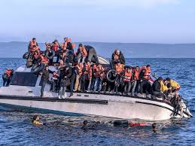
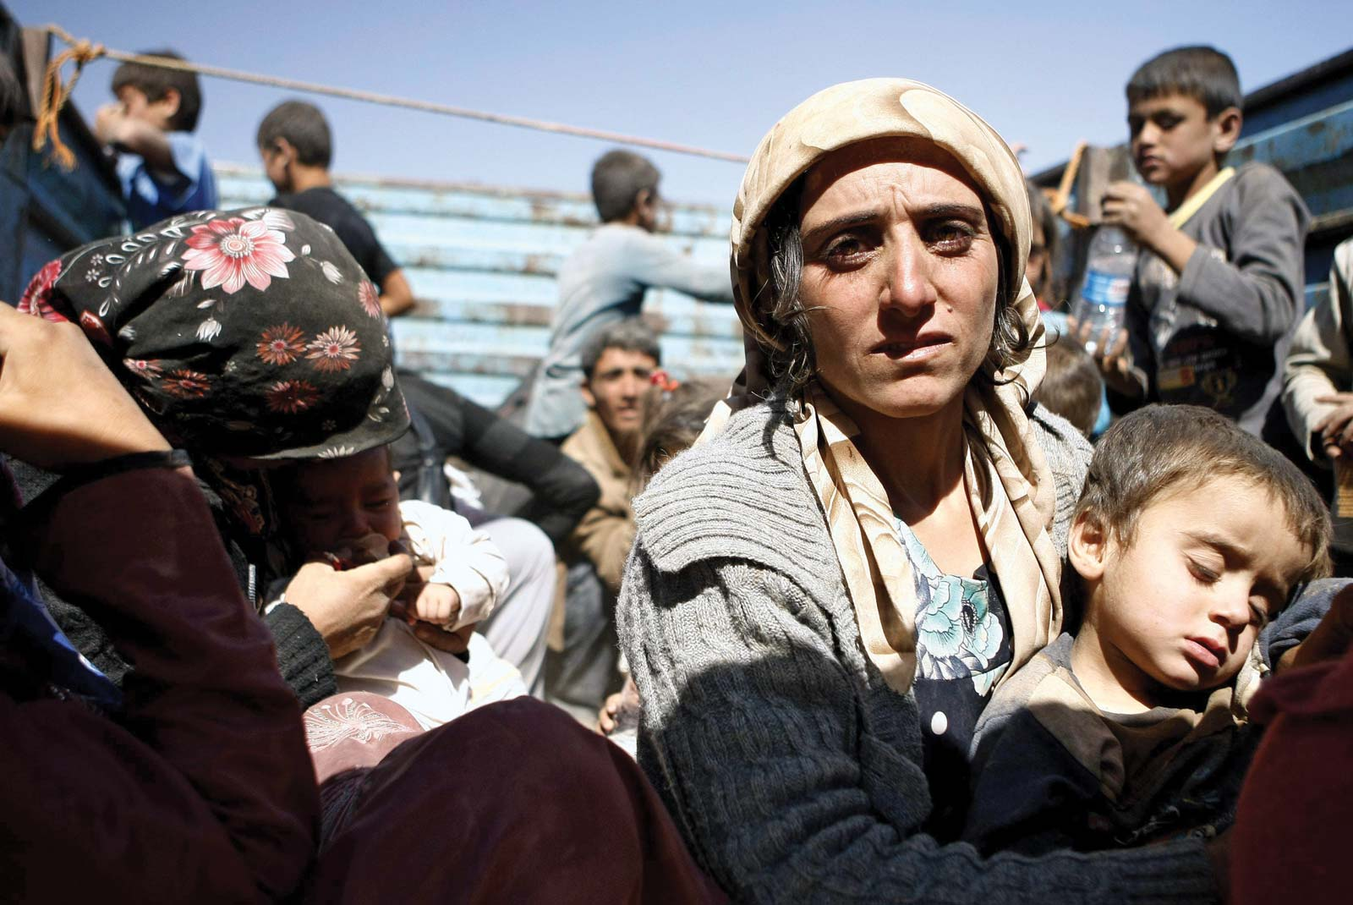
Refugees
Look at the following images and complete the task over the page.
Watch these videos to help:
https://www.youtube.com/watch?v=vsvBqtg2RM0
https://www.youtube.com/watch?v=q6msUKyiYic
https://www.savethechildren.org/us/what-we-do/emergency-response/refugee-children-crisis/refugee-stories

Slide 5
Refugees
A refugee is someone who has had to leave their country because of war.
A refugee camp is a temporary place that many refugees are forced to live in when they flee their country.
Complete the mind-map:
Emerging: What can you see
Developing: Can you describe the images or videos
Secure: How do you think the people would feel?
Mastered: What different parts of their journey are there?
Refugees

Slide 7
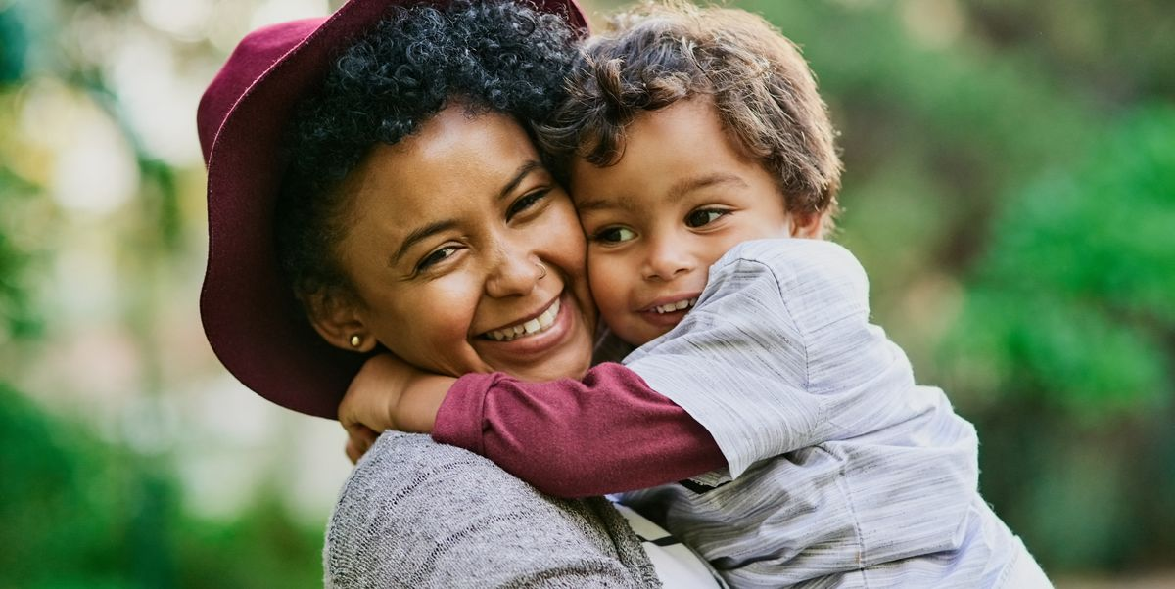
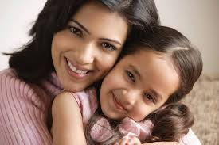
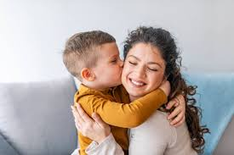
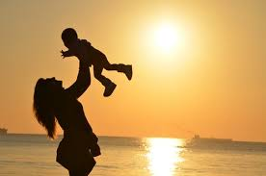
What does the word mother make you think of?
Mother

Slide 8
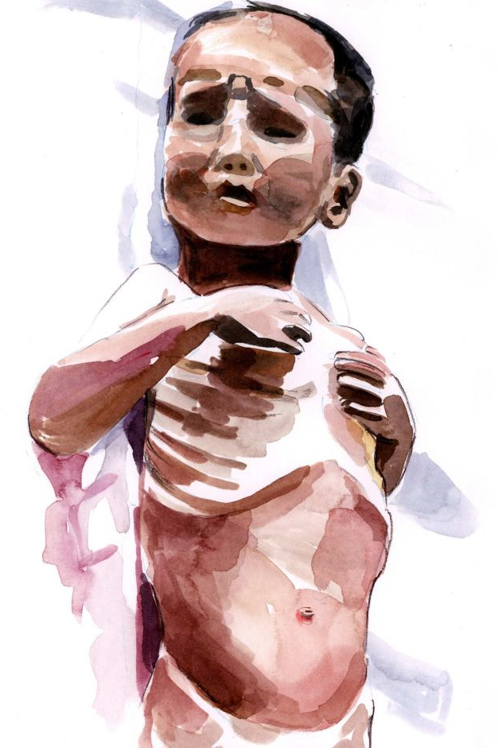

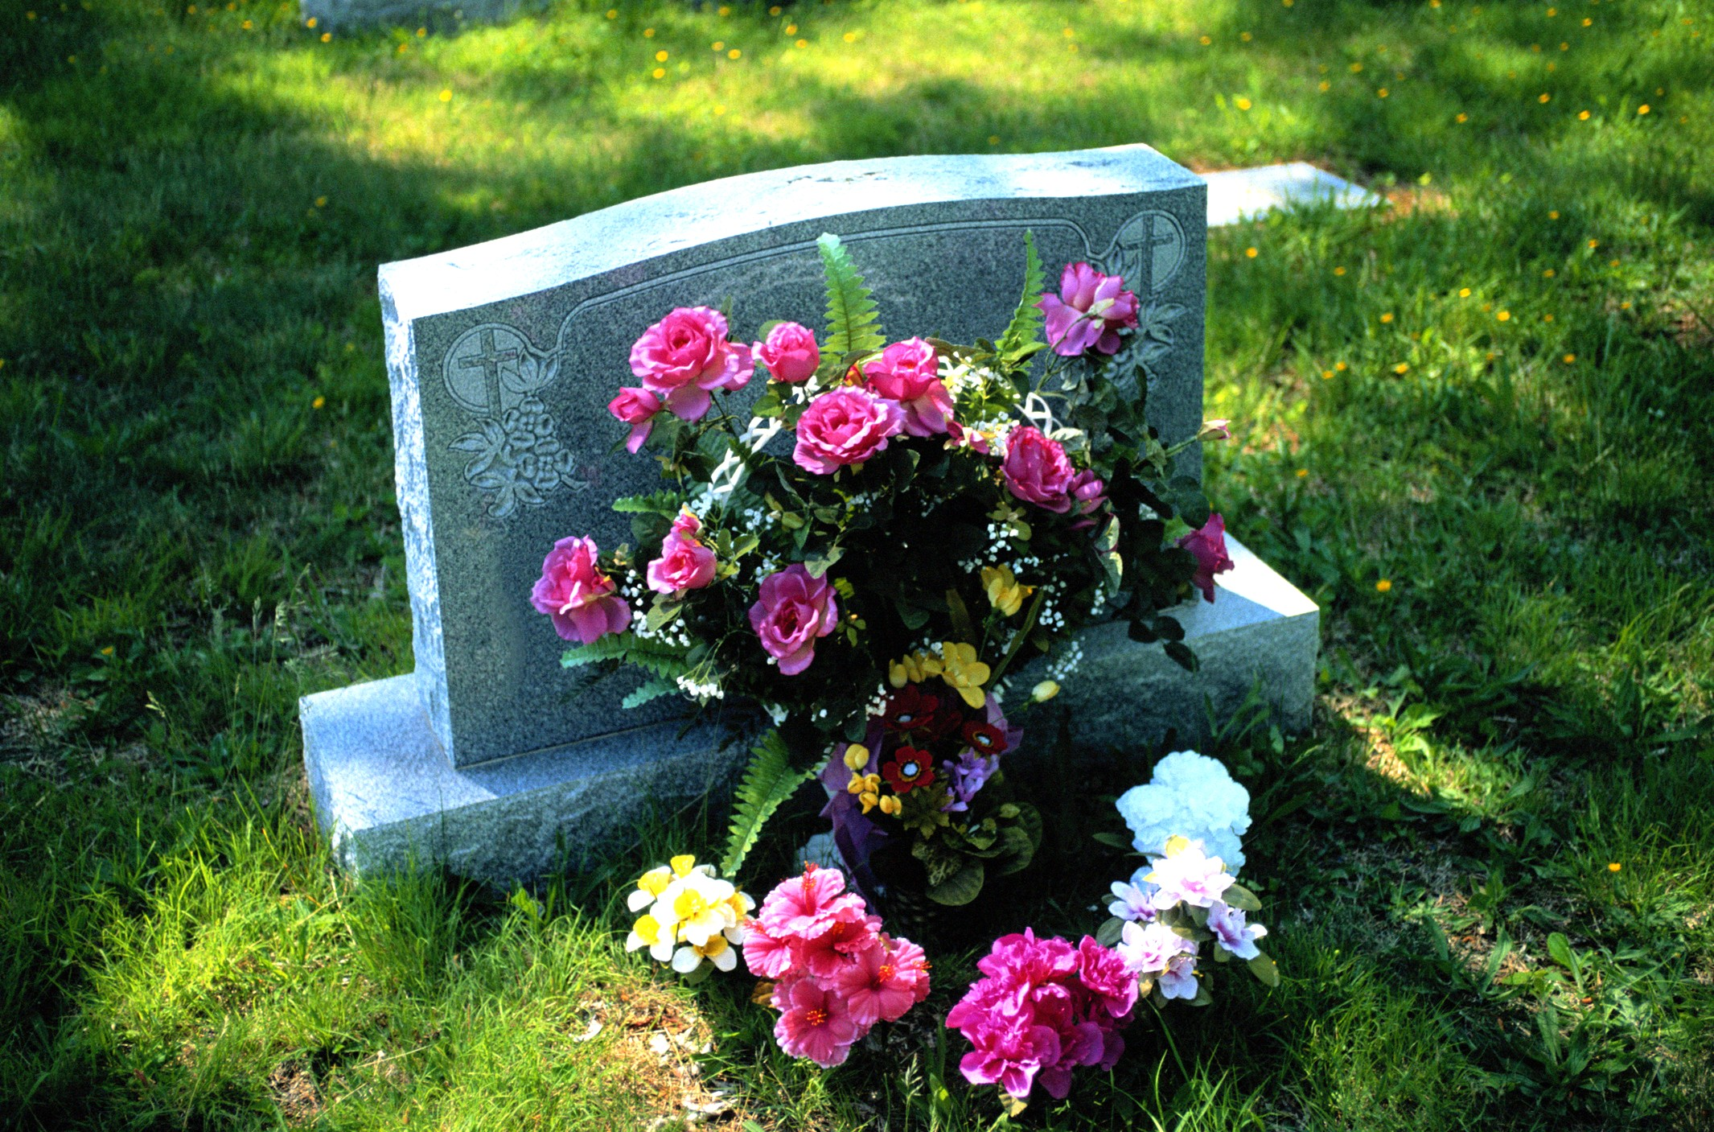
A Mother in a Refugee Camp
No Madonna and Child could touch
Her tenderness for a son
She soon would have to forget. . . .
The air was heavy with odors of diarrhea,
Of unwashed children with washed-out ribs
And dried-up bottoms waddling in labored steps
Behind blown-empty bellies. Other mothers there
Had long ceased to care, but not this one:
She held a ghost-smile between her teeth,
And in her eyes the memory
Of a mother’s pride. . . . She had bathed him
And rubbed him down with bare palms.
She took from their bundle of possessions
A broken comb and combed
The rust-colored hair left on his skull
And then—humming in her eyes—began carefully to part it.
In their former life this was perhaps
A little daily act of no consequence
Before his breakfast and school; now she did it
Like putting flowers on a tiny grave.

Slide 9
A Mother in a Refugee Camp
Complete the Cloze Summary on the poem.
A Mother in a ____________ Camp is about someone caring or her __________. All around there are ___________ children. They are skinny and you can see their ______________. Their bellies are also _______________.The other mothers no longer ____________ but she still does. She remembers better ___________. She combs his hair with a ________________ comb. She used to do this every day before ________________ now she compares it to putting ______________ on a grave.
Refugee school ribs swollen
son sick broken
flowers times care

Slide 11
Annotation
You are now going to create a key and annotate the poem.
Highlight or underline each item in a different colour (or if you only have one pen, with a different pattern!)
Colour or Pattern | Technique
 | Mother’s actions (verbs)
 | Emotive Language
 | A Simile

Slide 12
A Mother in A Refugee Camp
Find quotes which show each emotion.
Love | Fear | Sadness
“Her tenderness for her son”
Extension: Highlight the quote you think is the most effective.

Slide 13
Imagery
Choose images from the poem and draw a picture for each one.
Label with a quotation. An example has been completed
“No Madonna or child could touch”

Slide 14
A Mother in A Refugee Camp

Slide 15
A Mother in A Refugee Camp

Slide 16

Self Assessment
Well done! You completed the tasks on A Mother in a Refugee Camp
List three things you have learnt:
_________________________________________
_________________________________________
_________________________________________
What went well this week?
My best piece of work is…
_________________________
because…
_________________________
_________________________

