Slide 1
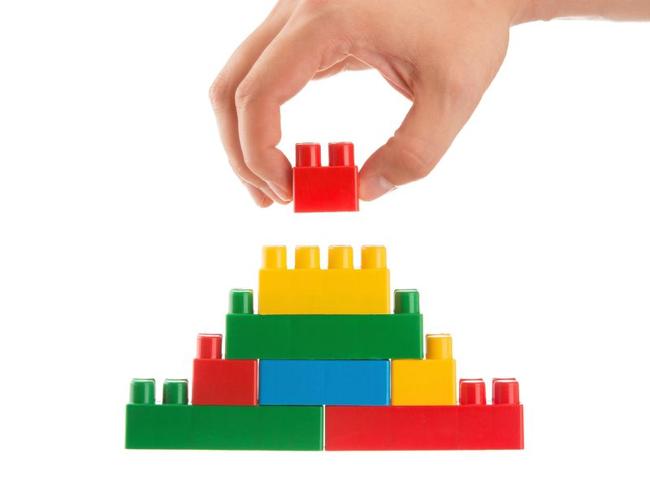
English
Home Learning Booklet
Writer’s Use of Structure Part 2
AO2: Explain how writer’s use structure, using relevant subject terminology.
Name: ___________

Slide 2
Key Words Recap
Can you remember these key terms? Match them up with the right answer.
Foreshadowing
Dialogue
Opening Paragraph
Closing Paragraph
One Sentence Paragraph
Climax
Atmosphere
Setting
Shift
Perspective
A paragraph of only one sentence at a dramatic point.
The first paragraph.
The person who the text focuses on.
The mood or tone of the extract.
Hints at events to come.
The most intense point of the extract.
A change in focus.
Characters speaking to each other.
The time or place where the text is happening
The last paragraph.

Slide 3
Source A
Alex Cold lives with his parents and two younger sisters, Andrea and Nicole, in a small American town, but when his mother becomes ill, family life changes beyond recognition.
Alexander Cold awakened at dawn, startled by a nightmare. He had been dreaming that an enormous black bird had crashed against the window with a clatter of shattered glass, flown into the house, and carried off his mother. In the dream, he had watched helplessly as it clasped her clothing in its yellow claws, flew out the same broken window, and disappeared into a sky heavy with dark clouds.
What had awakened him was the noise from the storm: wind lashing the trees, rain on the rooftop, and thunder. He turned on the light with a sensation of being adrift in a boat, and pushed closer to the bulk of the large dog sleeping beside him. He pictured the roaring Pacific Ocean a few blocks from his house, spilling in furious waves against the rocks. He lay listening to the storm and thinking about the black bird and about his mother, waiting for the pounding in his chest to die down. He was still tangled in the images of his bad dream.
Alexander looked at the clock: 6.30, time to get up. Outside, it was beginning to get light. He decided that this was going to be a terrible day, one of those days when it’s best to stay in bed because everything is going to turn out bad. There had been a lot of days like that since his mother got sick; sometimes the air in the house felt heavy, like being at the bottom of the sea.
At breakfast Alex was not in the mood to applaud his father’s efforts at making pancakes. His father was not exactly a good cook; the only thing he knew how to do was pancakes, and they always turned out like rubber-tyre tortillas. His children didn’t want to hurt his feelings, so they pretended to eat them, but any time he wasn’t looking, they spit them out.
‘When’s Momma going to get better?’ Nicole asked, trying to spear a rubbery pancake with her fork.
‘Shut up, Nicole,’ Alex replied.
‘Momma’s going to die,’ Andrea added.
‘Liar! She’s not going to die!’ shrieked Nicole.
‘You two are just kids. You don’t know what you’re talking about!’ Alex exclaimed.

Slide 4
Source A
Here, girls. Quiet now. Momma is going to get better,’ his father interrupted, without much conviction.
Alex was angry with his father, his sisters, life in general – even with his mother for getting sick. He rushed out of the kitchen, ready to leave without breakfast.
Except for his father’s pancakes and an occasional tuna-and-mayonnaise sandwich, no one in the family had cooked for months. There was nothing in the refrigerator but orange juice, milk and ice cream; at night they ordered in pizza or Chinese food. At first it was almost like a party, because each of them ate whenever and whatever they pleased, mainly sweets, but by now everyone missed the balanced diet of normal times.
Alex had realised during those months how enormous their mother’s presence had been and how painful her absence was now. He missed her easy laughter and her affection, even her discipline. She was stricter than his father, and sharper. It was impossible to fool her; she could see the unseeable. He missed her music, her flowers, the once-familiar fragrance of fresh-baked cookies, and the smell of paint. It used to be that his mother could work several hours in her studio, keep the house immaculate, and still welcome her children after school with cookies. Now she barely got out of bed to walk through the rooms with a confused air, as if she didn’t recognise anything; she was too thin, and her sunken eyes were circled with shadows. Her canvases, which once were explosions of colour, sat forgotten on their easels, and her oil paints dried in their tubes. His mother seemed to have shrunk; she was little more than a silent ghost.
After reading the text, answer the questions over the page.

Slide 5
Source A
City of Beasts
1. Who does the text focus on at the beginning?
____________________________________________________________________
2. What is happening to him in the first paragraph?
____________________________________________________________________
3. What is the weather like?
____________________________________________________________________
4. What is the atmosphere like in these two paragraphs?
____________________________________________________________________
5. What does the writer suggest the day is going to be like?
____________________________________________________________________
6. What are the characters talking about?
____________________________________________________________________
7. What does the paragraph from line 30 focus on?
____________________________________________________________________
8. Why do they focus on this?
____________________________________________________________________
____________________________________________________________________
9. List three things Alex says he misses about his mum.
____________________________________________________________________
____________________________________________________________________
10. How does the extract end?
____________________________________________________________________

Slide 7
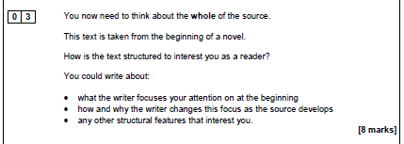
City of Beasts
The third bullet point can be any features from your list the writer has used
Key Words:
Opening
Closing
Foreshadowing
Atmosphere
Setting
Perspective
Dialogue
Climax
Paragraph
Shift
Change
Perspective
Grief
Frightened
Lost
Scared
Complete the planning table on the next page.
Emerging: Complete plan for question by finding quotes for each bullet point.
Developing: Comment on why used.
Secure: Use subject words from your list of structural features.
Mastered: Explain using because.

Slide 8
Planning
Features and Techniques | Quote | Why is it used?
Opening Paragraph
Change of Focus

Slide 9
Word Search

Slide 10
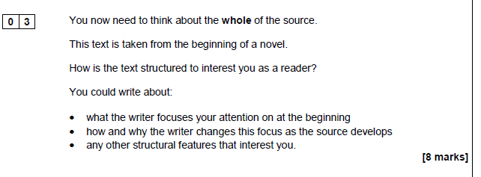
Effective Openings
WAGOLL: What a good one looks like
Read the example answer (on a different text) over the page.
Highlight the following in different colours
Colour | What is included
 | Quotes
 | Subject Words (structural features)
 | Comment on why used
 | Explain why used

Slide 11
Effective Openings
WAGOLL: What a good one looks like
In Source A, the writer focuses your attention at the beginning on a small boy. He describes how the boy is alone playing in “a heap of broken glass.” This immediately interests the reader because it foreshadows that something bad will happen to the boy. It makes the reader wonder why a young boy would be on their own outside, especially If there is “broken glass” which could hurt him.
As the writer continues, he changes the focus to a tall thin man. The man “looks at the boy, directly in the eyes.” This shift in the story contributes to the sense that the boy is in danger, because he is by himself and now there is a man looking at him in a threatening way.
An interesting structural feature the writer uses is dialogue. The man questions the boy, but the boy does not seem to think he is dangerous. He says “I am just playing,” said the boy, without looking up.” This interests the reader because you want the boy to stop talking to the man as he clearly seems dangerous, but the boy has not spotted the danger.

Slide 12
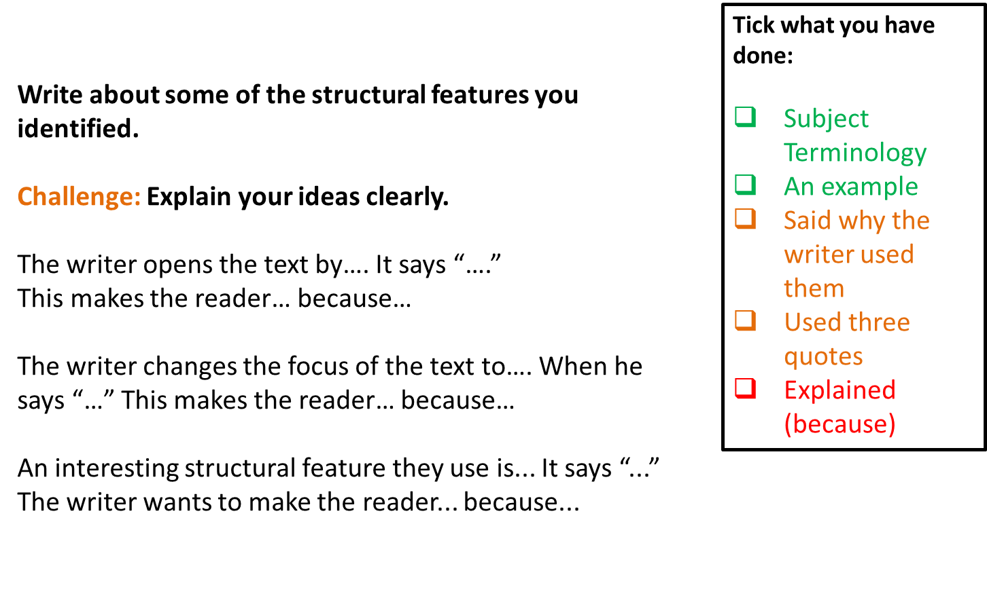
Effective Openings

Slide 13
Structure Question
______________________________________________________
______________________________________________________
______________________________________________________
______________________________________________________
______________________________________________________
______________________________________________________
______________________________________________________
______________________________________________________
______________________________________________________
______________________________________________________
______________________________________________________
______________________________________________________
______________________________________________________
______________________________________________________
______________________________________________________
______________________________________________________
______________________________________________________
______________________________________________________
______________________________________________________

Slide 14
Structure Question
______________________________________________________
______________________________________________________
______________________________________________________
______________________________________________________
______________________________________________________
______________________________________________________
______________________________________________________
______________________________________________________
______________________________________________________
______________________________________________________
______________________________________________________
______________________________________________________
______________________________________________________
______________________________________________________
______________________________________________________
______________________________________________________
______________________________________________________
______________________________________________________
______________________________________________________

Slide 15

Self Assessment
Well done! You completed the tasks on structure.
List three things you have learnt:
_________________________________________
_________________________________________
_________________________________________
How did you do at your exam question?
What went well?
_________________________
_________________________
How could you improve?
_________________________
_________________________

