Slide 1

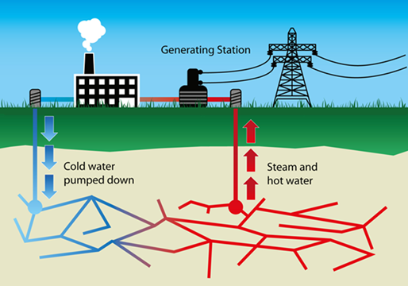
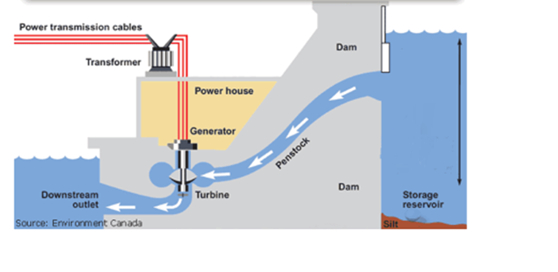
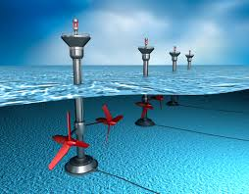
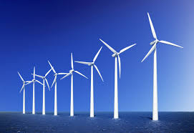
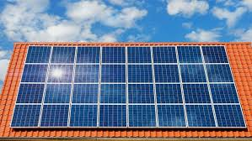
Science: Nuclear power and biomass
If want to do some work online please visit SENECA learning and sign up using the class code: 4ggjlziov
Use: https://www.bbc.co.uk/bitesize/guides/zggk87h/revision/2 to help if you get stuck or contact me!
Recap
What are the energy transfers in tidal power?
What is geothermal power?
Name the 3 fossil fuels.
Name the energy resource
_ _ _ _ _ _ _ _ _ _ _ _ _
_ _ _ _ _ _ _ _ _ _
_ _ _ _ _
_ _ _ _ _
_ _ _ _

Slide 2
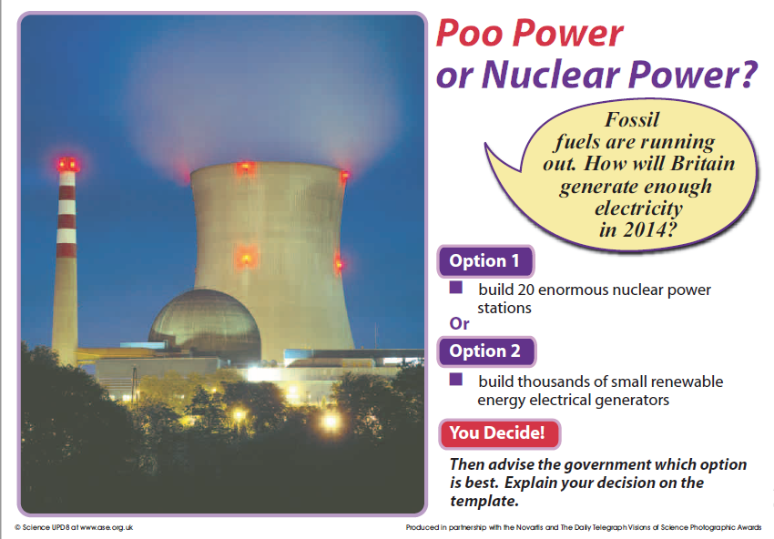
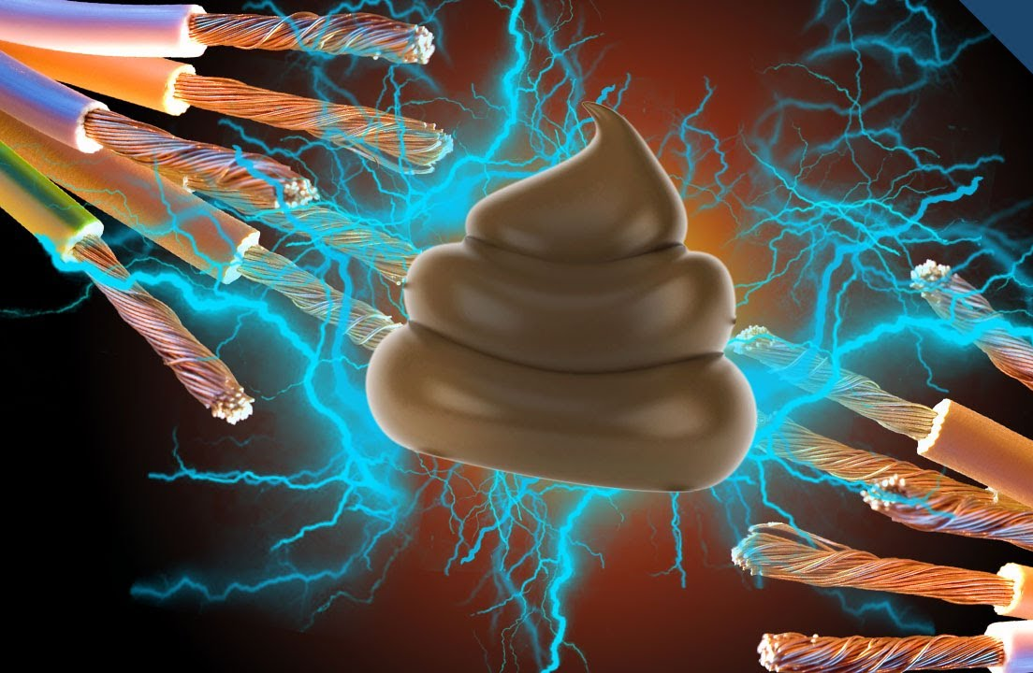
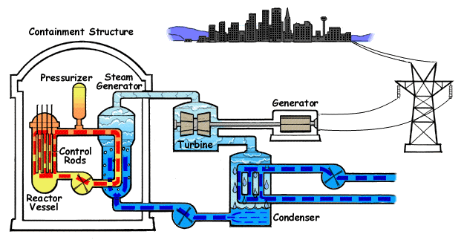
In a nuclear power station, a nuclear reaction releases heat – nuclear energy is converted to heat energy. This heats up water to produce steam which turns a turbine (just like a coal power station)
Poo power uses the chemical energy stored in poo. The poo starts to break down, and as this happens it can generate an electricity

Slide 3
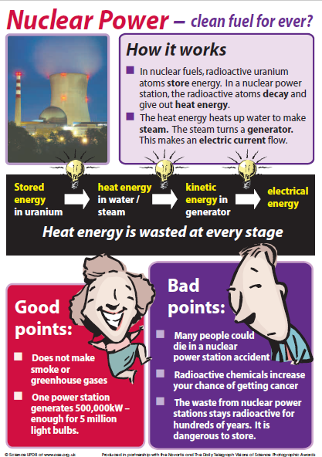

Slide 4
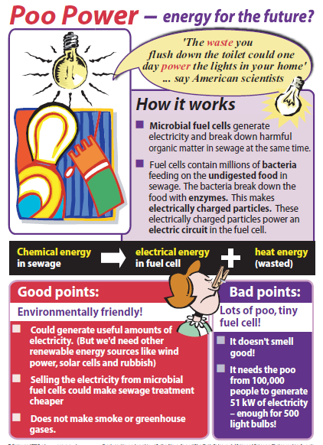

Slide 5
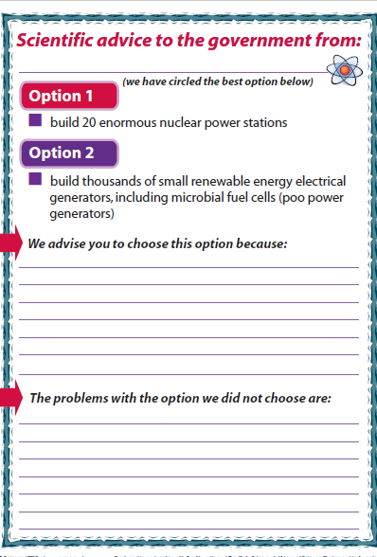
Circle the option you would choose

Slide 6
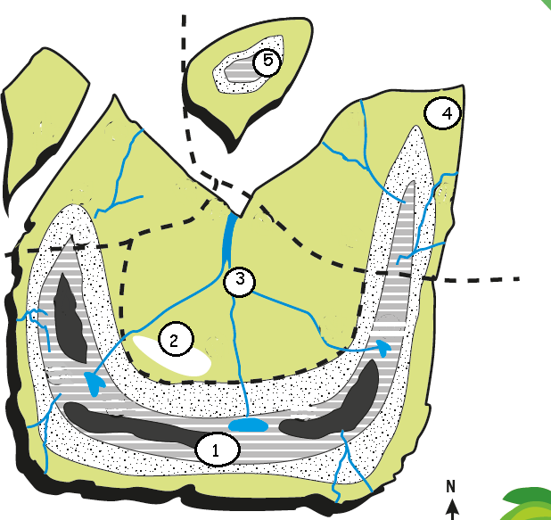

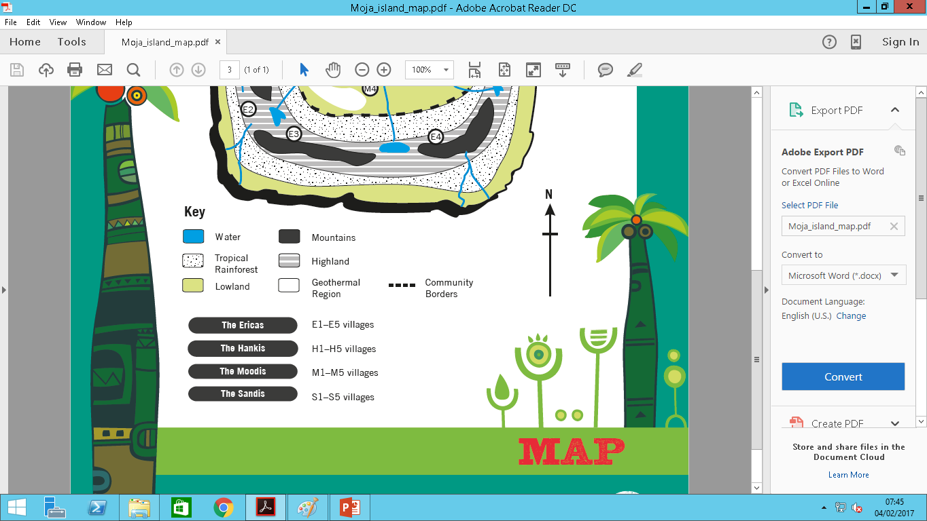
Village 1 = 20 people
Village 2 = 45 people
Village 3 = 40 people
Village 4 = 30 people
Village 5 = 25 people

Slide 7
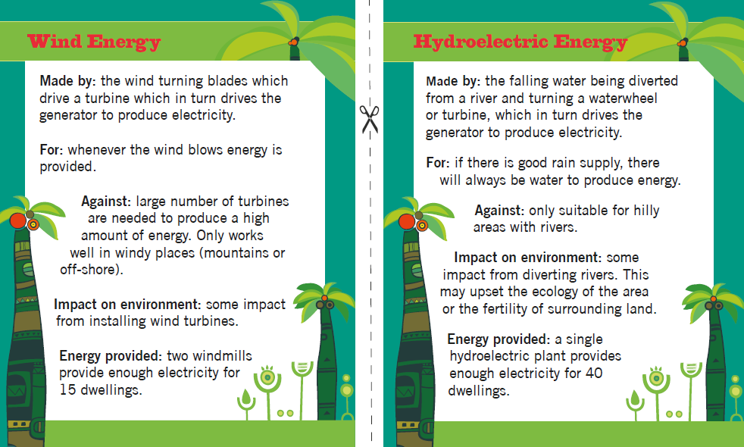

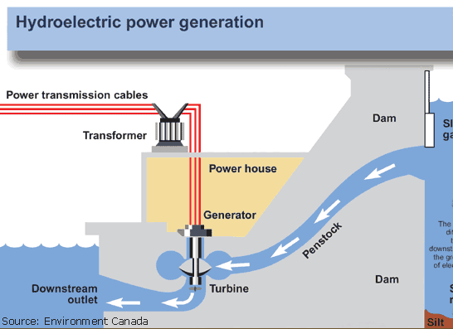
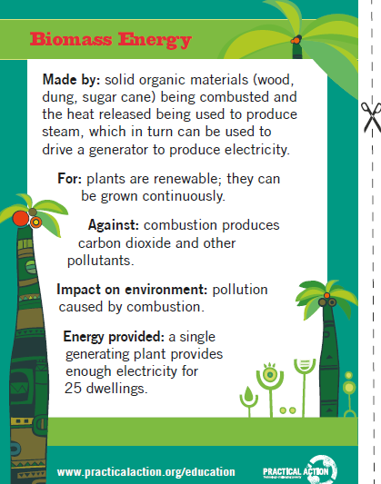
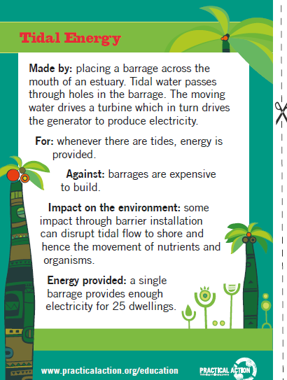
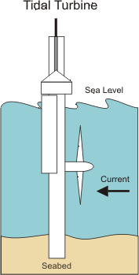
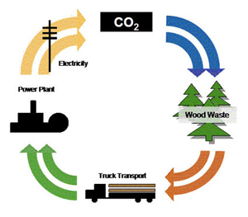
Renewable energy sources
Whenever wind blows electricity is provided
As long as there is enough water you can always make electricity
1 wind turbine provides power for 15 people
1 provides power for 40 people
If there are trees you can cut them down and burn them
As the tide goes in and out it makes electricity
1 provides power for 25 people
1 provides power for 25 people

Slide 8
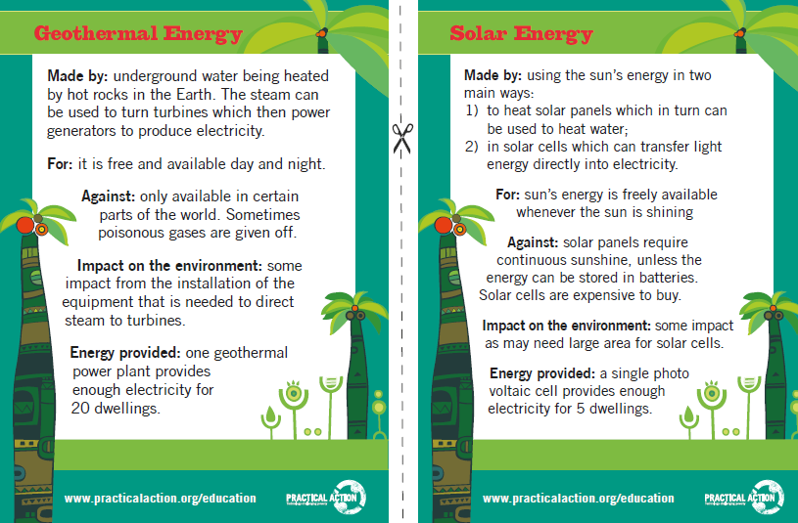
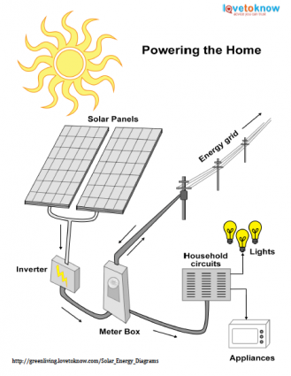

Uses heat from underground to heat up water and make electricity
Energy from the sun is converted into electricity
1 provides power for 20 people
1 provides power for 5 people
For each of the areas marked on the map decide which type of energy resource could be used.
For example area 1 is high up so would be windy so wind power could be used, it provides enough electricity for 15 homes so 2 wind turbines would be needed. But it is not near the sea so tidal power could not be used.
You must use a different energy source for each area
Area | Renewable energy choice | Reasons for choice
1
2
3
4
5

Slide 9
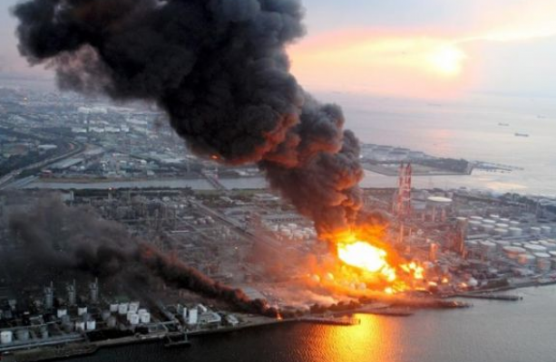
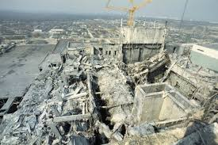
Chernobyl nuclear power station disaster
The Chernobyl disaster was a nuclear disaster which occurred on April 26, 1986 at the Chernobyl nuclear power plant in Pripyat, Ukraine. At that time, Ukraine was part of the Soviet Union.
This event was one of the worst accidents in the history of nuclear power. It was rated at level 7, the most severe level, on the International Nuclear Event Scale.
About 60% of the radioactive went into Belarus. About 360,000 people needed to be moved to other places, because the radiation was so high in their area. In addition, many people suffered from long term illnesses and some people were even diagnosed with thyroid cancer and acute radiation poisoning.
Before the accident, there was a safety test planned but this went wrong leading to the core reactor exploding. The explosion was so powerful that it blew the 1000 ton steel lid off the reactor. Due to this explosion, large amounts of radioactive materials and fuel were released.
It is difficult to accurately tell the number of deaths caused by the events at Chernobyl. The Chernobyl accident happened when some workers were testing the safety of the reactor. Some of the devices that stopped the reactor from exploding were switched off. Then, there was a power surge; the reactor fell out of control and exploded.
According to the official, internationally recognised death toll, just 31 people died as an immediate result of Chernobyl while the UN estimates that only 50 deaths can be directly attributed to the disaster. In 2005, it predicted a further 4,000 might eventually die as a result of the radiation exposure.
https://www.bbc.com/future/article/20190725-will-we-ever-know-chernobyls-true-death-toll
https://kids.kiddle.co/Chernobyl_disaster

Slide 10

Nuclear power station disaster-Chernobyl
Research what happened to Chernobyl power station and create a news article to explain what happened. Use the template below or design your own on the next page

Slide 12
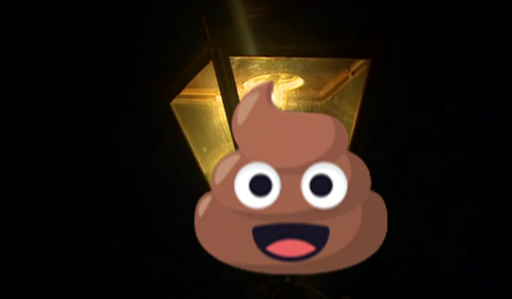
Watch the video
https://www.bbc.co.uk/newsround/42542894
Could poo-power light your street?
It sounds like a pretty smelly source of light!
But one man in Worcestershire has invented a special gas-lit street lamp that uses dog poo as fuel.
Brian Harper made a special machine where people simply put their dog waste in to power the lamp!
So how does it work?
Once put into the lamp, the dog waste is broken down by microbes, producing methane which fuels the light. Brian says that ten small bags of poo could keep the light going for two hours each evening.
It's the first dog-poo powered street lamp in the UK, and it also produces fertiliser!
In many countries around the world, including Mongolia and Pakistan, animal dung is sometimes burned on fires to produce heat.
It's an idea that's also become more accepted in the UK too.
In 2014 Birmingham became the first place in the UK to use poo to heat homes, in 2015 a special machine that turned poo into water and electricity was invented, and in India, poo has been used as charcoal, to heat homes.
Who invented a special gas-lit street lamp?
How does the poo powered street lamp work?
Which other countries use animal poo (dung)
Where is poo being used to heat homes in the UK?

Slide 13
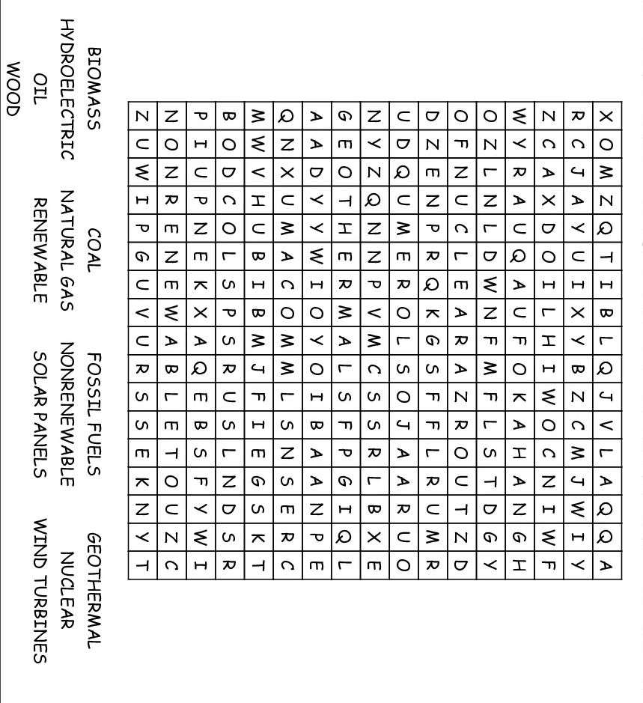
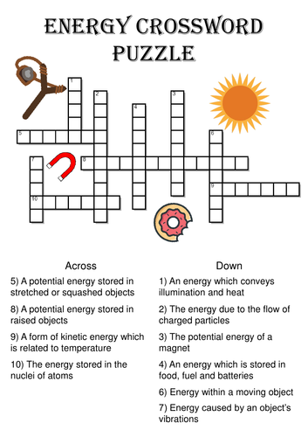
Renewable and non renewable energy

