Slide 1

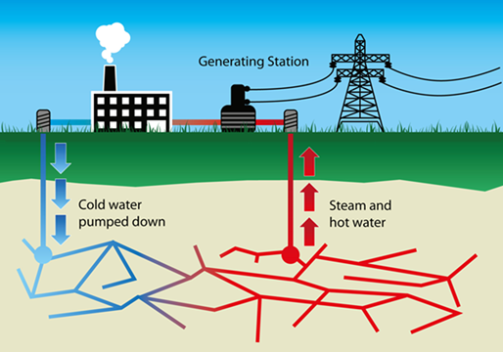
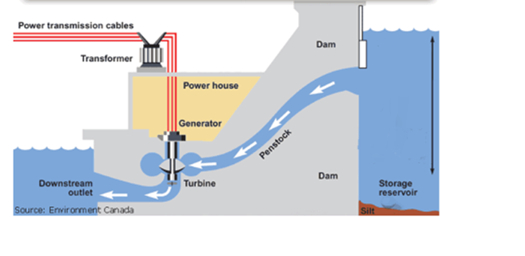
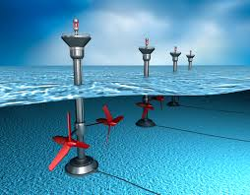
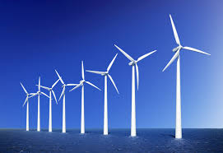
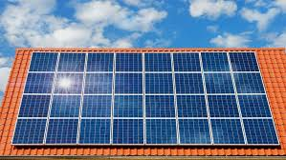
Science: Nuclear power and biomass
If want to do some work online please visit SENECA learning and sign up using the class code: 4ggjlziov
Use: https://www.bbc.co.uk/bitesize/guides/zggk87h/revision/2 to help if you get stuck or contact me!
Recap
What are the energy transfers in tidal power?
What is geothermal power?
Name the 3 fossil fuels.
Name the energy resource
_ _ _ _ _ _ _ _ _ _ _ _ _
_ _ _ _ _ _ _ _ _ _
_ _ _ _ _
_ _ _ _ _
_ _ _ _
Solar wind tidal geothermal hydroelectric

Slide 2
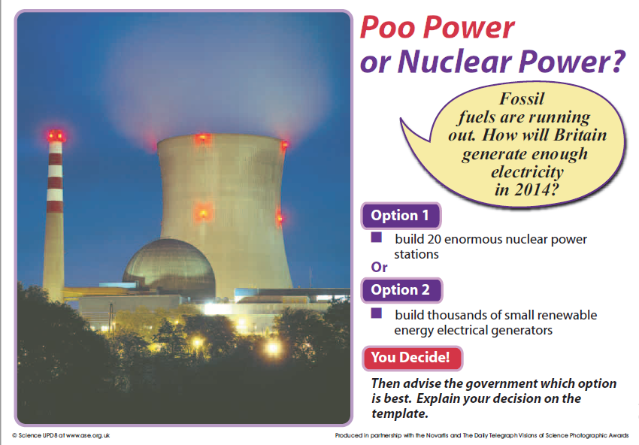
Look at the information on the next 2 pages to help you to decide!

Slide 3
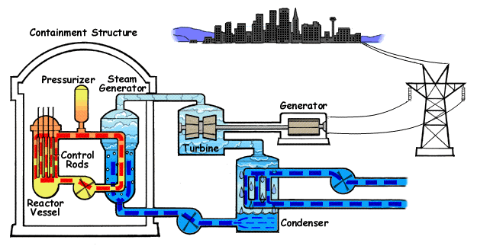
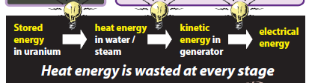
Nuclear power
The steam makes the turbine spin which makes the generator spin which makes electricity
This heats up water turning it into steam
A nuclear reaction gives off heat
Good points | Bad points
Does not give off smoke Does not give off carbon dioxide so won’t make global warming worse 1 power station generate enough energy for 5 million light bulbs | People could be hurt in there is a nuclear power station accident Radioactive chemicals in the power station increase your risk of getting cancer Waste from nuclear power stations stays radioactive for hundreds of years

Slide 4
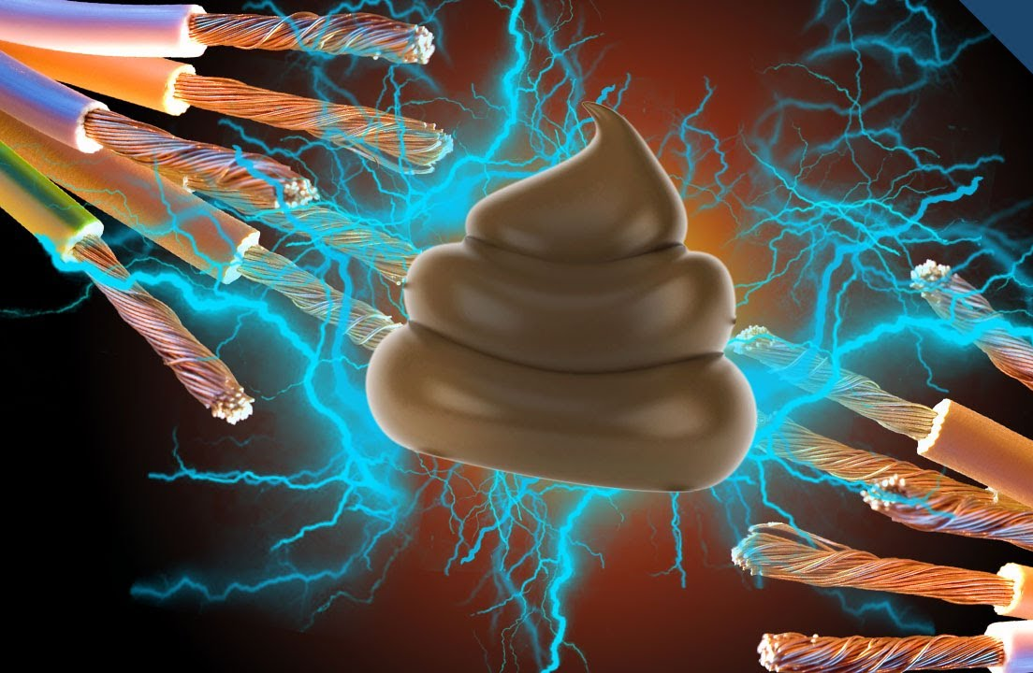
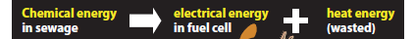
Poo power
Poo power uses the chemical energy stored in poo. The poo starts to break down, and as this happens it can generate an electricity
Good points | Bad points
Environmentally friendly Can generate some electricity (but not enough for the whole country) would need other renewable energy resources such as wind power By selling the electricity from poo power it could make water treatment cheaper Does not make smoke Does not give off carbon dioxide so won’t make global warming worse | It doesn’t smell good It needs 100 000 people’s poos to give enough electricity for 500 light bulbs

Slide 5
Scientific advice to the government
I would choose:
  Building 20 enormous nuclear power stations
  Build thousands of small renewable energy generators including poo power
Tick one
Nuclear power stations are good because………….
……………………………………………………………………………………………..
Nuclear power stations are not good because……………………….
……………………………………………………………………………………………..
Poo power is good because …………………………………………………
...................................................................................................
Poo power is not good because …………………………………………..
...................................................................................................
Overall I chose (circle) nuclear power/poo power because………………………………………………………………………………….
..................................................................................................
..................................................................................................
Cheaper dangerous expensive smell radioactive electricity
5 million light bulbs 500 light bulbs renewable

Slide 6


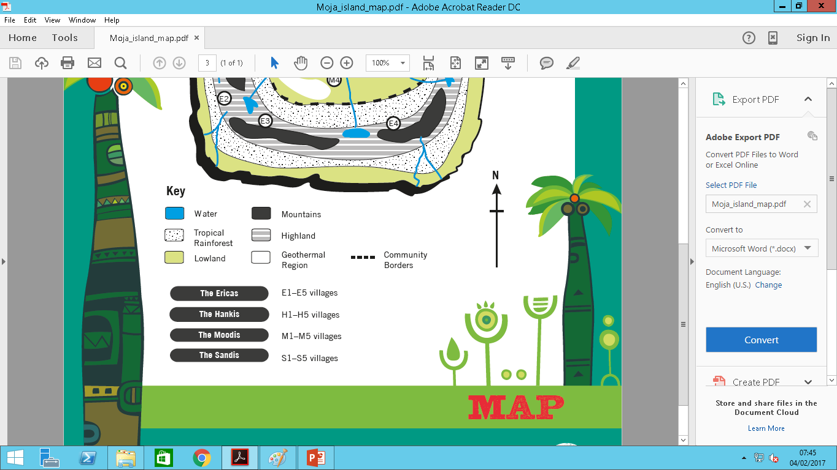
Village 1 = 20 people
Village 2 = 45 people
Village 3 = 40 people
Village 4 = 30 people
Village 5 = 25 people

Slide 7
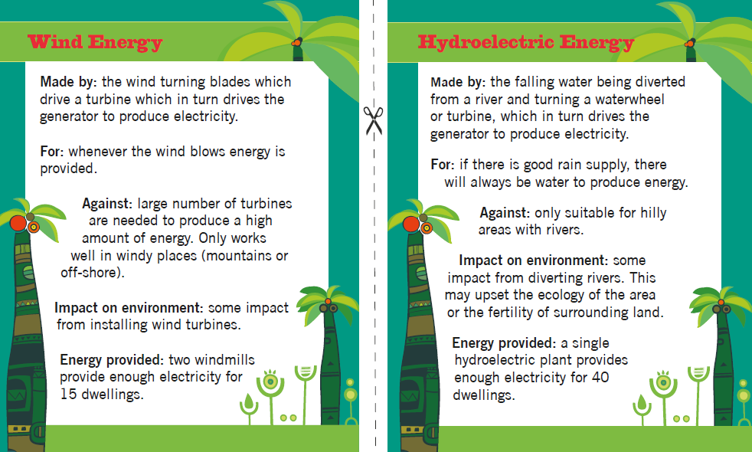

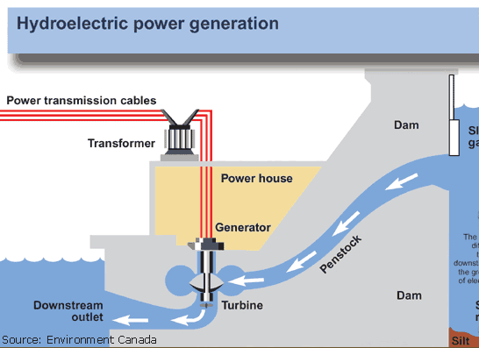
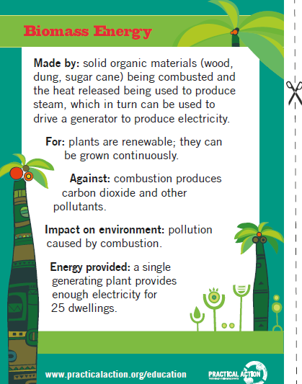
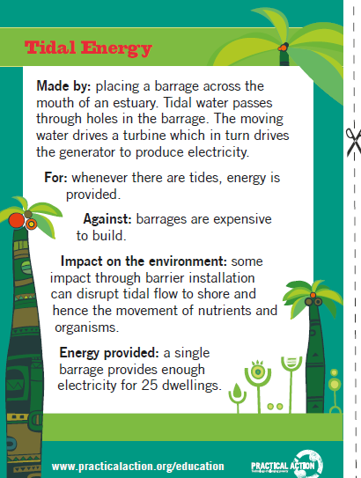
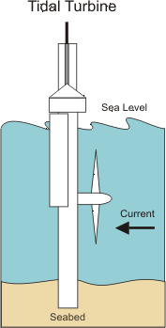
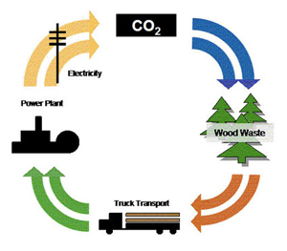
Renewable energy sources
Whenever wind blows electricity is provided
As long as there is enough water you can always make electricity
1 wind turbine provides power for 15 people
1 provides power for 40 people
If there are trees you can cut them down and burn them
As the tide goes in and out it makes electricity
1 provides power for 25 people
1 provides power for 25 people

Slide 8
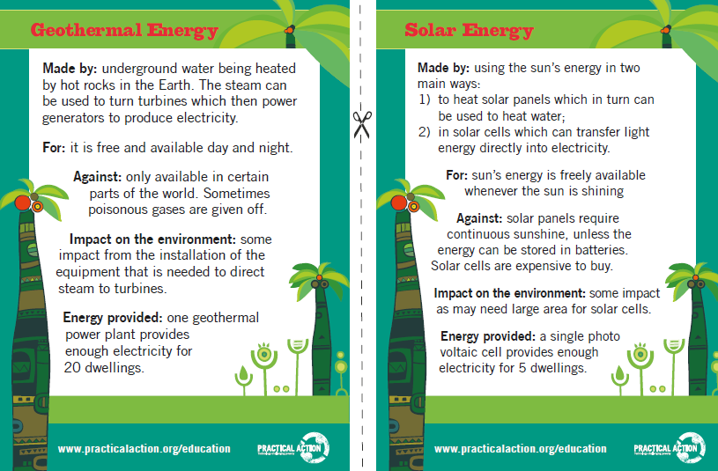
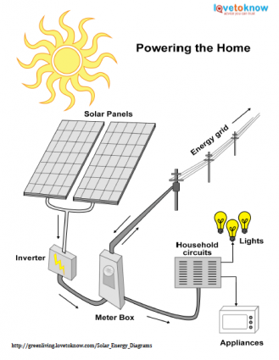

Uses heat from underground to heat up water and make electricity
Energy from the sun is converted into electricity
1 provides power for 20 people
1 provides power for 5 people
For each of the areas marked on the map decide which type of energy resource could be used. Area 1 has been done as an example
Try to use a different energy source for each area
Area | Renewable energy choice | Reasons for choice
1 | Wind turbine | Area 1 is high up so would be very windy, you would only need 2 wind turbines for the whole village to have plenty of electricity
2
3
4
5

Slide 9
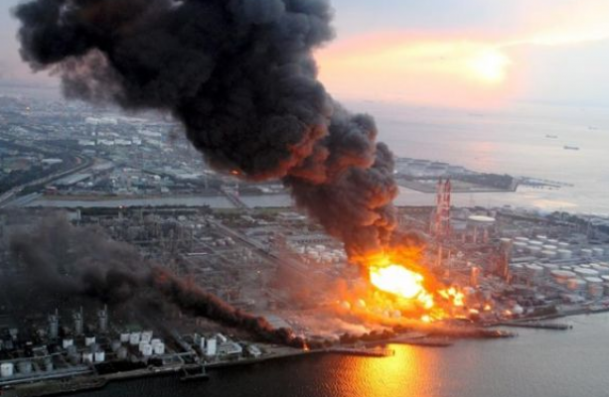
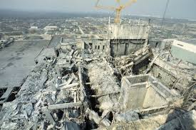
Chernobyl nuclear power station disaster
The Chernobyl disaster was a nuclear disaster which occurred on April 26, 1986 at the Chernobyl nuclear power plant in Pripyat, Ukraine. At that time, Ukraine was part of the Soviet Union.
This event was one of the worst accidents in the history of nuclear power. It was rated at level 7, the most severe level, on the International Nuclear Event Scale.
About 60% of the radioactive material went into Belarus. About 360,000 people needed to be moved to other places, because the radiation was so high in their area. In addition, many people suffered from long term illnesses and some people were even diagnosed with thyroid cancer and acute radiation poisoning.
Before the accident, there was a safety test planned but this went wrong leading to the core reactor exploding. The explosion was so powerful that it blew the 1000 ton steel lid off the reactor. Due to this explosion, large amounts of radioactive materials and fuel were released.
According to the official, internationally recognised death toll, just 31 people died as an immediate result of Chernobyl while the UN estimates that only 50 deaths can be directly attributed to the disaster. In 2005, it predicted a further 4,000 might eventually die as a result cancers from being exposed to the radiation.
https://www.bbc.com/future/article/20190725-will-we-ever-know-chernobyls-true-death-toll
https://kids.kiddle.co/Chernobyl_disaster

Slide 10

Nuclear power station disaster-Chernobyl
Research what happened to Chernobyl power station
Fill in the news article to explain what happened
Write a headline to catch the reader’s attention
Where is Chernobyl power station?
___________________
In what year was there a problem with the power station?
_________
What happened?
____________________________________________________________________________________________________________________________________________________________________________________
Draw a diagram of what happened
How many people were killed?
___________________
What caused people to die?
________________________________________________________________________________________

Slide 11
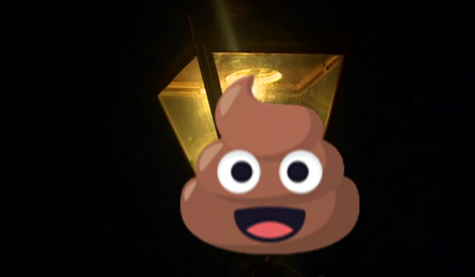
Watch the video
https://www.bbc.co.uk/newsround/42542894
Could poo-power light your street?
It sounds like a pretty smelly source of light!
But one man in Worcestershire has invented a special gas-lit street lamp that uses dog poo as fuel.
Brian Harper made a special machine where people simply put their dog waste in to power the lamp!
So how does it work?
Once put into the lamp, the dog waste is broken down by microbes, producing methane which fuels the light. Brian says that ten small bags of poo could keep the light going for two hours each evening.
It's the first dog-poo powered street lamp in the UK, and it also produces fertiliser!
In many countries around the world, including Mongolia and Pakistan, animal dung is sometimes burned on fires to produce heat.
Who invented a special gas-lit street lamp?
How does the poo powered street lamp work?
Which other countries use animal poo (dung)

Slide 12
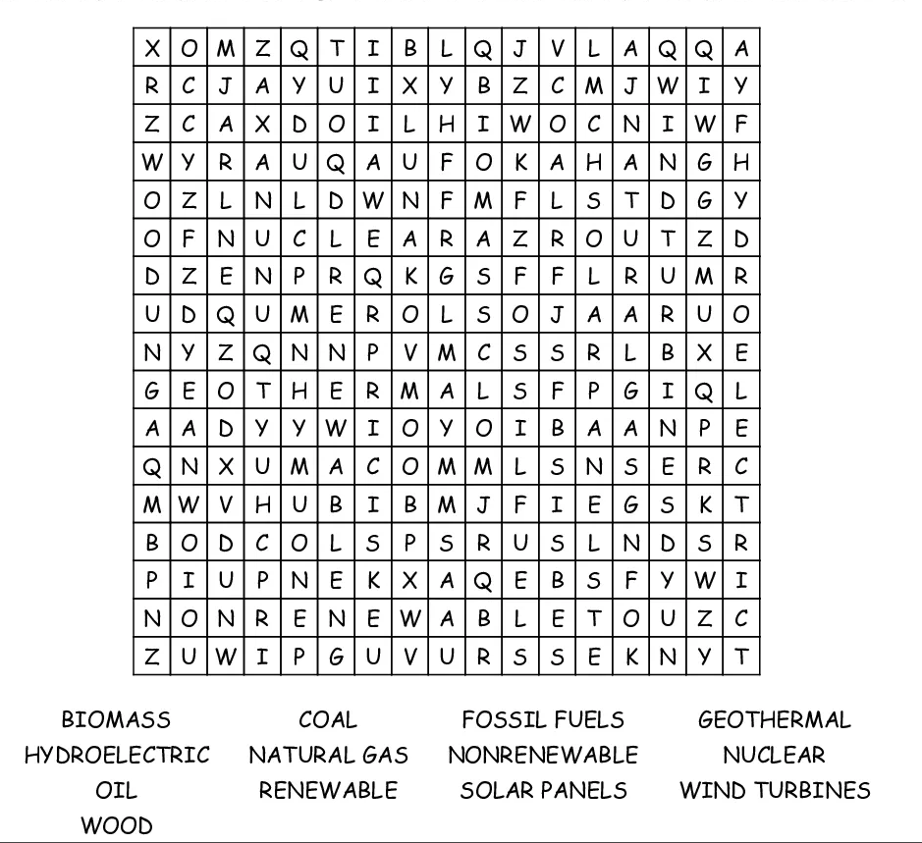
Renewable and non renewable energy

