Slide 1
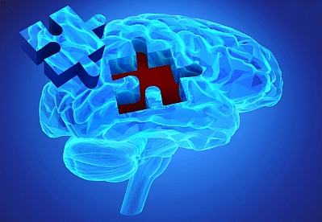
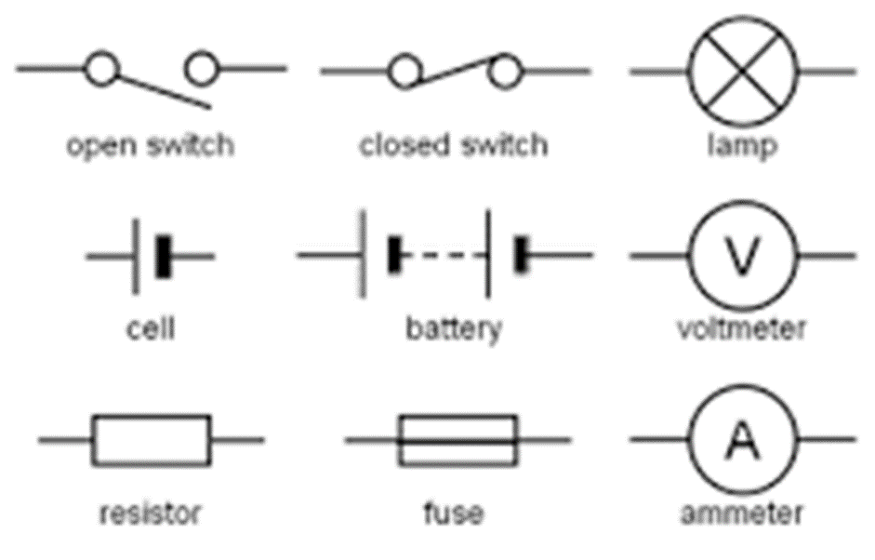
Science: calculating power and the national grid
Use Seneca learning online with the code: ow0q7tt10a
Or have a look at BBC bitesize, follow the link below
https://www.bbc.co.uk/bitesize/guides/zttrd2p/revision/1
Recap
Name 3 renewable energy resources
If a circuit has high resistance, what does this mean?
What type of materials conduct electricity?
Name the circuit symbols

Slide 2
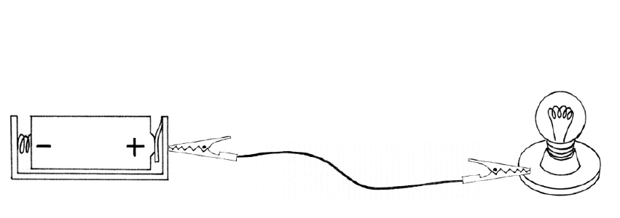
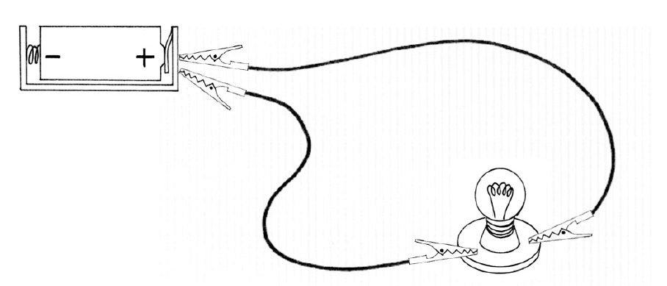
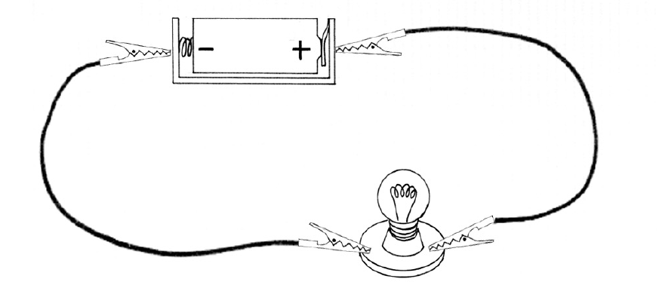
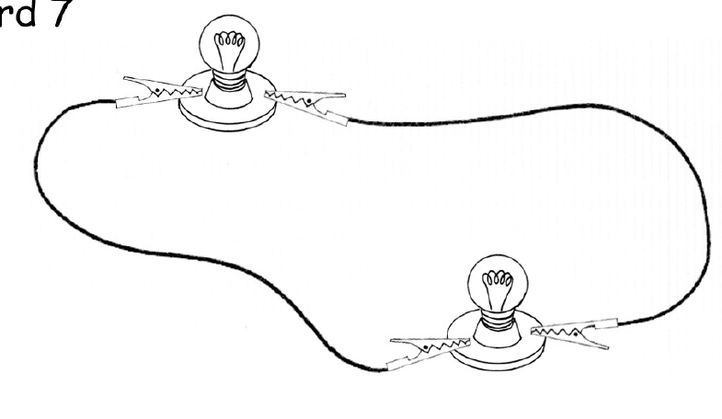
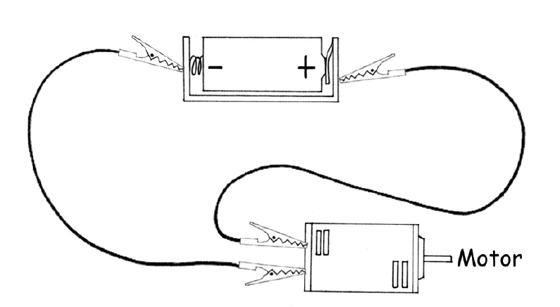
Diagram | Is it a circuit? Will it work? | Draw a diagram ((using correct symbols) to make the circuit work

Slide 3
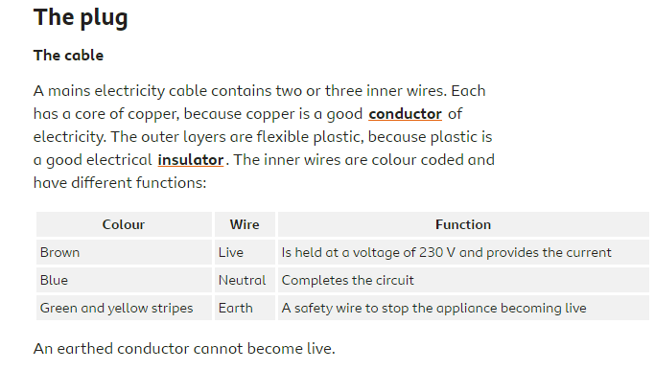
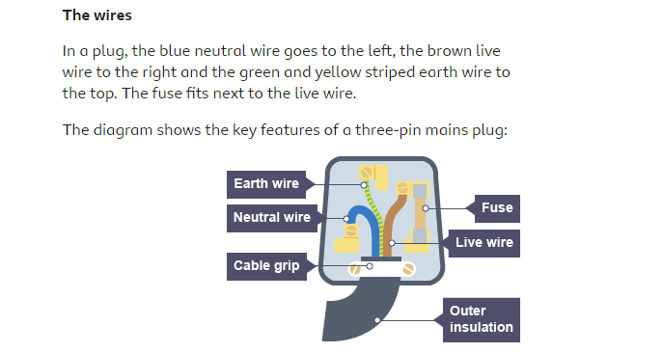
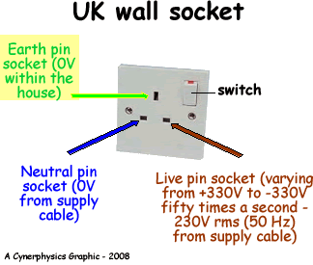
Electricity in the house
In the UK mains electricity is 230V

Slide 4
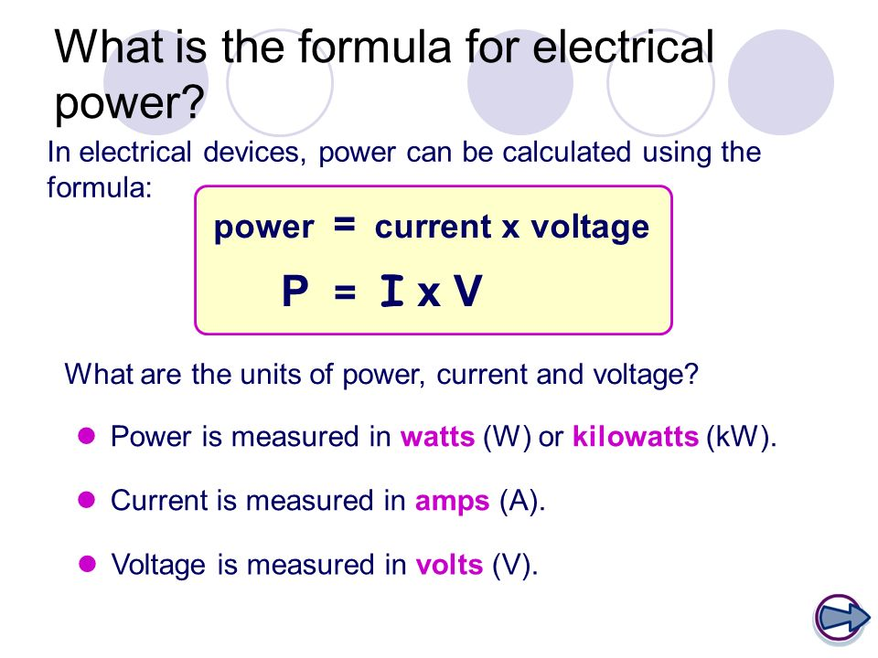
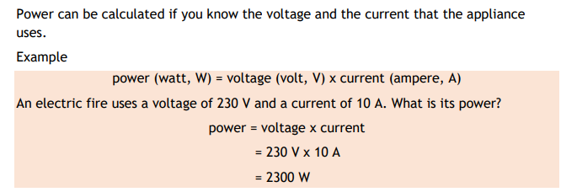
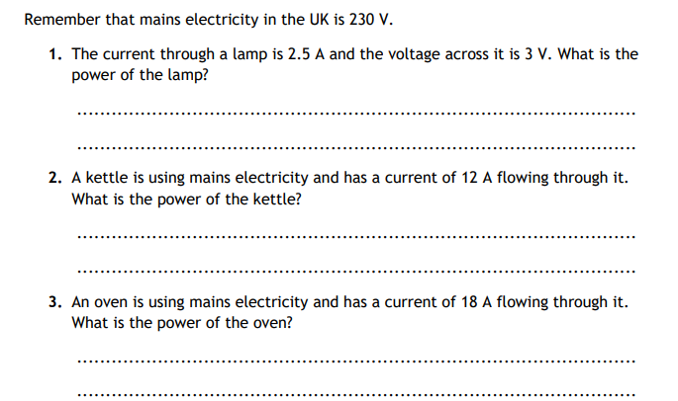
Sometimes called potential difference
Example:

Slide 5
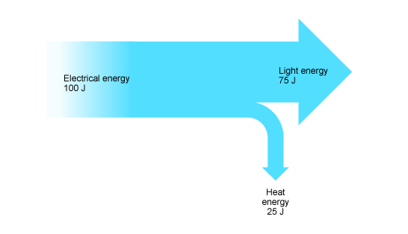
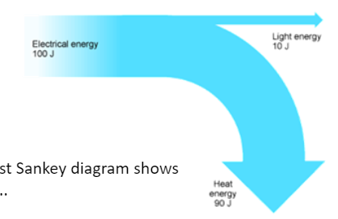

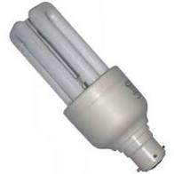
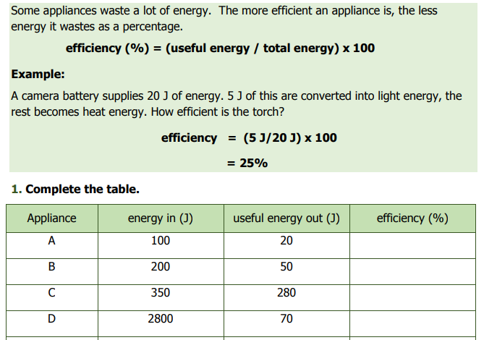
Efficiency
Devices are designed to waste as little energy as possible. This means that as much of the input energy as possible should be transferred into useful energy stores.
How good a device is at transferring energy input to useful energy output is called efficiency.
Older light bulbs were not very efficient.
-90J of energy turned into heat (wasted)
-10J into light (useful).
More energy converted into light so more efficient
Energy saving light bulbs are more efficient
-25J of energy turned into heat (wasted)
-75J into light (useful).

Slide 6
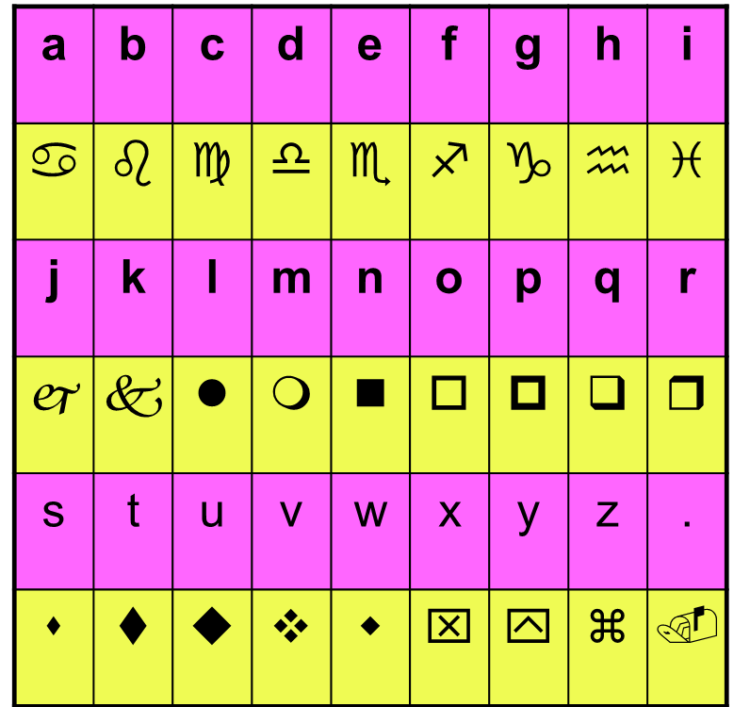
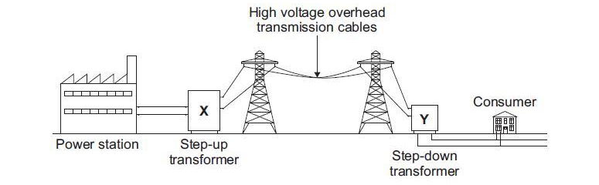
The national grid
electricity
is generated in a power station and transported around the uk by the
national grid
Can you break the code?
Electricity is transported around the UK to your homes using the national grid. The national grid is cables which carry electricity. The electricity is stepped-up to a high voltage so that electricity isn’t wasted by heating up the cables. The electricity is then stepped-down to 230V to be safe for use in your home. Transformers are used to change the voltage.
132 000V
11 000V
240V
Energy is transferred by electricity from a power station to your home along the _________ ______.
At the power station a ________ is used to step _____ the voltage .
Increasing the voltage ________ the current.
The smaller current reduces the _______ losses in the cables. This is because there is less _________ of the cables.
Near your home a step ______ transformer produces a safer voltage of approximately ______ V.
Transformer 240V down resistance National grid heat up decreases

Slide 7
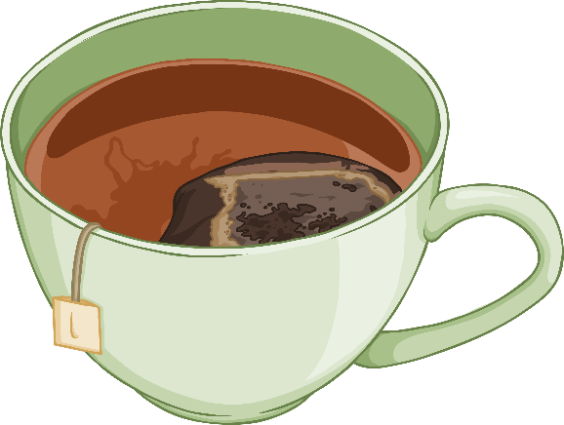
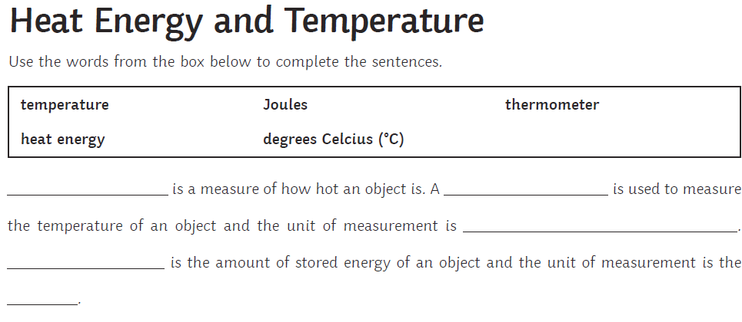
Equilibrium
When something is balanced.
Equilibrium means:
Hot objects cool down. Energy is always transferred from a hot object to a cold object, and not the other way round. Think of a cup of tea - as the temperature gradually cools, and it reaches the same temperature as the room, there are no more energy transfers and it has reached equilibrium.
equilibrium
50 °C
20 °C

Slide 8
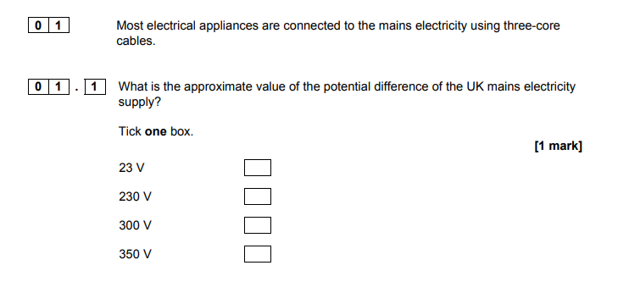
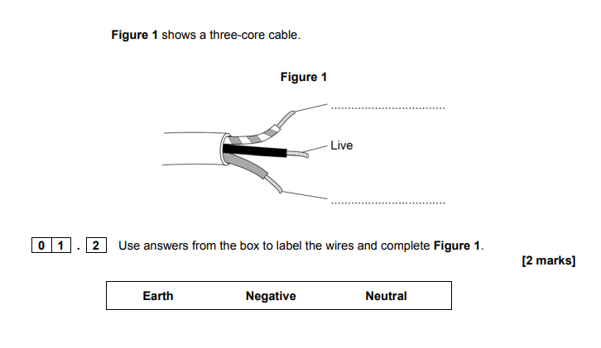
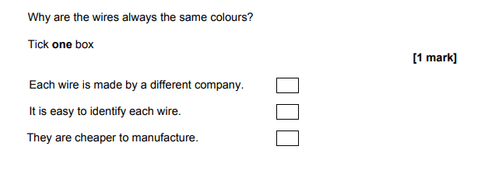

Slide 9
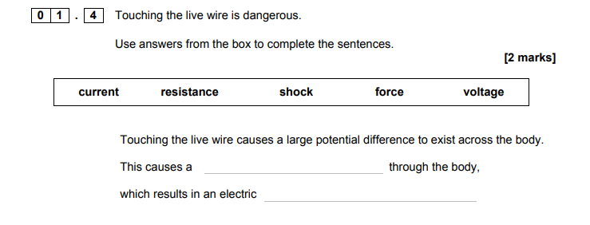
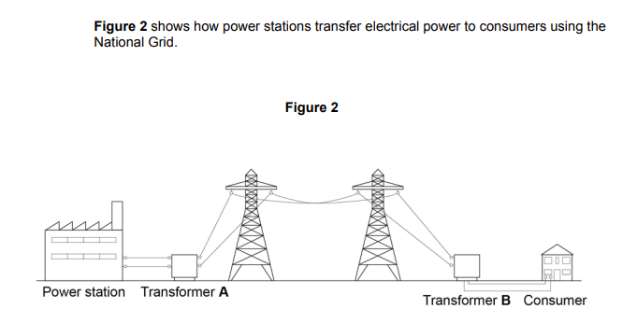
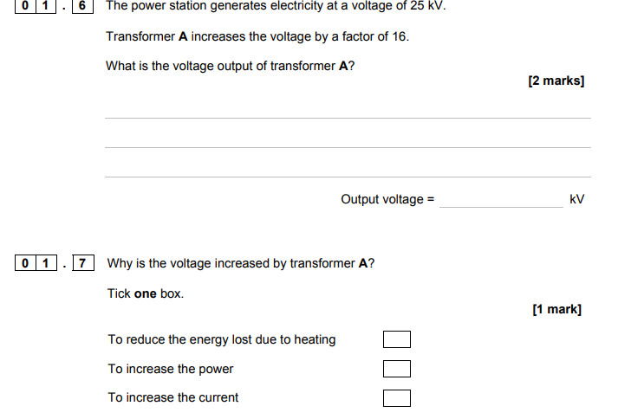

Slide 10
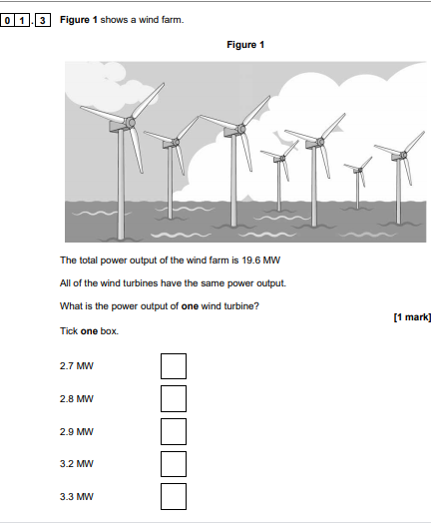
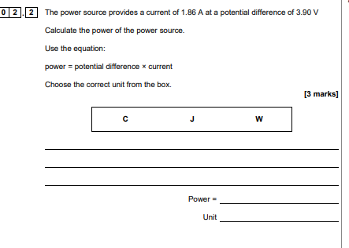

Slide 11


