Slide 1
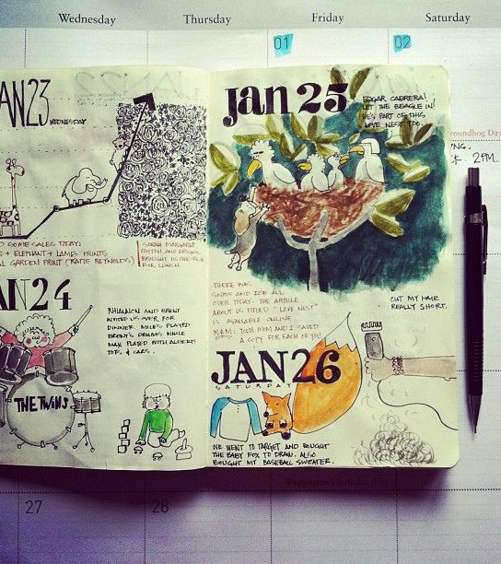
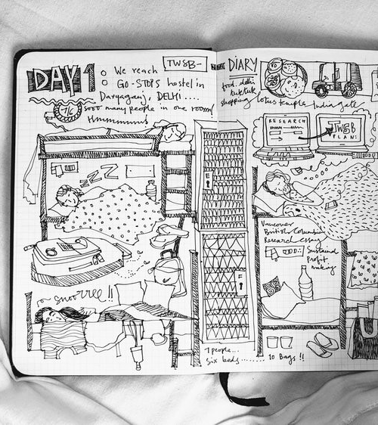
Life and Death part five- A Visual Diary of a Week of my Life.
What is a visual diary? As the name suggests, visual diaries are a collection of visual references compiled by an artist. Made up of notes, diagrams, collage, photography, images, and detritus, a visual diary can contain any number of materials
art@stmatthias

Slide 2
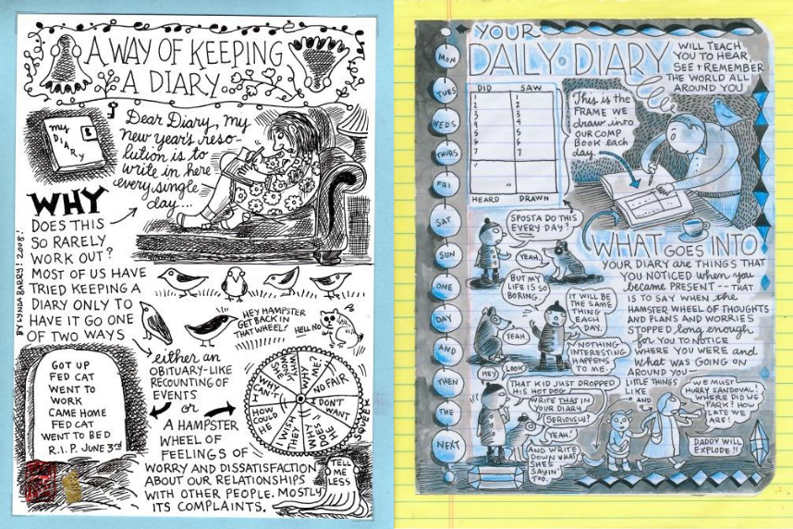
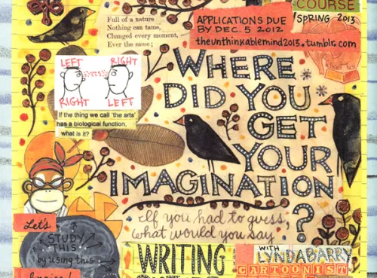
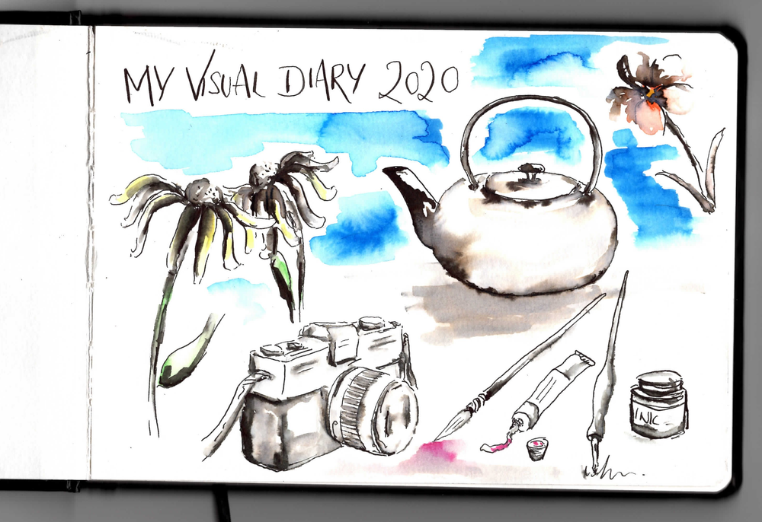
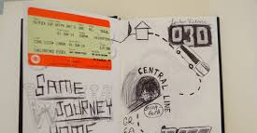
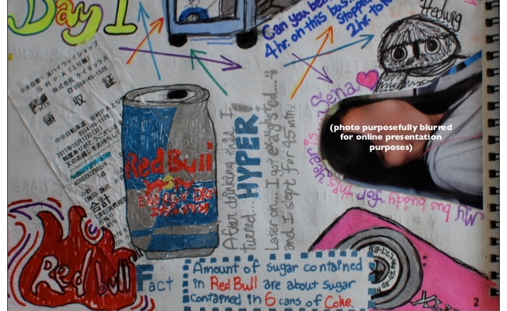
A week of my life
TASK
Use several pages of your sketchbook to record your day over a week. You could record what you did throughout the day, how you felt, your worries, your thoughts, what made you happy or just your routine.
Did you go to the shop? Stick in your receipt. Did you catch a bus? Stick in your ticket.
What lessons did you study?
You can use doodle, words, cut outs from papers and magazines, photographs, cartoon strips etc.
TRY TO USE DIFFERENT MATERIALS

Slide 3
Elements of Art
Name:
This is a way ordering colours and is the theory of making all the other colours
The basic parts used to communicate in Art
The lightness and darkness of a colour
A gradual change from light to dark
This is using lines to shade with and can also be cross-hatchings
This is the name given for arranging and composing all the parts in your Art work
This is the space surrounding an object and sometimes the background
A mechanical shape and normally man-made
A shape which comes from nature
Colours made by mixing primary colours
This is creating marks with the point of a pencil or paint brush.
A shape which has height, width, depth and weight.
All colours can be made from these three colours, red, yellow and blue
This is the basic element in art and it has only one property length
This is the movement one creates in a work of art by repeating parts
This is the space that is in the middle of a composition
This is the solid space of the object in a picture
This deals with the scale of an object and relates the sizes of shapes in a picture
This is made by enclosing a line and it is flat and 2D
This it the unity in a picture and creates a wholeness, sometimes through colour
This is when there is a skull in a Still-life composition as a symbol for the mortality of life
1.________ Elements of Art
2. _______ Line
3._______ Organic/Natural Shapes
4._______ Geometrical shape
5._______ Shape
6._______ Form
7._______ Value
8._______ Shading
9._______ Primary colours
10._______ Secondary colours
11._______ harmony
12._______ Positive space
13._______ Negative space
14._______ Proportion
15._______ Stippling
16._______ Middle ground
17._______ hatchings
18._______ Composition
19._______ Colour wheel
20. _______ rhythm
21.________ Vanitas
Circle the word that is not an Element of Art
Line Shape Perspective
Texture
Space Value Colour

Slide 4
This is a way ordering colours and is the theory of making all the other colours 19
This is the movement one creates in a work of art by repeating parts 20
This is the space that is in the middle of a composition 16
This is the name given for arranging and composing all the parts in your Art work 18
1._______Elements of Art
2. _______Line
3._______Organic/Natural Shapes
4._______Geometrical shape
5._______Shape
6._______Form
7._______Value
8._______Shading
9._______Primary colours
10.______Secondary colours
11.______harmony
12.______Positive space
13.______Negative space
14.______Proportion
15.______Stippling
16.______Middle ground
17.______hatchings
18.______Composition
19.______Colour wheel
20. ______rhythm
21.______vanitas
This is when there is a skull in a Still-life composition as a symbol for the mortality of life 21
A mechanical shape and normally man-made 4
This is the space surrounding an object and sometimes the background 13
The basic parts used to communicate in Art 1
This is creating marks with the point of a pencil or paint brush 15
The lightness and darkness of a colour 7
A shape which comes from nature 3
This deals with the scale of an object and relates the sizes of shapes in a picture 14
A shape which has height, width, depth and weight. 6
Colours made by mixing primary colours 10
A gradual change from light to dark 8
This is the basic element in art and it has only one property length 2
This is made by enclosing a line and it is flat and 2D 5
This is the solid space of the object in a picture 12
This it the unity in a picture and creates a wholeness, sometimes through colour 11
This is using lines to shade with and can also be cross-hatchings 17
All colours can be made from these three colours, red, yellow and blue 9

Slide 5
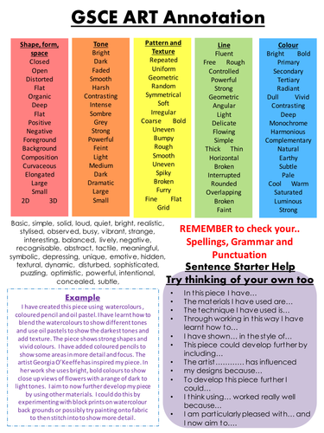

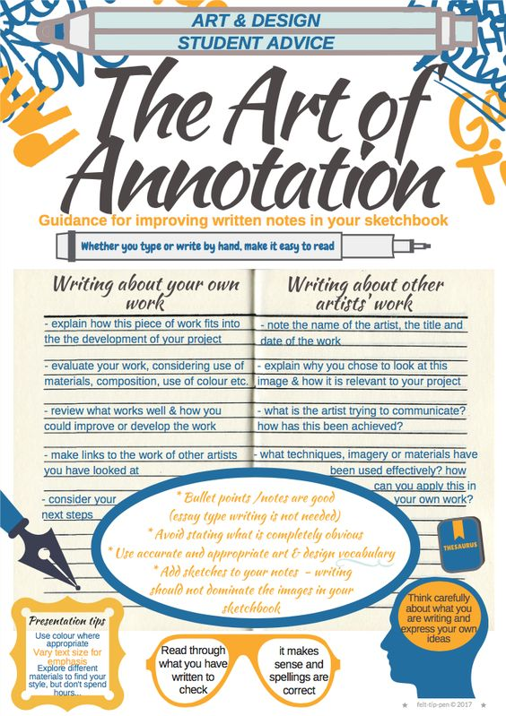
When you are producing artworks remember to annotate and explain your work using art vocabulary.
Annotate some of your sketchbook work making use of art vocabulary.

Slide 6

Grade boundaries
KEYWORDS
Record develop observations diary visual words medium techniques
GCSE assessment objective A02/3:Record and develop ideas using a range of media
.Observations and insights relevant to intentions
Grade 2-Basic use of materials with some basic explorations. Basic visual dairy. Annotation using some basic art terms.
Grade 3- Competent use of appropriate materials showing some techniques. Visual dairy showing some creativity. Annotation using some art terms.
Grade 4- Control of appropriate materials exploring different techniques-labelled. Visual dairy showing creativity. Annotation using a range of art terms with some reflection and evaluating.
Grade 5- Creative use of appropriate materials and techniques to produce a visual diary. Annotations reflecting and evaluating using a range of art terms.
Objectives
To develop ability to record observations
To develop creative skills
Success Criteria
Use a range of media to PRESENT a creative record of you week

