Slide 1

English Skills
Home Learning Booklet Week Four
Name: ___________

Slide 2
Key Words
Write down or look up the definitions for these key English terms.
Key Word | Definition
Simile
Stanza
Verbs
Personification
Use this box to make a list of verbs. Aim to include at least five: Extension task: Can you also write your own example of personification and a simile?

Slide 3
Context
The poem we are looking at across the next few lessons was written about Nigeria, a country in Western Africa that is home to 186 million people. The poet, Niyi Osundare, used his poetry to object to the cruel dictatorship that ruled his country.
TASK:
To help us understand the poem we are going to continue to explore some unfamiliar vocabulary. Write down or look up the definitions for these words.
A Dictatorship is…
____________________________________________________
____________________________________________________
Prejudice is …
____________________________________________________
____________________________________________________
Discrimination is …
____________________________________________________
____________________________________________________

Slide 4
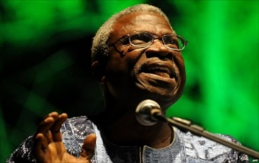
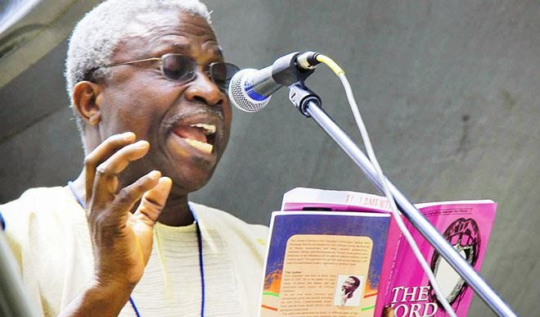
Exploring Context
Niyi Osundare is an African poet born in Nigeria, who has used his poetry to criticise and object to the the dictatorship that ruled his country under General Sani Abacha from 1993 to 1998. During Abacha's rule, writing poetry was considered a dangerous activity
Osundare regularly wrote poems for a Nigerian national newspaper which commented on the lives of people in that country. As a result, he was frequently called to account by security agents and quizzed about what his poems meant and to whom they referred. Osundare himself says, "with the kind of poetry I write, I can never be the dictator's friend. So I get a knock on the door at two in the morning a couple of times.“
He firmly believed that African poets have no choice but to be political in their writing and expose human rights abuses that occur. He has said:
‘You cannot keep quiet about the situation in the kind of countries we find ourselves in, in Africa. When you wake up and there is no running water, when you have a massive power outage for days and nights, no food on the table, no hospital for the sick, no peace of mind; when the image of the ruler you see everywhere is that of a dictator with a gun in his hand; and, on the international level, when you live in a world in which your continent is consigned to the margin, a world in which the colour of your skin is a constant disadvantage, everywhere you go –then there is no other way than to write about this, in an attempt to change the situation for the better.’
Use the next page to answer the questions below. Answer in full sentences.
What did Niyi Osundare use his poetry for?
Explain the risks he has experienced through writing his poetry
Explain what he feels are the African poet’s responsibilities

Slide 5
______________________________________________________
______________________________________________________
______________________________________________________
______________________________________________________
______________________________________________________
______________________________________________________
______________________________________________________
______________________________________________________
______________________________________________________
______________________________________________________
______________________________________________________
______________________________________________________
______________________________________________________
______________________________________________________
______________________________________________________
______________________________________________________
______________________________________________________
______________________________________________________
______________________________________________________

Slide 6
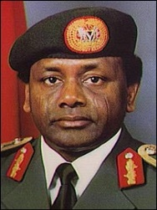
Exploring Context
General Sani Abacha was a Nigerian army general and politician who served as the President of Nigeria from 1993 to 1998. He had participated in a string of coups which resulted in him seizing power, and in September 1994 he issued a decree that placed his government above the jurisdiction of the courts, effectively giving him absolute power. Another decree gave him the right to detain anyone for up to three months without trial. His regime divided people’s opinions; although it helped Nigeria to prosper, there were also widespread human-rights abuses.
He was known as a man of “few words and deadly actions” and he demonstrated this as head of state with one of the most brutal regimes Nigeria has ever had. There was massive crackdown on the media, civil rights groups and pro-democracy campaigns.
One example is the hanging of an activist: Ken Saro-Wiwa. He was involved in a non-violent campaign protesting against the treatment of the Ongoni people (an ethnic minority group in Nigeria) and their land, which suffered environmental damage as a result of the crude oil extraction. Under Abacha’s rule Ken Saro-Wiwa was arrested several times and eventually executed, alongside other activists from similar groups.
While General Abacha was president writing poetry was considered a dangerous activity, as Niyi Osundare found out himself. ‘With the kind of poetry I write, I can never be the dictator’s friend. So I got a knock on the door at two in the morning a couple of times.’
Despite this, Osundare continued to believe that African poets have a responsibility to expose political injustice in their countries through their writing.
Use the next page to answer the questions below. Answer in full sentences.
Who was General Abacha and how did he come to power?
Explain what life would have been like living under his rule for the citizens of Nigeria
In his dictatorship why was writing poetry considered a “dangerous activity”?

Slide 7
______________________________________________________
______________________________________________________
______________________________________________________
______________________________________________________
______________________________________________________
______________________________________________________
______________________________________________________
______________________________________________________
______________________________________________________
______________________________________________________
______________________________________________________
______________________________________________________
______________________________________________________
______________________________________________________
______________________________________________________
______________________________________________________
______________________________________________________
______________________________________________________
______________________________________________________

Slide 8
Reading and annotation
1: Start by reading through the poem on the next page a few times
2: Label the four words below to help you better understand some of the vocabulary
Yam = like sweet potato Probe = investigation
Stainless = perfect Bewildered = confused, fearful
3: Look up the meaning of any other unfamiliar words
4: Highlight all verbs that sound violent. What does this show about Nigeria when General Abacha was in charge?
5: Find the simile. What does it show about what happened to Akanni?
6: Find the personification. How does it make the jeep sound dangerous and aggressive?
7: Highlight what happens to Danladi. What do you think “lengthy absence” might mean?
8: Highlight what happens to Chinwe. What shows you that her treatment is unfair?
9: Look at the question asked at the end of every stanza. How does the person speaking in the poem feel about what is happening? How is he ‘turning a blind eye’?
What happens in the last stanza? Annotate the poem to show your ideas

Slide 9
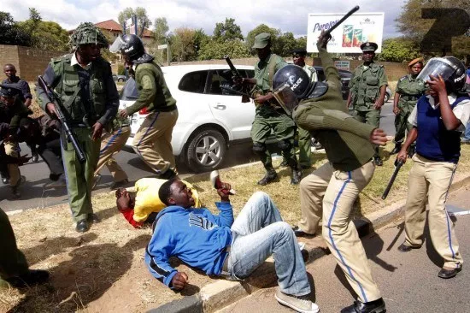
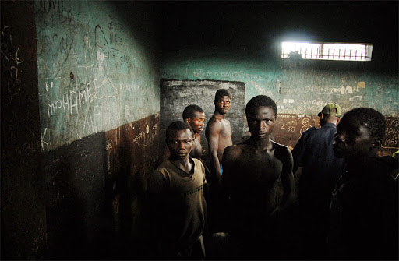

Not My Business
Not My Business:
They picked Akanni up one morning
Beat him soft like clay
And stuffed him down the belly
Of a waiting jeep.
What business of mine is it
So long they don't take the yam
From my savouring mouth?
They came one night
Booted the whole house awake
And dragged Danladi out,
Then off to a lengthy absence.
What business of mine is it
So long they don't take the yam
From my savouring mouth?
Chinwe went to work one day
Only to find her job was gone:
No query, no warning, no probe -
Just one neat sack for a stainless record.
What business of mine is it
So long they don't take the yam
From my savouring mouth?
And then one evening
As I sat down to eat my yam
A knock on the door froze my hungry hand.
The jeep was waiting on my bewildered lawn
Waiting, waiting in its usual silence.
Niyi Osundare

Slide 10
PEE Paragraph
POINT: In the poem, ‘Not my business’, the poet shows how people in Nigeria were attacked by General Abacha’s soldiers.
EVIDENCE (QUOTATION) :
______________________________________________________
______________________________________________________
EXPLANATION: This shows _______________________________
______________________________________________________
KEY WORD: The word “__________________” makes me think
______________________________________________________
______________________________________________________
EFFECT ON READER: This shows the reader
______________________________________________________
______________________________________________________
POINT: In the poem, ‘Not my business’, the poet shows how General Abacha’s soldiers didn’t respect the citizens and abused their human rights.
EVIDENCE (QUOTATION) :
______________________________________________________
______________________________________________________
EXPLANATION: This shows
______________________________________________________
______________________________________________________
KEY WORD: The word “__________________” makes me think
______________________________________________________
______________________________________________________
EFFECT ON READER: This shows the reader
______________________________________________________
______________________________________________________

Slide 11
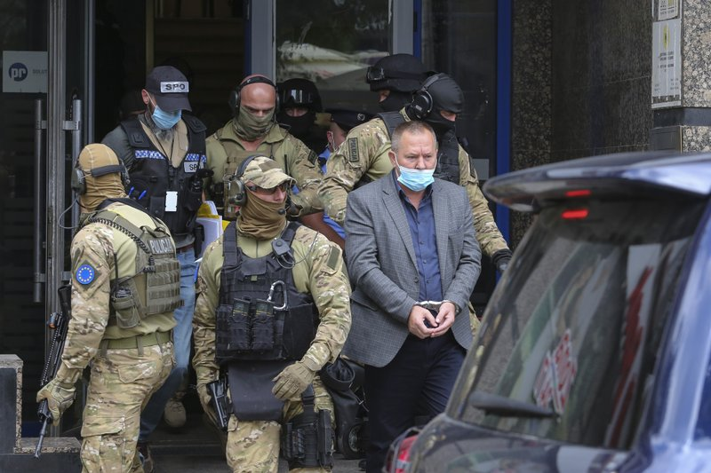
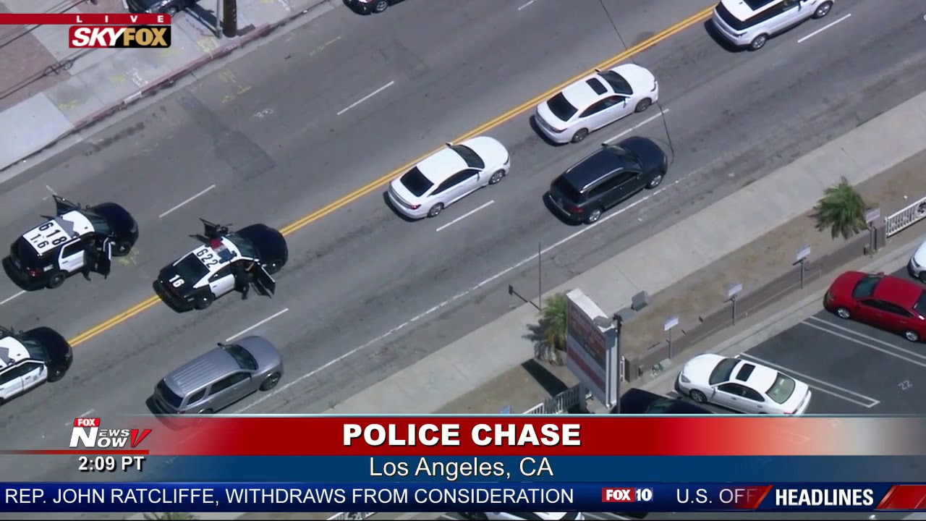
Creative Writing
Task: Produce a piece of original writing called ‘The Arrest’
You could base it on the narrator or other characters in ‘Not My Business’
Decide what the ‘crime’ is.
From whose point of view are you going to write the story?
Is it going to be a first or third person account?
Remember to describe feelings, as well as events
Use the sheet on the next page to help plan your story

Slide 12
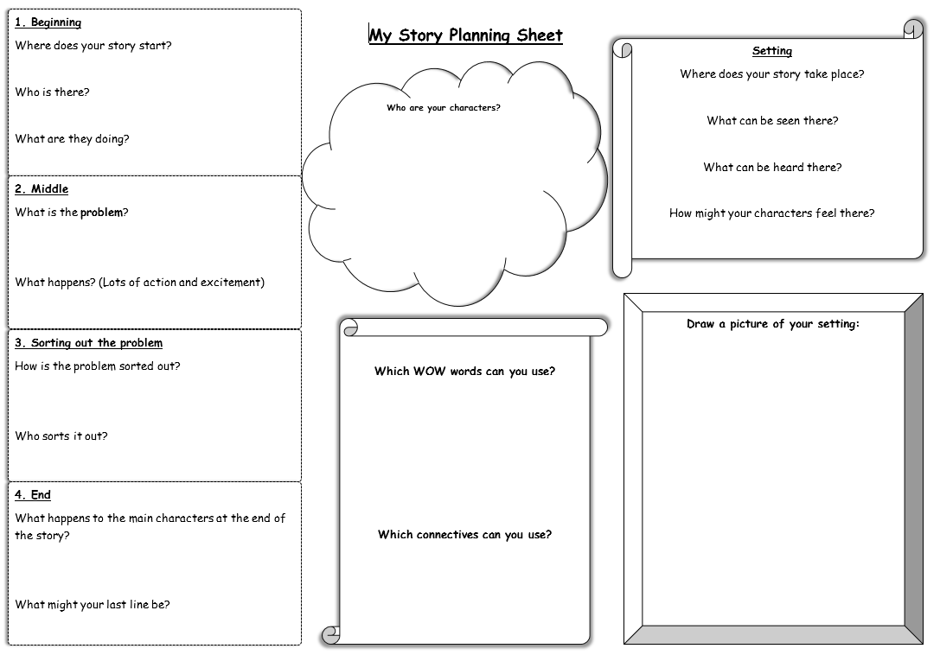

Slide 13
______________________________________________________
______________________________________________________
______________________________________________________
______________________________________________________
______________________________________________________
______________________________________________________
______________________________________________________
______________________________________________________
______________________________________________________
______________________________________________________
______________________________________________________
______________________________________________________
______________________________________________________
______________________________________________________
______________________________________________________
______________________________________________________
______________________________________________________
______________________________________________________
______________________________________________________

Slide 14
______________________________________________________
______________________________________________________
______________________________________________________
______________________________________________________
______________________________________________________
______________________________________________________
______________________________________________________
______________________________________________________
______________________________________________________
______________________________________________________
______________________________________________________
______________________________________________________
______________________________________________________
______________________________________________________
______________________________________________________
______________________________________________________
______________________________________________________
______________________________________________________
______________________________________________________

Slide 15

Self Assessment
Well done! You’ve completed your week on Not My Business
Summarise in less than three sentences what you think this week’s poem is about.
_________________________________________
_________________________________________
_________________________________________
What went well this week?
My best piece of work is…
_________________________
because…
_________________________
_________________________

