Slide 1

English Skills
Home Learning Booklet Week Four
Name: ___________

Slide 2
Key Words
Draw lines to match the key words to their definitions.
Key Word | Definition
Simile | Is when things or ideas are given human characteristics e.g. The sun hid nervously behind the dark clouds
Stanza | Are action or doing words e.g. ran, asked
Verbs | is a series of lines grouped together in order to divide a poem
Personification | Is when one thing is compared to another using “like” or “as” e.g. As light as a feather
Use this box to make a list of verbs. Aim to include at least five: Extension task: Can you also write your own example of personification?

Slide 3
Context
The poem we are looking at across the next few lessons was written about Nigeria, a country in Western Africa that is home to 186 million people. The poet, Niyi Osundare, used his poetry to object to the cruel dictatorship that ruled his country. People who try to protest or express their ideas in a dictatroship either in speech, writing or actions are arrested, imprisoned, punished and possibly killed to silence them.
TASK:
To help us understand the poem we are going to continue to explore some unfamiliar vocabulary. Write down or look up the definitions for these words. The first one has been done for you.
Dictatorship- When a country is ruled by someone with absolute authority. Dictators often use the military to enforce their rule.
Prejudice is …
____________________________________________________
____________________________________________________
Discrimination is …
____________________________________________________
____________________________________________________

Slide 4
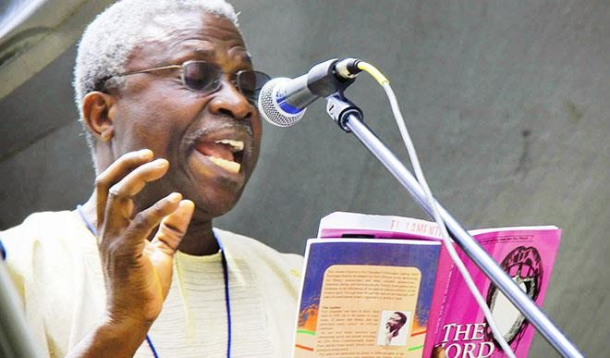
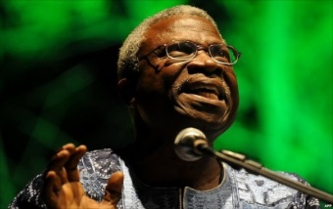
Exploring Context
Niyi Osundare was born in 1947 in Nigeria. He is a poet and has written many poems that are often studied in school. Osundare has always been a supporter of the right to free speech and believes in the power of words. He has not been afraid to stand up to people in power, including the government in Nigeria and criticise them for treating people unfairly.
He believes that African poets have no choice but to write about the politics (the government’s rules and laws). In the 1990s, Osundare often wrote poems that criticised the people in charge of Nigeria and showed the lives of the people living there. As a result of this, he was frequently visited, threatened and intimidated by security agents.
Use the next page to answer the questions below. Answer in full sentences.
Who is Niyi Osundare?
What does he believe about his poetry?
What happened to him when he wrote poems about Nigeria?

Slide 5
______________________________________________________
______________________________________________________
______________________________________________________
______________________________________________________
______________________________________________________
______________________________________________________
______________________________________________________
______________________________________________________
______________________________________________________
______________________________________________________
______________________________________________________
______________________________________________________
______________________________________________________
______________________________________________________
______________________________________________________
______________________________________________________
______________________________________________________
______________________________________________________
______________________________________________________

Slide 6
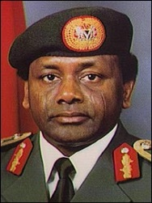
Context
General Sani Abacha was a Nigerian army general and politician who served as the President of Nigeria from 1993 to 1998. In September 1994 he issued an order that gave him complete power. Another order gave him the right to detain anyone for up to three months without trial. His government was responsible for widespread human-rights abuses. He was known as a man of “few words and deadly actions” and he demonstrated this as head of state with one of the most brutal regimes Nigeria has ever had.
One example is the hanging of an activist: Ken Saro-Wiwa who was arrested several times for peacefully protesting and eventually hanged. While General Abacha was president writing poetry was considered a dangerous activity, as Niyi Osundare found out himself. ‘With the kind of poetry I write, I can never be the dictator’s friend. So I got a knock on the door at two in the morning a couple of times.’
Use the next page to answer the questions below. Answer in full sentences.
Who was General Abacha?
What would life have been like living under his rule?
Extension task:
In his dictatorship why was writing poetry considered a “dangerous activity”?

Slide 7
______________________________________________________
______________________________________________________
______________________________________________________
______________________________________________________
______________________________________________________
______________________________________________________
______________________________________________________
______________________________________________________
______________________________________________________
______________________________________________________
______________________________________________________
______________________________________________________
______________________________________________________
______________________________________________________
______________________________________________________
______________________________________________________
______________________________________________________
______________________________________________________
______________________________________________________

Slide 8
Reading and annotation
1: Start by reading through the poem on the next page a few times
2: Label the four words below to help you better understand some of the vocabulary
Yam = like sweet potato Probe = investigation
Stainless = perfect Bewildered = confused, fearful
3: Look up the meaning of any other unfamiliar words
4: Label the simile with what happened to Akanni. What does this show you about Nigeria when General Abacha was in charge?
5: When did they come for Danladi? Why would this have been quite scary?
How do you think they treated Danladi? Which verbs show you this?
6: Look at the last 3 lines of each stanza. Do you think the man cares about what is happening to people like Akanni, Danladi and Chinwe?
7: What happens to the man in the last stanza? Do you think the poem has a message? Annotate the poem to show your thoughts

Slide 9
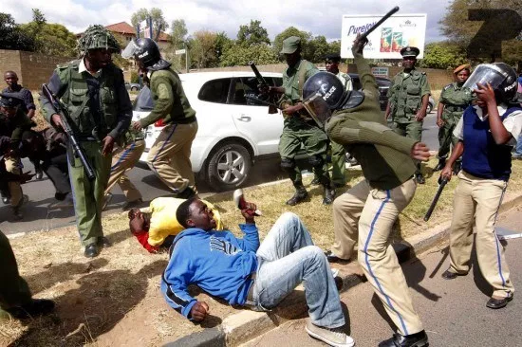
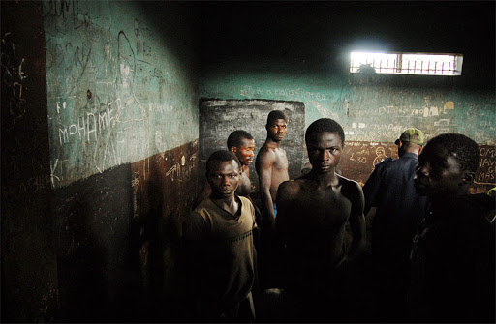

Not My Business
Not My Business:
They picked Akanni up one morning
Beat him soft like clay
And stuffed him down the belly
Of a waiting jeep.
What business of mine is it
So long they don't take the yam
From my savouring mouth?
They came one night
Booted the whole house awake
And dragged Danladi out,
Then off to a lengthy absence.
What business of mine is it
So long they don't take the yam
From my savouring mouth?
Chinwe went to work one day
Only to find her job was gone:
No query, no warning, no probe -
Just one neat sack for a stainless record.
What business of mine is it
So long they don't take the yam
From my savouring mouth?
And then one evening
As I sat down to eat my yam
A knock on the door froze my hungry hand.
The jeep was waiting on my bewildered lawn
Waiting, waiting in its usual silence.
Niyi Osundare

Slide 10
PEE Paragraph
POINT: In the poem, ‘Not my business’, the poet shows how people in Nigeria were attacked by General Abacha’s soldiers. EVIDENCE: He says “They picked Akanni up one morning, beat him soft like clay.” EXPLANATION: This shows ______________________________________________________
______________________________________________________
KEY WORD: The word “__________________” makes me think
______________________________________________________
______________________________________________________
EFFECT ON READER: This shows the reader
______________________________________________________
______________________________________________________
POINT: In the poem, ‘Not my business’, the poet shows how General Abacha’s soldiers didn’t respect the citizens and abused their human rights. EVIDENCE: He says “They came one night, Booted the whole house awake And dragged Danladi out”
EXPLANATION: This shows
______________________________________________________
______________________________________________________
KEY WORD: The word “__________________” makes me think
______________________________________________________
______________________________________________________
EFFECT ON READER: This shows the reader
______________________________________________________
______________________________________________________

Slide 11
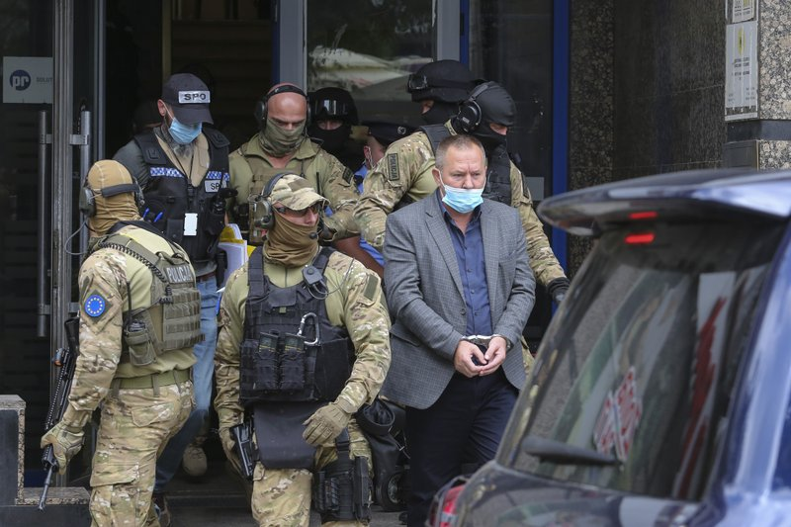
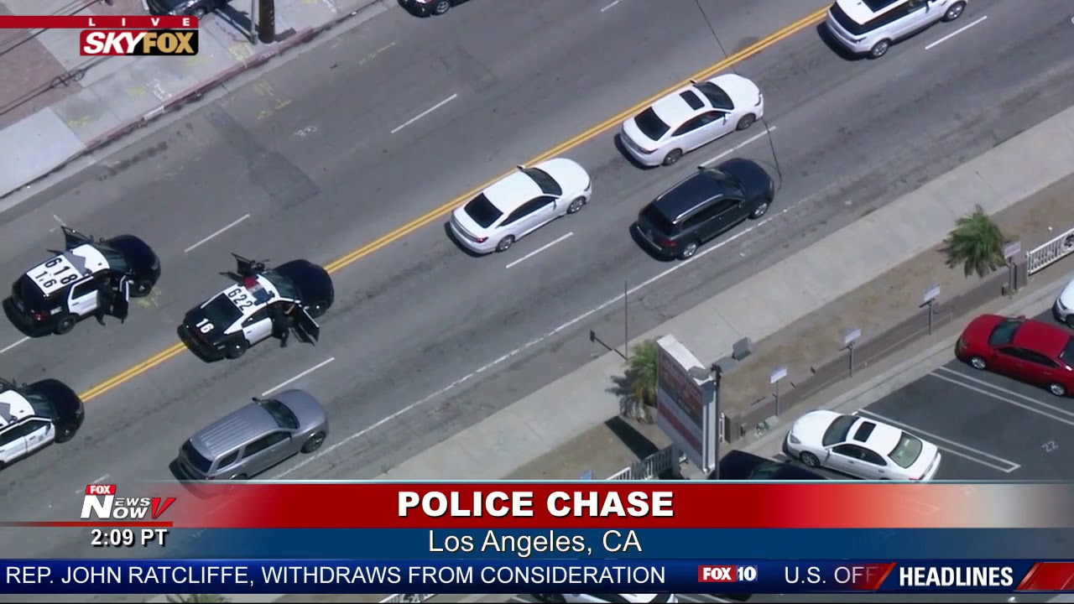
Creative Writing
Task: Produce a piece of original writing called ‘The Arrest’
You could base it on the narrator or other characters in ‘Not My Business’
Decide what the ‘crime’ is.
From whose point of view are you going to write the story?
Is it going to be a first or third person account?
Remember to describe feelings, as well as events
Use the sheet on the next page to help plan your story

Slide 12
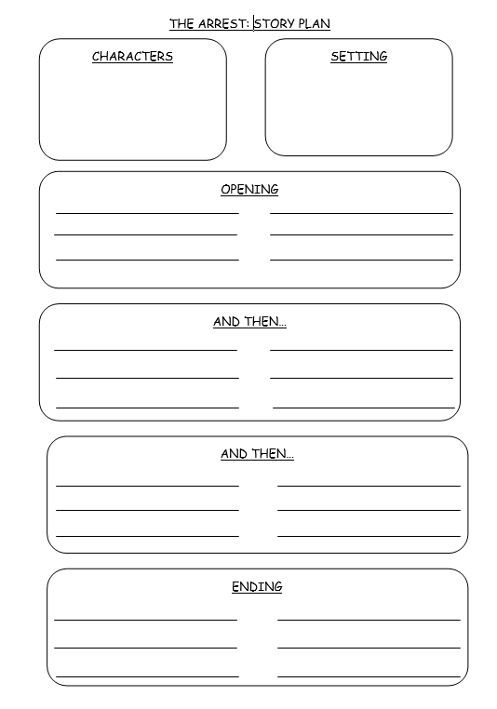

Slide 13
______________________________________________________
______________________________________________________
______________________________________________________
______________________________________________________
______________________________________________________
______________________________________________________
______________________________________________________
______________________________________________________
______________________________________________________
______________________________________________________
______________________________________________________
______________________________________________________
______________________________________________________
______________________________________________________
______________________________________________________
______________________________________________________
______________________________________________________
______________________________________________________
______________________________________________________

Slide 14
______________________________________________________
______________________________________________________
______________________________________________________
______________________________________________________
______________________________________________________
______________________________________________________
______________________________________________________
______________________________________________________
______________________________________________________
______________________________________________________
______________________________________________________
______________________________________________________
______________________________________________________
______________________________________________________
______________________________________________________
______________________________________________________
______________________________________________________
______________________________________________________
______________________________________________________

Slide 15

Self Assessment
Well done! You’ve completed your fourth week on poetry.
Summarise in less than three sentences what you think this week’s poem is about.
_________________________________________
_________________________________________
_________________________________________
What went well this week?
My best piece of work is…
_________________________
because…
_________________________
_________________________

