Slide 1

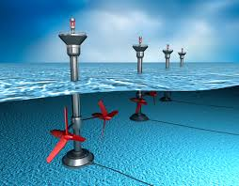
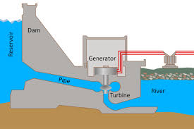
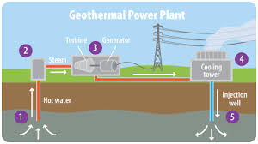
*Science: Energy resources and global warming
If want to do some work online please visit SENECA learning and sign up using the class code: 4ggjlziov
Use: https://www.bbc.co.uk/bitesize/guides/z8k9v9q/revision/1#:~:text=Different%20energy%20resources%20%20%20%20Energy%20resource,%20Very%20low%20%205%20more%20rows%20
to help if you get stuck or contact me!
Recap
What are the energy transfers in hydroelectricity?
  Gravitational potential K _ _ _ _ _ _ + s_ _ _ _ + e_ _ _ _ _ _ _ _
What energy type is stored in a battery?
  c _ _ _ _ _ _ _
Give an advantage and disadvantage of nuclear power
  Advantage:
  Disadvantage:
Match the energy resource with it’s picture
Tidal
Geothermal
Hydroelectric

Slide 2
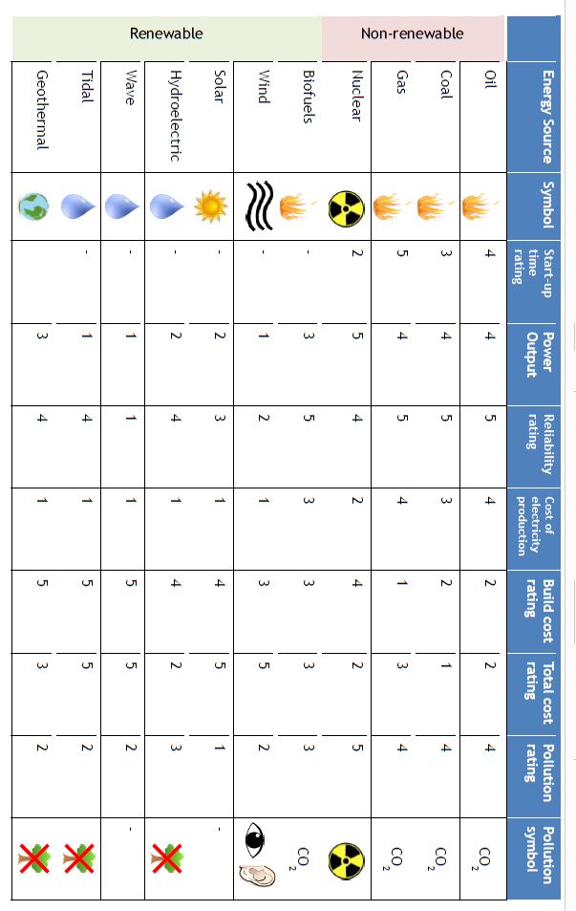
Energy resources table

Slide 3
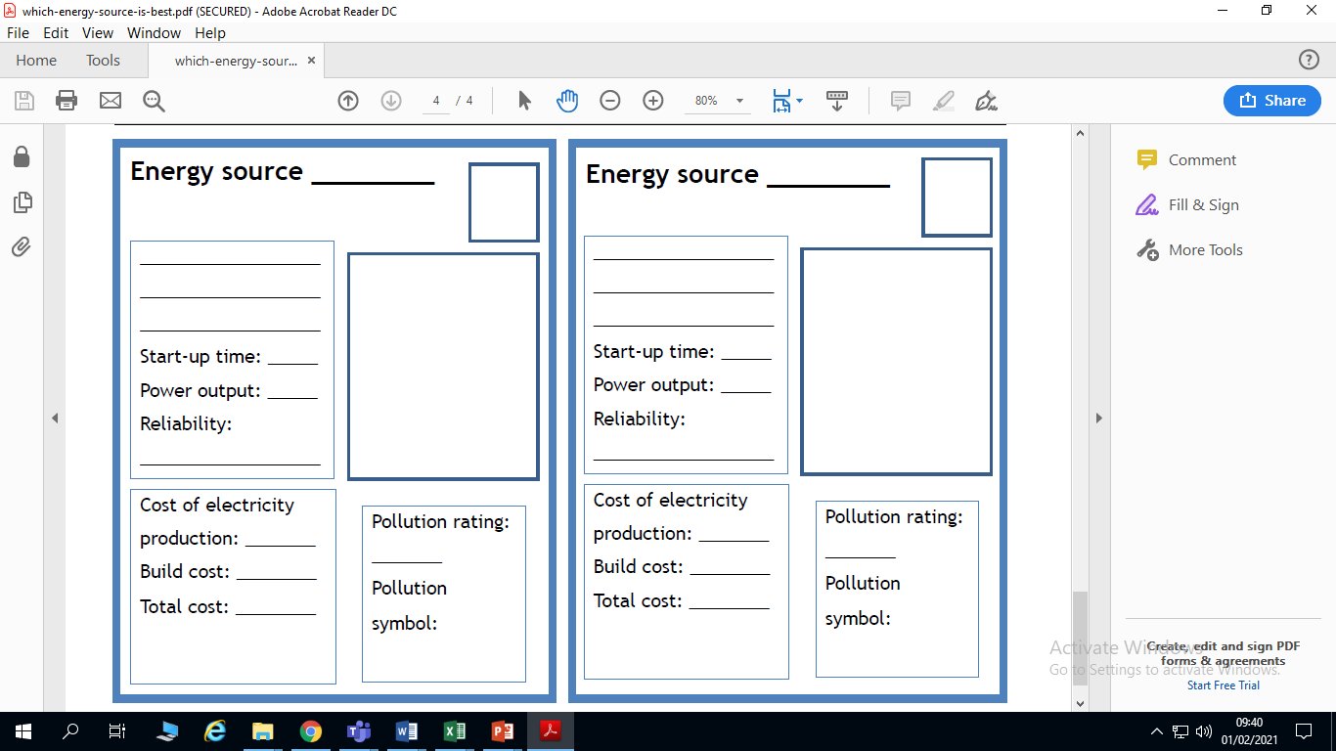

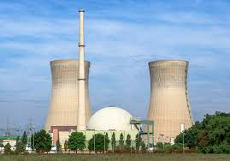
Pick 2 energy resources and fill in the cards below using the information from the table
Example
nuclear
Nuclear uses radioactive chemicals to generate heat
2
5
4
2
4
2
5

Slide 4
Use the information from the table to answer the following questions:
The energy resource which gives the largest power output is _ _ _ _ _ _ _ .
The most expensive energy resources to build are _ _ _ _ _ _ _ _ _ _ , _ _ _ _ _ , _ _ _ _
The least polluting energy resources is _ _ _ _ _
The most reliable energy resources are
_ _ _ _ , _ _ _ , _ _ _ , _ _ _ _ _ _ _ _
Imagine you are in charge of the energy resources in the UK
Which 3 would you use to provide electricity for the UK
Give reasons for your answers
_____________ because………………………………………….. ……………………………………………………………………………………
_____________ because………………………………………….
……………………………………………………………………………………
3. _____________ because …………………………………………..
……………………………………………………………………………………
Nuclear coal solar wave oil tidal gas geothermal biofuels

Slide 5
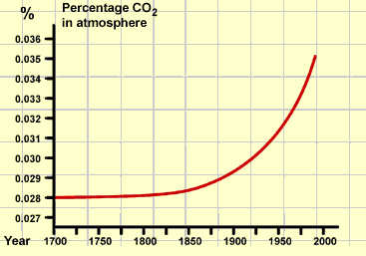
Watch this clip and answer the questions:
https://www.bbc.co.uk/programmes/p091vjxq
How many mass extinction events have there been?
What cause most of these extinction events?
Which gas caused the extinction?
How are humans acting like volcanoes?
Watch the full episode to find out more: https://www.bbc.co.uk/programmes/p08xc32c
Carbon dioxide levels are increasing due to human activity such as burning fossil fuels to generate electricity and for cars, planes and ships fuels. Humans are also cutting down and burning trees.

Slide 6

Where does the carbon dioxide come from?
Human activity | Percentage
Transportation fuels (e.g.petrol) | 14%
factories | 17%
Farming (e.g. cows bums) | 13%
Fossil fuel mining | 11%
Homes and offiices | 10%
Burning trees | 10%
Getting rid of waste | 4%
Power stations | 21%
Draw a bar graph to show where carbon dioxide comes from.
Remember to label your axes
The first one has been done for you
5 10 15 20 25
Transport factories farming fossil fuel homes burning getting PowerStation
mining and trees rid of
offices waste

Slide 7
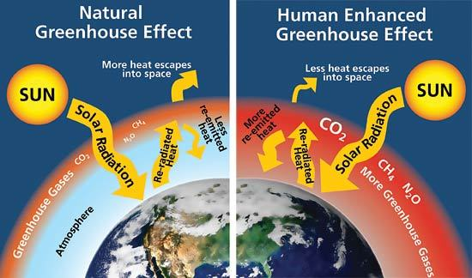
Label/colour the pie chart to show where the carbon dioxide comes from
The more carbon dioxide and methane in the atmosphere leads to heat being trapped and the earth getting hotter.
This leads to icecaps melthing, more extreme weather (such as flooding, drought (no water) and hurricanes)

Slide 8
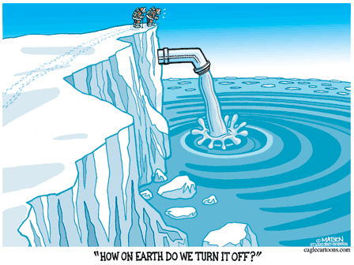
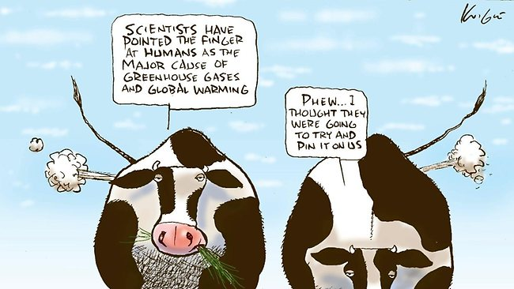
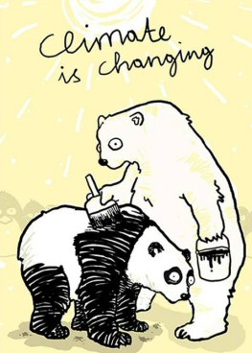
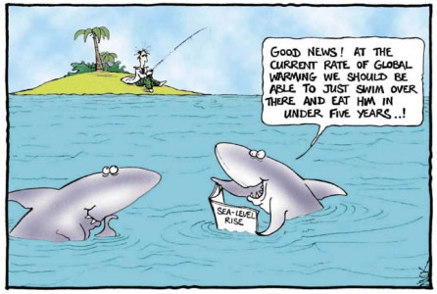
What is the message in the cartoon?
(Think how they relate to global warming)
The first one has been done for you
Cartoon | Message
 | The ice is melting, meaning more water is going into the oceans. This could lead to flooding and the stopping of ocean currents. The cartoon is saying we need to stop the melting of the ice.

Slide 9
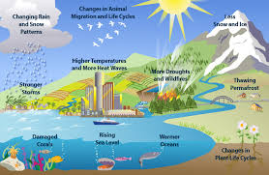
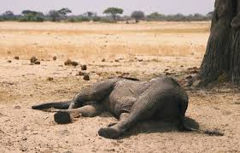
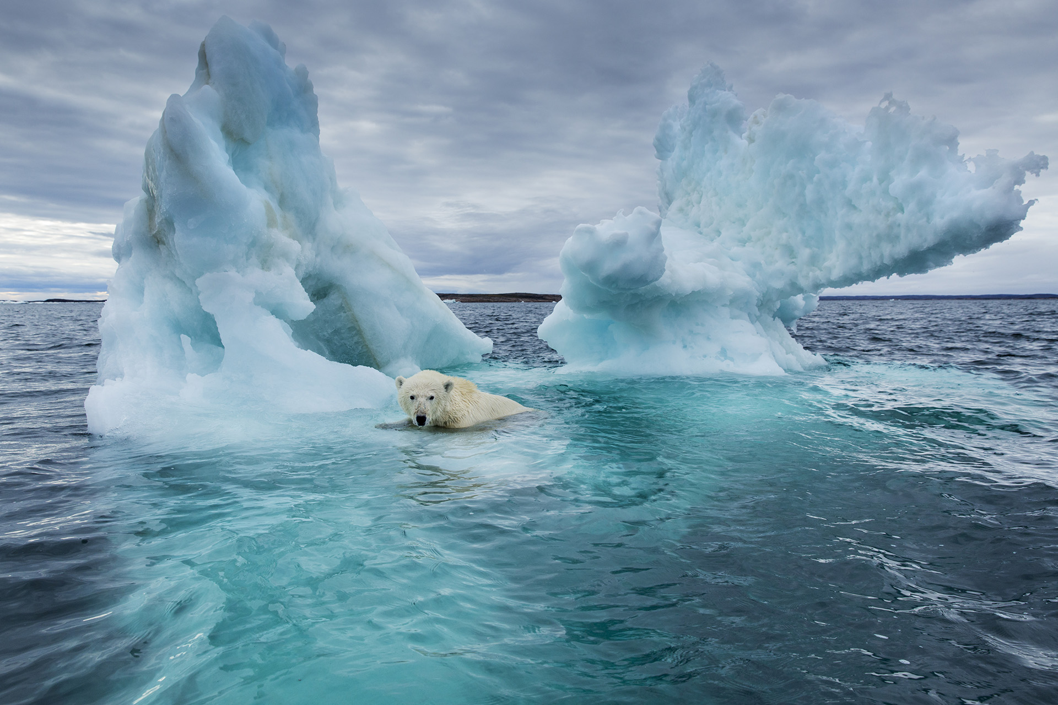
Research task- use the words at the bottom of the page to help
The main causes of global warming are………………….
…………………………………….
……………………………………….
……………………………………….
………………………………………
Global warming is a problem because ……………………………………………………………………………………………………………………………………………………………………………………………………
What can we do to slow down global warming?
Carbon dioxide cars fossil fuels cows ice burning melting animals hurricanes drought death bus renewable wind solar

Slide 10
Create a poster to identify ways in which we can slow down global warming

Slide 11


