Slide 1
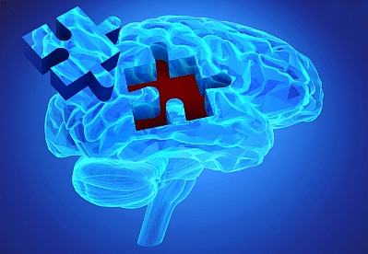
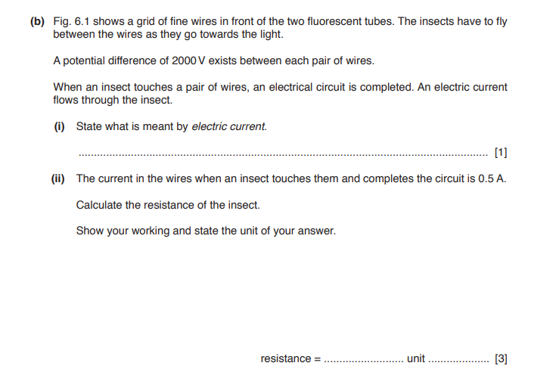
Science: conduction, convection and radiation
Use Seneca learning online with the code: ow0q7tt10a
Or have a look at BBC bitesize, follow the link below
https://www.bbc.co.uk/bitesize/guides/zttrd2p/revision/1
Recap
How can you reduce friction?
What are the energy transfers in a wind turbine?
Name 3 conductors of electricity and 3 insulators of electricity

Slide 2
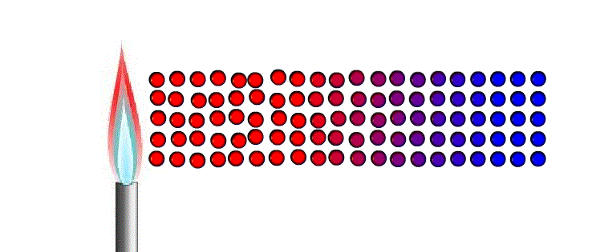
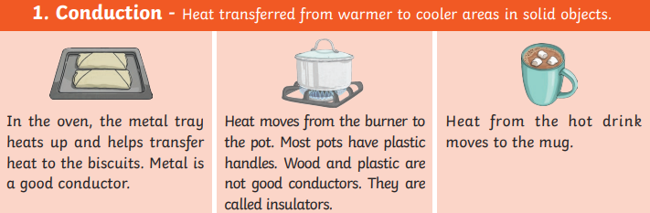
Conduction
Conduction happens in solids, it occurs by the particles heating up and this makes them vibrate (shake). The particles in solids are so close together this shaking causes the next particle to vibrate, the vibration transfers the heat energy.
C _ _ _ _ _ _ _ _ _ can only occur in s _ _ _ _ _
The heat travels by …………………………………………………
……………………………………………………………………………….
Try this at home.
Put hot water in a mug until it is ¼ full. Put a metal spoon into the mug, after few minutes the top of the spoon (not in the hot water) will feel hot. This is because the heat energy has travelled up the spoon by conduction.
Metals are good conductors of heat (they let heat travel easily)
Plastic and wood are insulators of heat (they do not let heat travel easily)

Slide 3
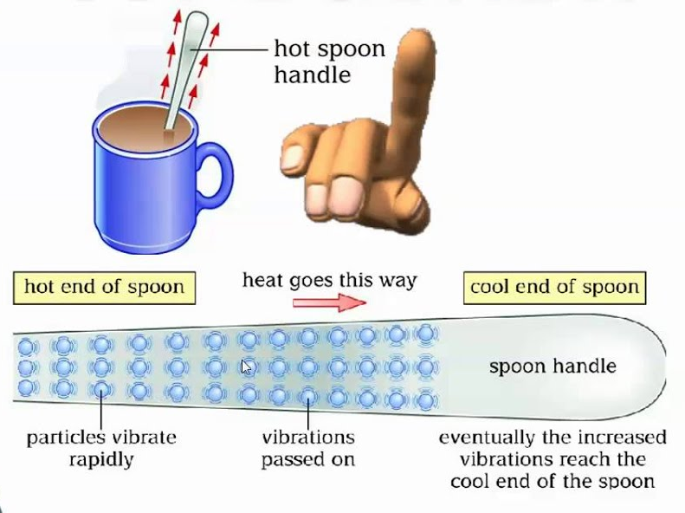
Conduction
When we heated the metal spoon in the hot water, the __________ received more energy. This meant they ________ more and bumped into each other.
As they bumped into each other, they passed on some of their energy. This meant the ______ (or thermal energy) moved through the spoon.
Eventually the whole spoon heated up. The movement of thermal energy like this is called ___________.
heat particles conduction vibrated
Draw and label diagrams showing what happened to the particles as the spoon was heated.
Substances that allow thermal energy to move easily through them are called conductors. Metals are good conductors of thermal energy.
Substances that do not allow thermal energy to move through them easily are called insulators. Air and plastics are insulators.
Explain why handles for pans are made from plastic and not metal?
Can you think of any other materials that are used as insulators or conductors of heat?

Slide 4
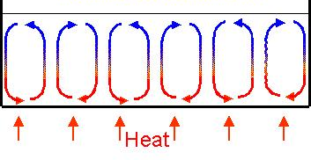
Convection
Convection occurs in liquids and gases. When a liquid/gas is heated the particles vibrate taking up more space, they expand and become less dense. This causes the particles to rise. When away from the heat, the particles cool and move down again.
The movement of gas or liquids as shown in the diagram is known as a convection current
C _ _ _ _ _ _ _ _ _ can occur in l _ _ _ _ _ _ and g _ _ _ _
The hot air rises and cools and then …………………………….
Fill in the gaps using the following words:
conduction convection convection conductors liquids gases solids
Heat flows through solids by _________________.
Liquids and gases are poor ______________ but transfer heat by _______________.
We make use of these _____________ currents in kettles, heaters and when cooking.
Convection takes place in ________________ and _______________.
Convection will not take place in ________________.

Slide 5
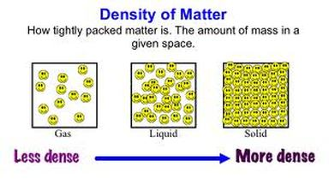
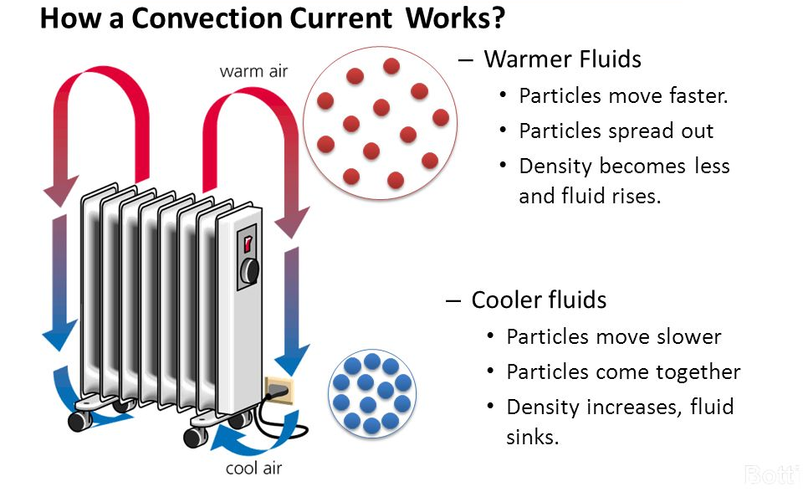
When particles heat up they vibrate more taking up more space and spreading out. This means the gas or liquid becomes less dense (lighter) so rises. As it cools it becomes more dense (heavier) so moves back down

Slide 6
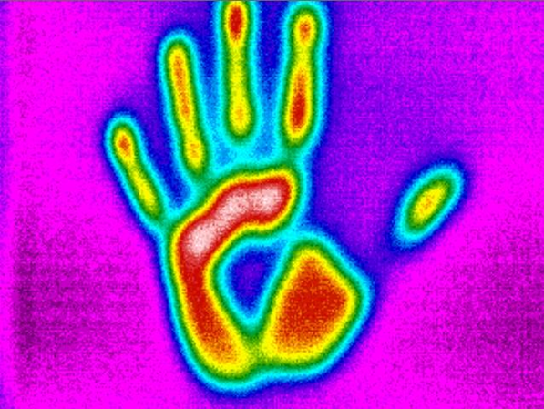
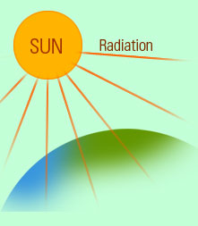
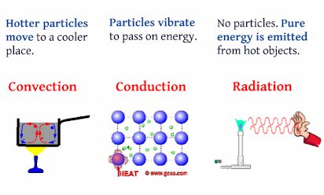
Infrared Radiation
Infrared radiation is thermal energy that is given off by all objects. Hotter, larger objects give off more infrared radiation then smaller, cooler ones.
Thermal energy (heat) travels from the sun using radiation.
Radiation does not need particles to transfer heat energy, it travels as a wave.
There are no particles in space, as radiation does not need particles heat from the sun can still travel through space.

Slide 7
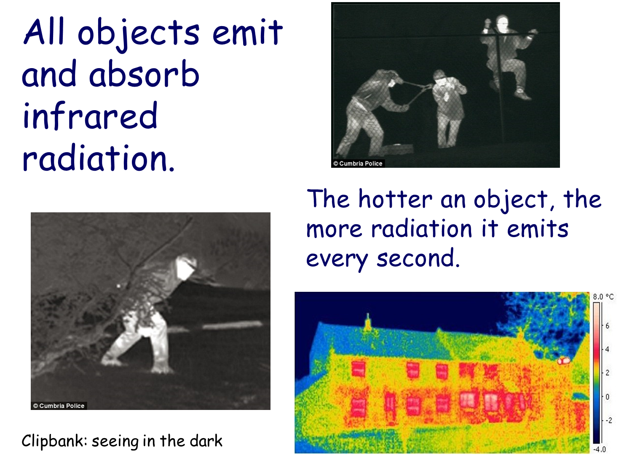
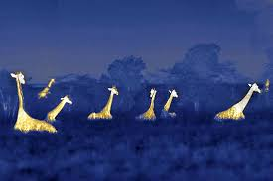
_ _ _ objects transfer heat by radiation in the form of infra-red _ _ _ _ _. Radiation is the only way heat can be transferred through a _ _ _ _ _ _. _ _ _ _ surfaces absorb radiation quickly, but _ _ _ _ _ surfaces _ _ _ _ _ _ _ radiation.
Dark Waves Reflect Hot Shiny Vacuum

Slide 8
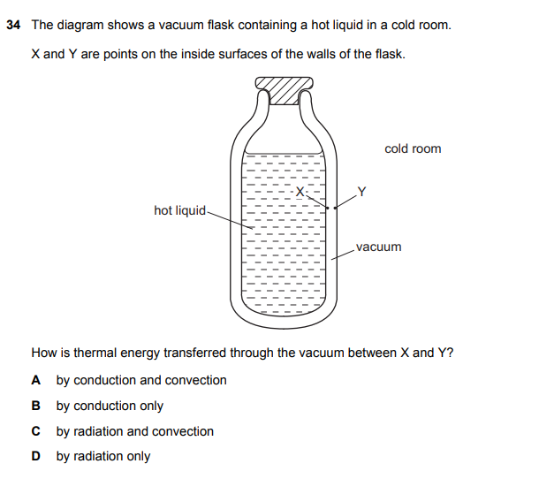
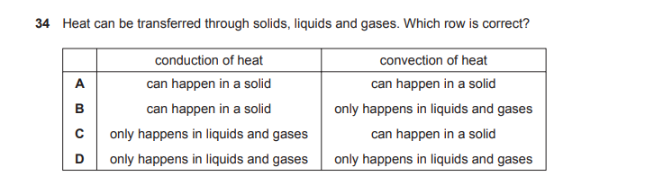

Slide 9
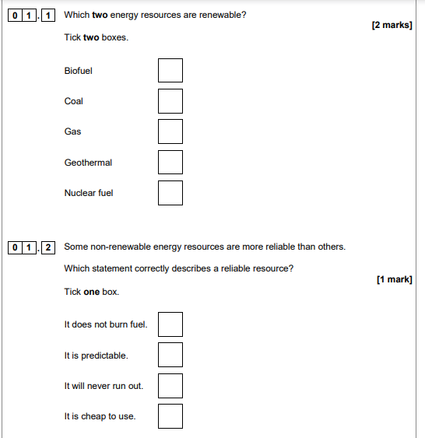

Slide 10
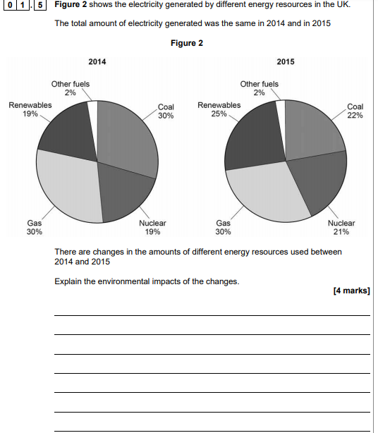

Slide 11
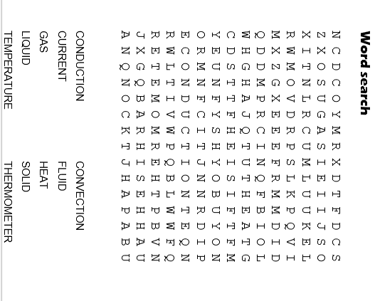
Glossary
Particle | A small piece of something that makes up matter
State | A state of matter refers to if something is a solid liquid or gas
Solid | A state of matter where the particles are closely packed together. They cannot be compressed and particles cannot move but can vibrate
Liquid | A state of matter where the particles are quite close together but are able to move over each other. The particles cannot be compressed
Conduction | heat transfer by particles vibrating against each other in a solid
Conductor | A substance that transfers energy easily from the hot part to the cold part is called a conductor .
Insulator | A substance that does not transfer energy easily from the hot part to the cold part is called an insulator
Convection | Convection happens when particles with a lot of thermal energy in a liquid or gas move, and take the place of particles with less thermal energy.
Density | A measure of mass per unit of volume. If something is dense the particles are close together and heavy

