Slide 1

English Home Learning Booklet
Transactional Writing:
Letters and Emails
Name: ___________

Slide 2
Key Words
Look up the definitions of the following key words and write down.
Key Word | Definition
Fiction
Non-Fiction
Transactional Writing
Formal
Informal
Slang

Slide 3
Introduction
Transactional writings are non-fiction texts. These are texts which communicate information between different groups of people
We are going to look at examples of transactional writing this term and have a go at writing them.
How many types of non-fiction transactional texts can you think of? Use Google to help
Transactional Writing

Slide 4

PAF
Non-fiction texts are written for different reasons. Each text will have a specific purpose, audience and form.
Purpose: Why the text is written.
Persuade, Inform, Explain, Argue, Entertain etc.
Audience: Who the text is written for.
Adults, Children, Elderly people etc.
Form: How the text is written.
Letter, Email, Article, Instructions, Newspaper etc.
Task: For each text, complete the table.
Core: State what the text is about.
Emerging: State the PAF for each text.
Secure: Say how you know.
Mastered: Refer to evidence.
Text 1: Newspaper

Slide 5
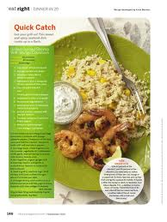
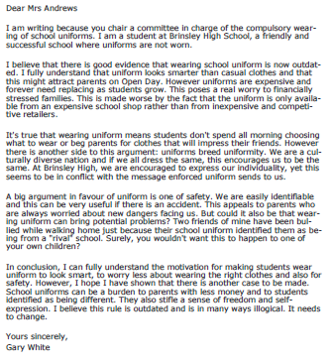
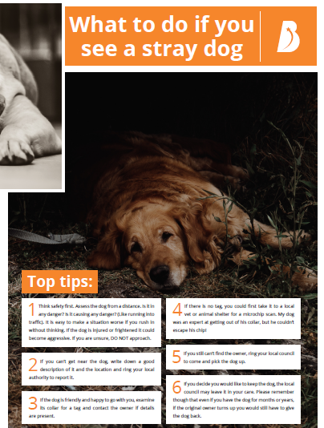
PAF
Text 2: Recipe
Text 3: Letter
Text 4: Leaflet

Slide 6
PAF
Text | Purpose | Audience | Format
1
2
3
4

Slide 7
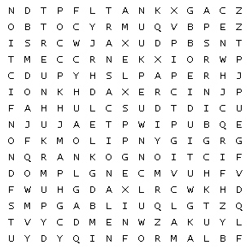
Can you find the key words in the word search?
Audience |  | Fiction |  | Form
Formal |  | Informal |  | Nonfiction
Purpose |  | Transactional |  | Writing

Slide 8
Formal and Informal
Formal language is used for serious situations, like writing a job application. It doesn’t use slang.
Informal language is more casual. You use it when you speak or message your friends. It can include slang.
Think of some examples for each one.
Formal Language | Informal Language
Extension Task:
Why do some situations need more formal language?
____________________________________________________________________________________________________________________________________

Slide 9
Formal and Informal
Formal language is used for serious situations, like writing a job application. It doesn’t use slang.
Informal language is more casual. You use it when you speak or message your friends. It can include slang.
Which kind of language would you use for the following situations?
Situation | Formal or Informal | Why?
Calling family member
Job Application
Meeting at new school
Face time your friend
Making a complaint

Slide 10
Complaint Email
SEND | To: | feedback@worldfoods.co.uk
 | Subject: | Ruined Birthday Meal
To whom it may concern, I am writing to complain about the service at World Foods Restaurant. I went for dinner there with my family on Saturday 27th February for my daughter’s birthday. I booked a table for 7pm. When we got there, they had no record of our booking .The waiter was very rude to us and I was outraged by the way he treated us. When I demanded to speak to the manager, she managed to find us a table, but now I wish she did not. We ordered our food and drinks at 7.30. Then we waited. We kept waiting until after 8.30! Finally, our food arrived, but not our drinks. My food was fine, but my wife’s fish was icy and completely inedible. My daughter’s burger had congealed fat on it and shrivelled up lettuce. Not only that, but our drinks still have not arrived. My daughter was so distraught we decided we would have to leave. It was late, we were tired and we were hungry. This was the worst meal out we have ever had and my daughter’s birthday was ruined. I demand my money back and apology from the owner. Regards, Mr Simon Matthews

Slide 11
Complaint Email
1. How does the letter open?
______________________________________________________
2. What are they complaining about?
______________________________________________________
3. When and what time was the meal booked for?
______________________________________________________
______________________________________________________
4. What did the waiter do?
_____________________________________________________
5. How did the manager help?
______________________________________________________
6. List three things that went wrong with their meal.
_____________________________________________________
_____________________________________________________
7. What did they decide to do about it?
_____________________________________________________
8. What does he want the restaurant to do?
_____________________________________________________

Slide 12
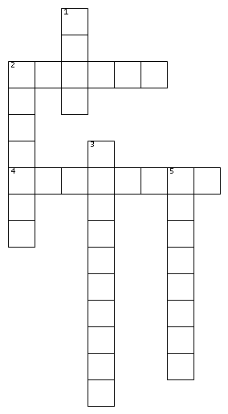
Can you put the key words in the right places?
ACROSS
2. Serious language.
4. Casual language.
DOWN
1. How the text is written.
2. Made up stories.
3. A text which deals with true or real events.
5. Who a text is written for.

Slide 13
Annotation
You are now going to create a key and annotate the letter.
Highlight or underline each item in a different colour (or if you only have one pen, with a different pattern!)
Colour or Pattern | Technique
 | Formal Language
 | Adjectives Words which describe what is wrong with the meal.
 | Features of an email Parts of the text which show it is an email.

Slide 14
Complaint Email
How does the writer show he is unimpressed with the service?
Point | Technique | Quote | Explanation
The writer explains how he felt about the situation. | Adjective | “I was outraged by the way he treated us.”
The writer describes the poor service.

Slide 15

Self Assessment
Well done! You completed the first week on transactional writing
List three things you have learnt.
_________________________________________
_________________________________________
_________________________________________
What went well this week?
My best piece of work is…
_________________________
because…
_________________________
_________________________

