Slide 1

English Home Learning Booklet
Transactional Writing:
Letters and Emails
Name: ___________

Slide 2
Key Words
Match up your definitions with the key words.
Use Google or a dictionary to check your answers
Key Words
Non-Fiction
Formal
Informal
Slang
Definitions
A text which explores true or real events.
Words you use with your friends which are not formal language.
Serious language used for serious situations.
Casual language used for more casual situations.

Slide 3

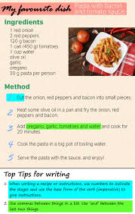

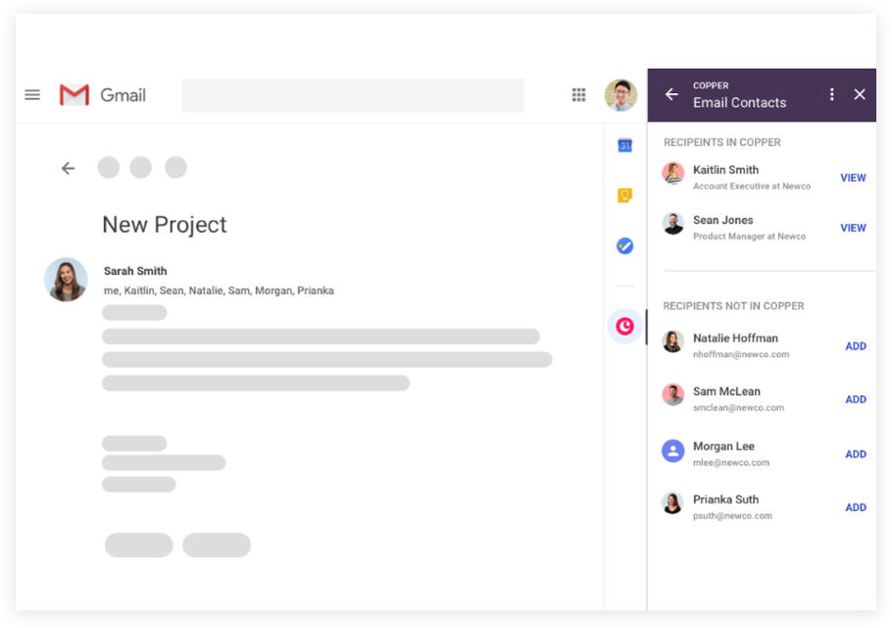
Introduction
Transactional writings are non-fiction texts.
We are going to look at examples of transactional writing this term.
How many types of non-fiction texts can you think of? Use good to help.
Non-Fiction Texts
Letter

Slide 4
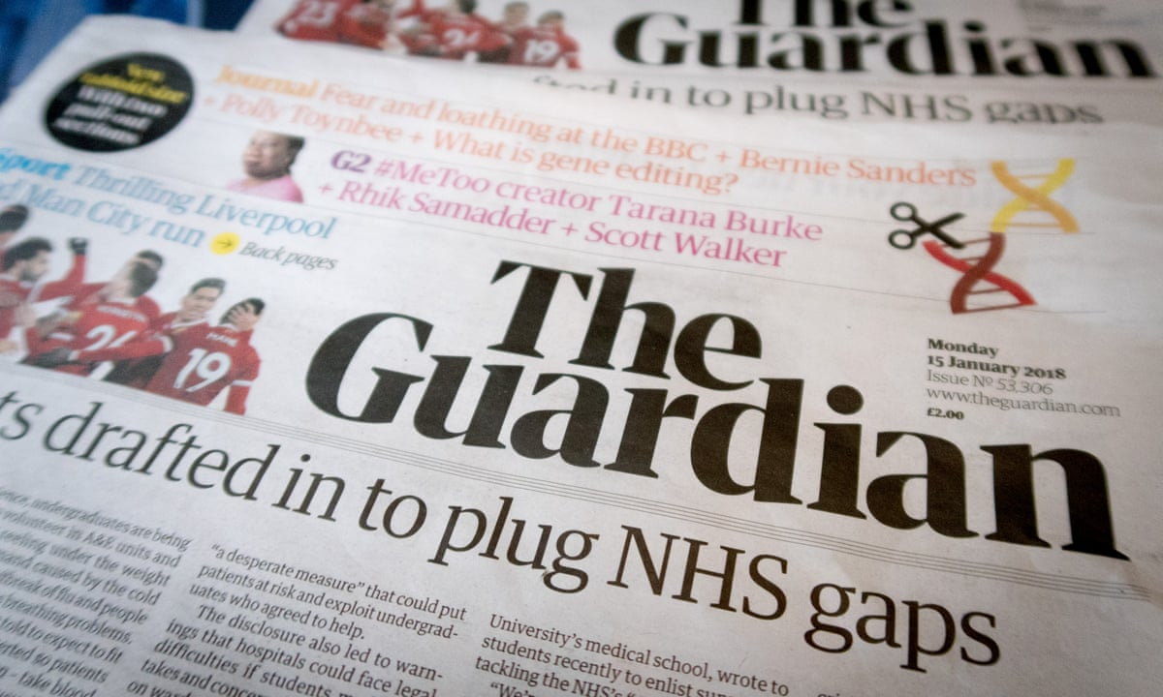
PAF
Non-fiction texts are written for different reasons. Each text will have a specific purpose, audience and form.
Purpose: Why the text is written.
Persuade, Inform, Explain, Argue, Entertain etc.
Audience: Who the text is written for.
Adults, Children, Elderly people etc.
Form: What kind of text it is.
Letter, Email, Article, Instructions, Newspaper etc.
Task: For each text, complete the table, by putting the key words in the right place.
Core: Put the correct form into the table.
Emerging: Put the correct purpose into the table.
Secure: Put the correct audience into the table.
Mastered: Explain your ideas.
Text 1: Newspaper

Slide 5
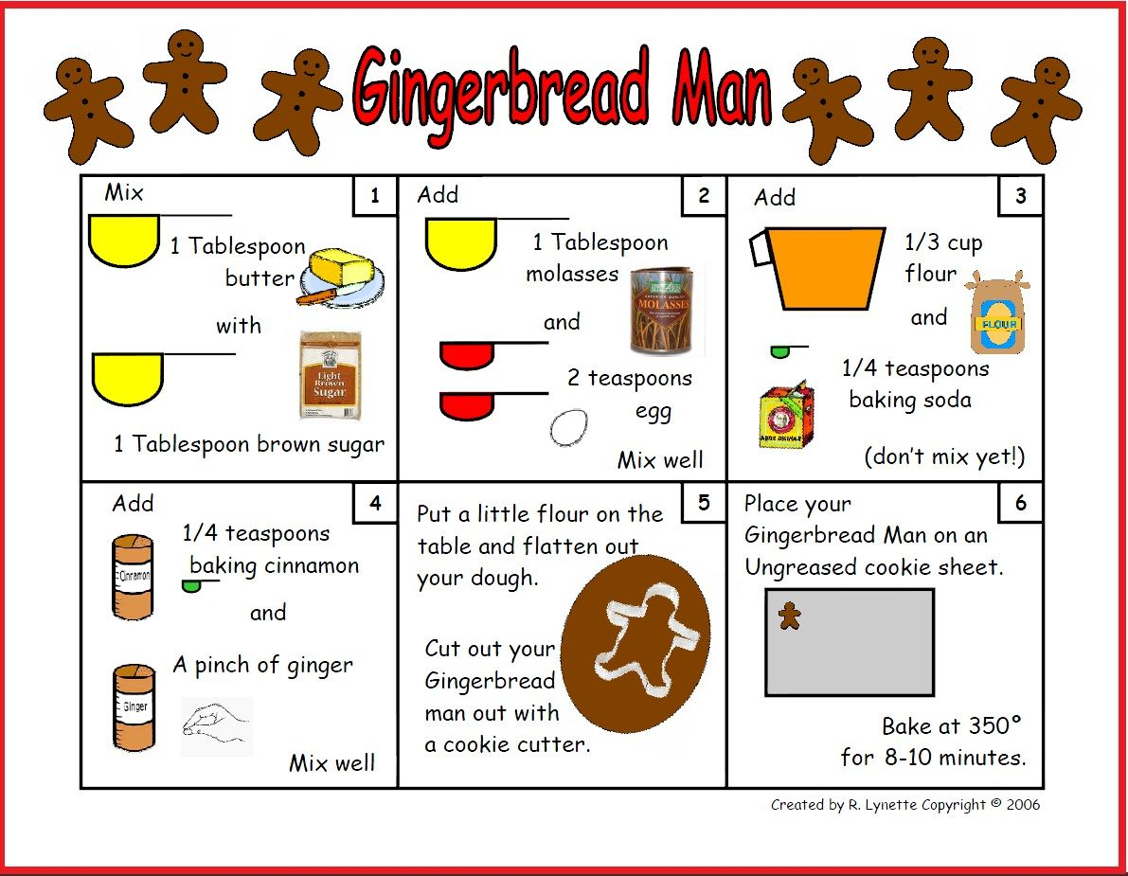
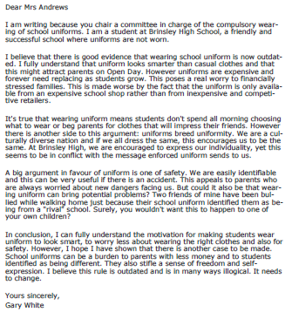
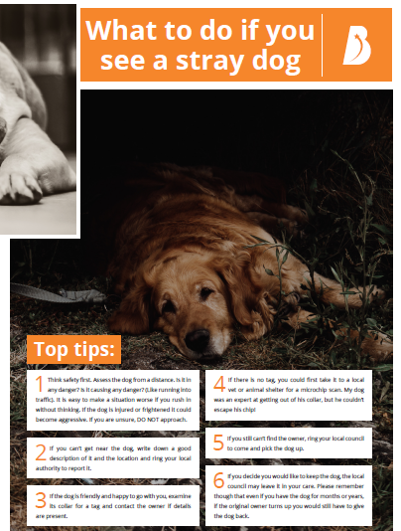
PAF
Text 2: Recipe
Text 3: Letter
Text 4: Leaflet

Slide 6
PAF
Text | Purpose | Audience | Form
1
2
3
4
Persuade
Inform
Instruct
Advise
Children
Adults
Dog Owners
Teacher
Recipe
Letter
Newspaper
Leaflet

Slide 7
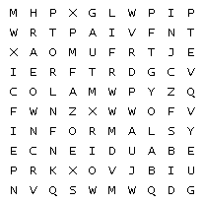
Can you find the key words in the word search?
Audience |  | Form |  | Formal
Informal |  | Purpose

Slide 8
Formal and Informal
Formal language is used for serious situations, like writing a job application. It doesn’t use slang.
Informal language is more casual. You use it when you speak or message your friends. It can include slang.
Task: Put the examples in the right boxes
Hi mate, wanna come over later?
Dear Sir or madam,
I am writing to inform you about an upcoming event.
I just cba today.
Good evening sir. How can I help you today?
Oi, you. What do you want?
Formal Language | Informal Language

Slide 9
Formal and Informal
Formal language is used for serious situations, like writing a job application. It doesn’t use slang.
Informal language is more casual. You use it when you speak or message your friends. It can include slang.
Which kind of language would you use for the following situations?
Situation | Formal or Informal
Calling family member
Job Application
Meeting at new school
Face time your friend
Making a complaint
Extension Task:
Why do some situations need more formal language?
____________________________________________________________________________________________________________________________________

Slide 10
Complaint Email
SEND | To: | feedback@worldfoods.co.uk
 | Subject: | Ruined Birthday Meal
To whom it may concern, I am writing to complain about the service at World Foods Restaurant. I went for dinner there with my family on Saturday 27th February for my daughter’s birthday. I booked a table for 7pm. When we got there, they had no record of our booking .The waiter was very rude to us and I was outraged by the way he treated us. When I demanded to speak to the manager, she managed to find us a table, but now I wish she did not. We ordered our food and drinks at 7.30. Then we waited. We kept waiting until after 8.30! Finally, our food arrived, but not our drinks. My food was fine, but my wife’s fish was icy and completely inedible. My daughter’s burger had congealed fat on it and shrivelled up lettuce. Not only that, but our drinks still have not arrived. My daughter was so distraught we decided we would have to leave. It was late, we were tired and we were hungry. This was the worst meal out we have ever had and my daughter’s birthday was ruined. I demand my money back and apology from the owner. Regards, Mr Simon Matthews

Slide 11
Complaint Email
Complete the Cloze Summary on the email.
The email is written to ____________ about a meal for the writer’s daughter’s ______________. The first problem they had was that they did not have their ____________. The waiter was then _____________ to them. The _____________ then found them a table, but when they ordered their food was very ___________. They did not get their ____________. The food wasn’t very _______________They decided they would have to __________. The writer wants his __________ back and an _____________.
complain money apology leave
birthday booking late good
drinks rude manager

Slide 12
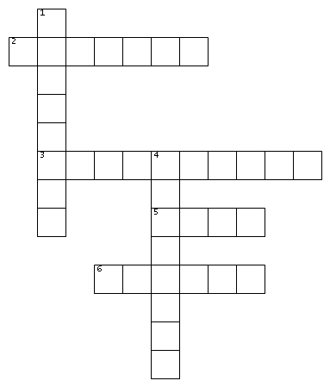
Can you put the key words in the right places?
ACROSS
2. Why a text is written.
3. Texts which deal with true or real events.
5. What kind of a text it is.
6. Serious language for serious situations.
DOWN
1. Who a text is written for.
4. Casual language for more casual situations.

Slide 13
Annotation
You are now going to create a key and annotate the letter.
Highlight or underline each item in a different colour (or if you only have one pen, with a different pattern!)
Colour or Pattern | Technique
 | Formal Language
 | Things which go wrong with the meal

Slide 14
Complaint Email
How does the writer show he is unimpressed with the service?
Point | Quote | Explanation
The writer explains how he felt about the situation. | “I was outraged by the way he treated us.” | This shows how disappointed the writer was with the meal because it focuses on his surprise and shock by using the word “outraged.”
The writer describes the poor service. | “We kept waiting until after 8.30!”
The writer describes the bad food.

Slide 15

Self Assessment
Well done! You completed the first week on transactional writing
List three things you have learnt.
_________________________________________
_________________________________________
_________________________________________
What went well this week?
My best piece of work is…
_________________________
because…
_________________________
_________________________

