Slide 1
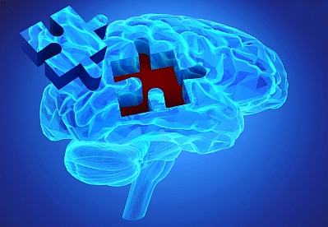
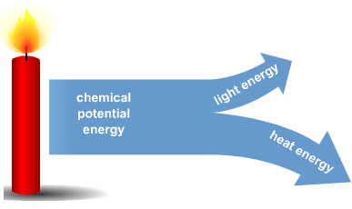
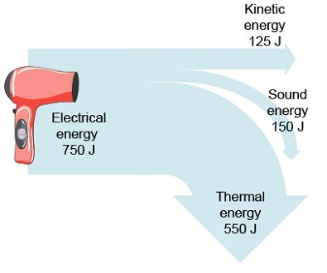
Name___________
Science: Cells and skeleton
If you prefer to work online please visit SENECA learning and sign up using the class code: 4ggjlziov1
If you want help with the topic please email me or go to:
https://www.bbc.co.uk/bitesize/guides/zpkq7ty/revision/1
Recap
fill in the missing energy types
Name as many energy types as you can
_ _ _ _ _ _ _ _
_ _ _ _ _
_ _ _ _ _ _ _ _

Slide 2
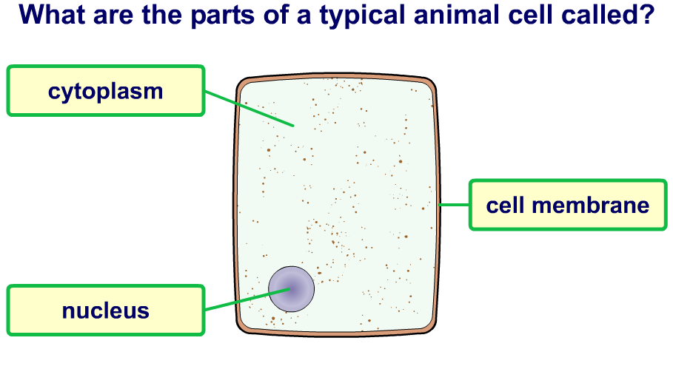
Animal cells
Cell membrane
Nucleus
Cytoplasm
Keeps the cell together and controls what goes in and out
Where the DNA is stored, it tells the cell what to do
A jelly like substance in which most of the cell reactions take place

Slide 3
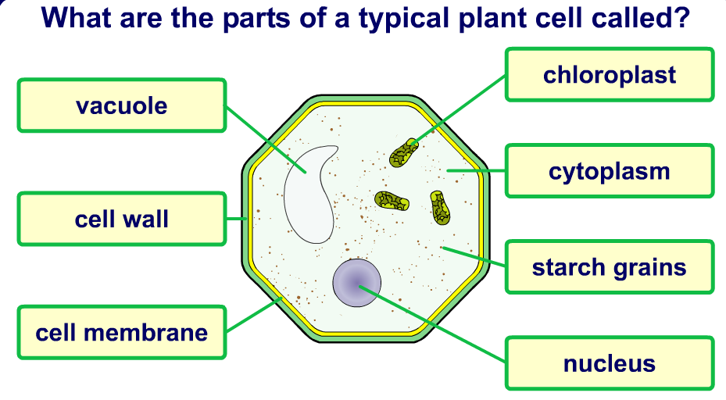
Plant cells
Part | Function
Nucleus | Where the DNA is stored and tells the cell what to do
Cytoplasm | A jelly like substance in which most of the cell reactions take place
Cell membrane | Controls the movement of substances into and out of the cell
Cell wall | Supports the cell
Chloroplasts | Photosynthesis happens here
Vacuole | Storage space filled with sap (sugary solution)

Slide 4
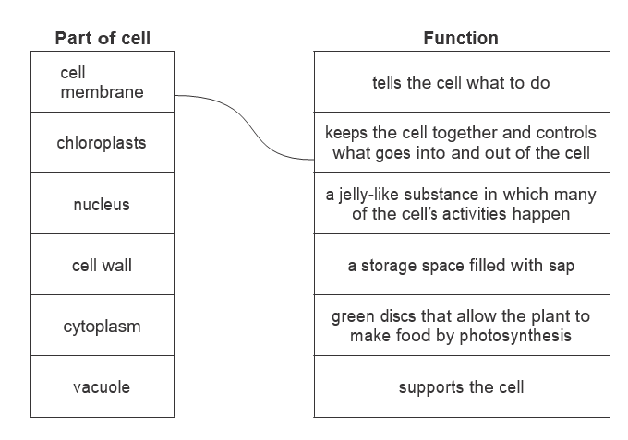
Plant cell membrane chloroplast vacuole animal cell wall
_ _ _ _ _ _ _ _ _ _ _ _
_ _ _ _ _ _ _ _ _ _ _
_ _ _ _ _ _ _ _
nucleus
cytoplasm
_ _ _ _ _ _ _
This is an _ _ _ _ _ _ cell.
This is a _ _ _ _ _ cell.
Match the part with what it does

Slide 5
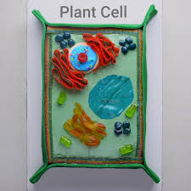
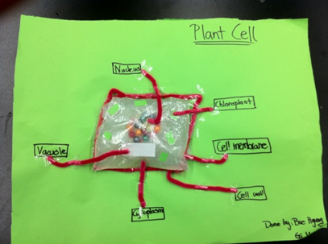
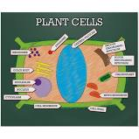
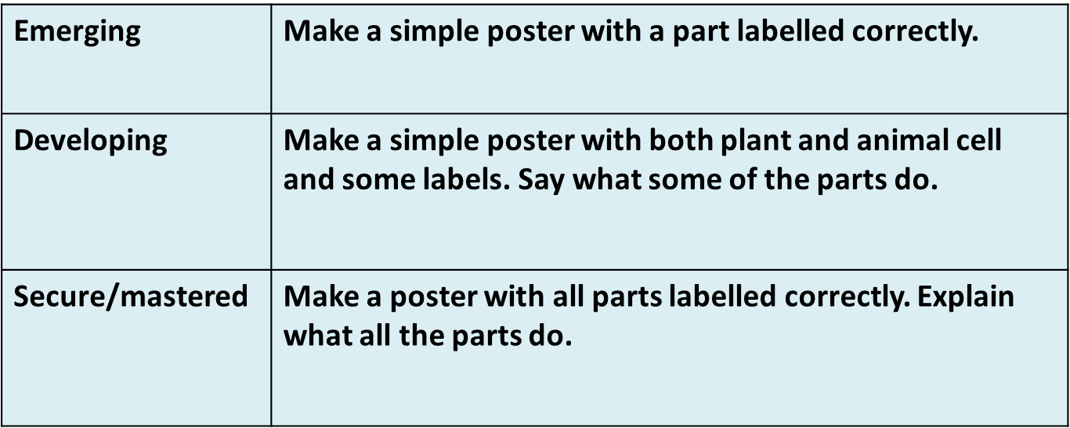
Make a plant cell poster with labels
Make it 3D if you like (could be made out of cake, pasta)
Use the back of this page.
Below are some ideas
Self assessment:
I think I am ………………….because………………………………………………..
………………………………………………………………………………………………….
To improve I could…………………………………………………………………….
………………………………………………………………………………………………...

Slide 6
Plant poster

Slide 7
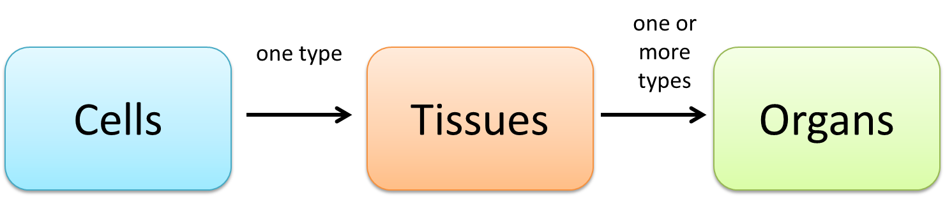
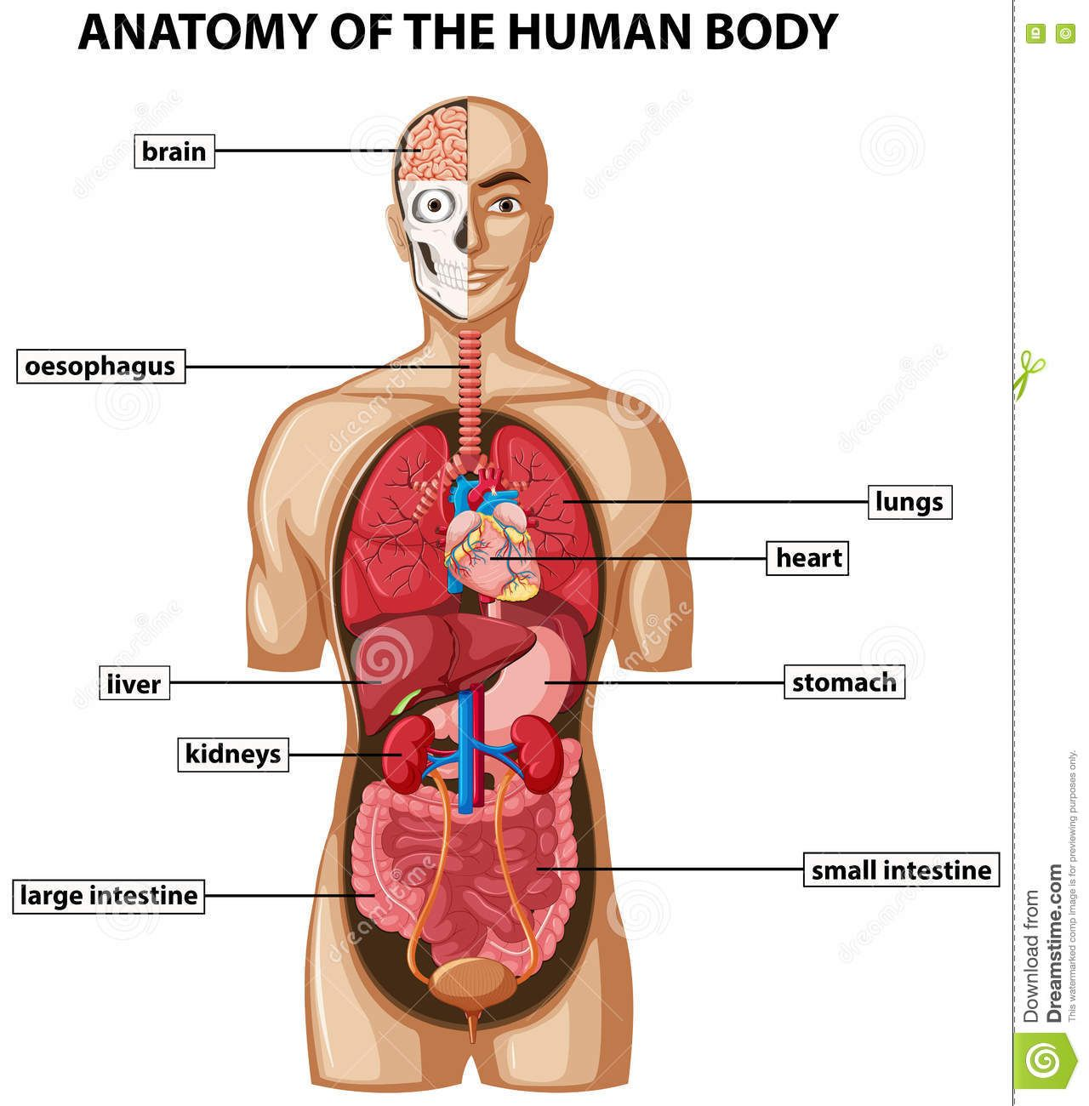
…………………………types
_ _ _ type
Cells
Tissues
Organs
Cells are the _ _ _ _ _ _ _ _ building block of the body.
Lots of the _ _ _ _ cell joined together is known as a _ _ _ _ _ _.
Lots of _ _ _ _ _ _ _ _ _ tissues joined together are known as an _ _ _ _ _ .
Organs in the human body are ………………………………………………………
Same different organs tissues smallest

Slide 8
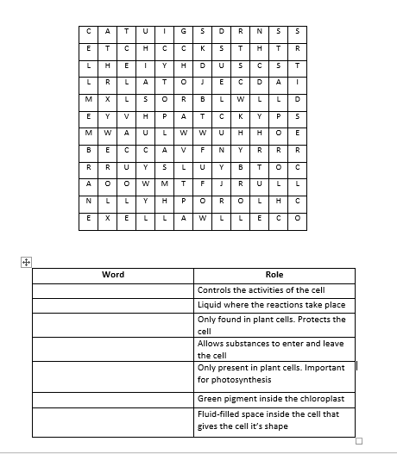
Parts of the cell wordsearch
Write the words that match the definition then find

Slide 9
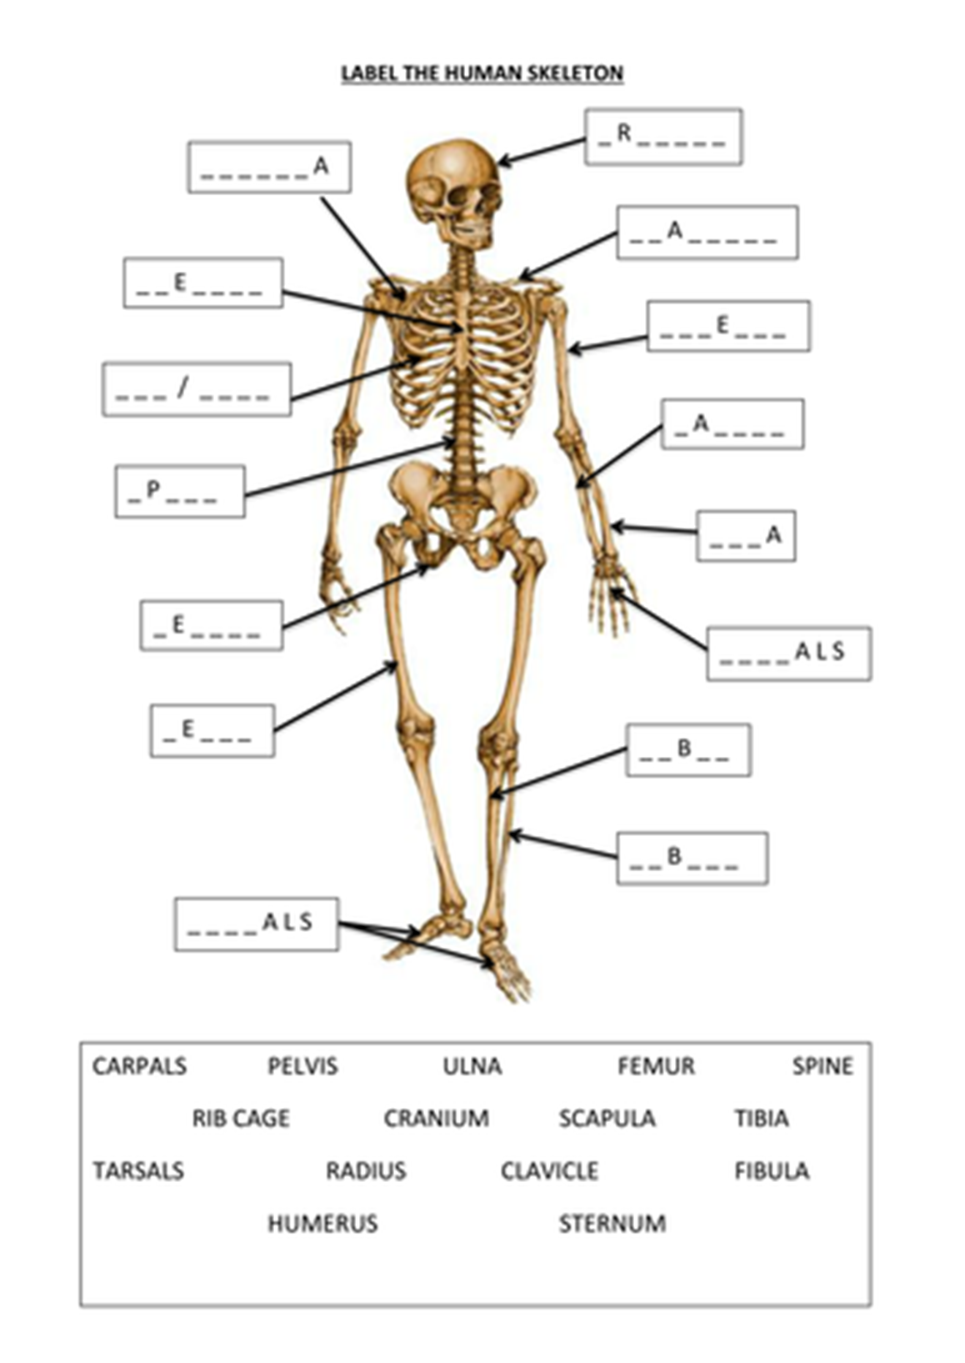

Slide 10
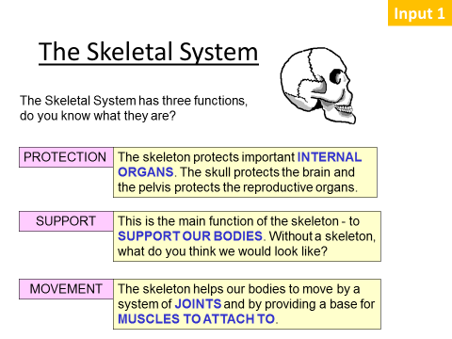
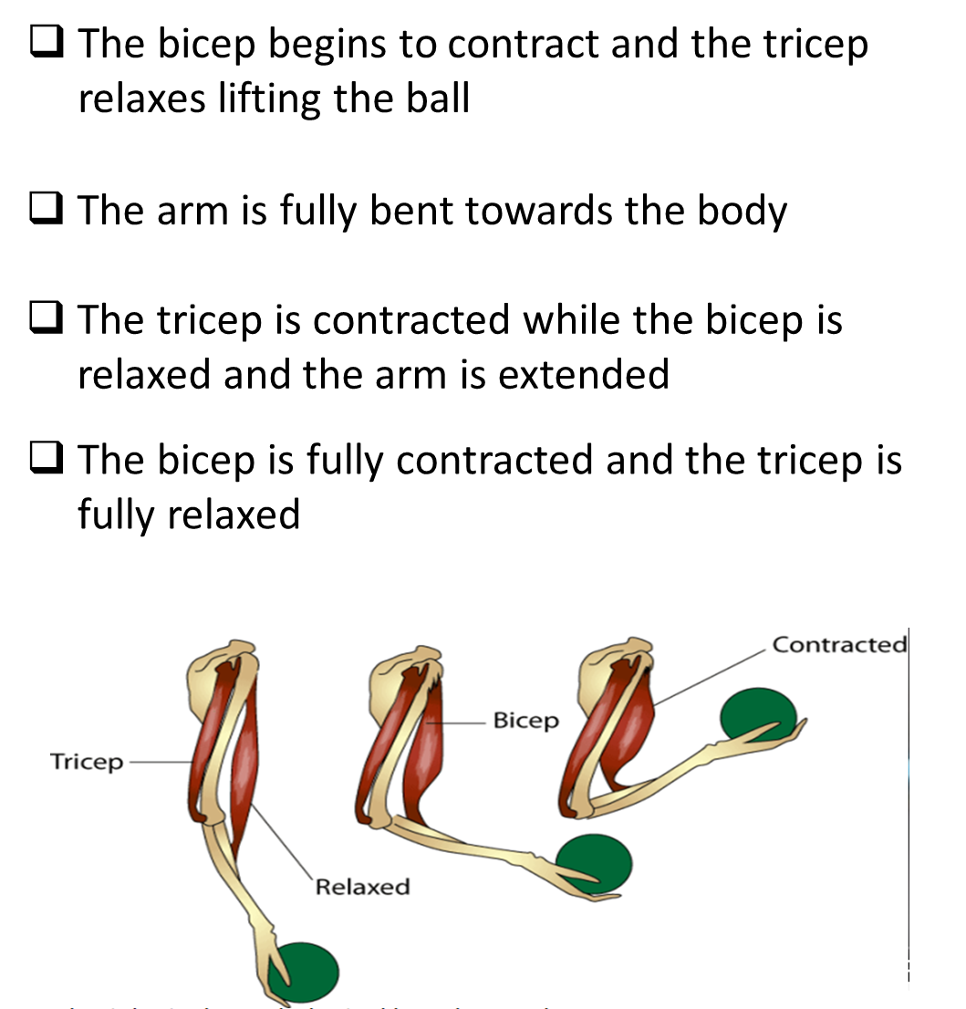
The muscles allow movement by pulling on the bones.
Order the sentences below

Slide 11
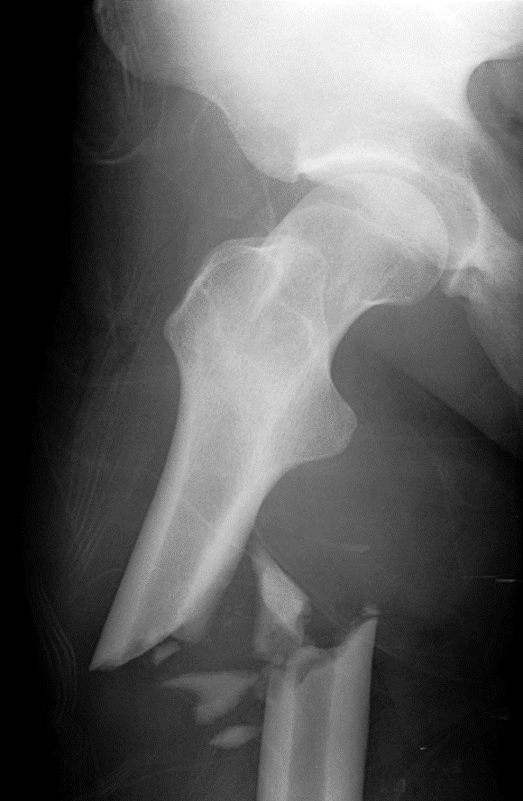
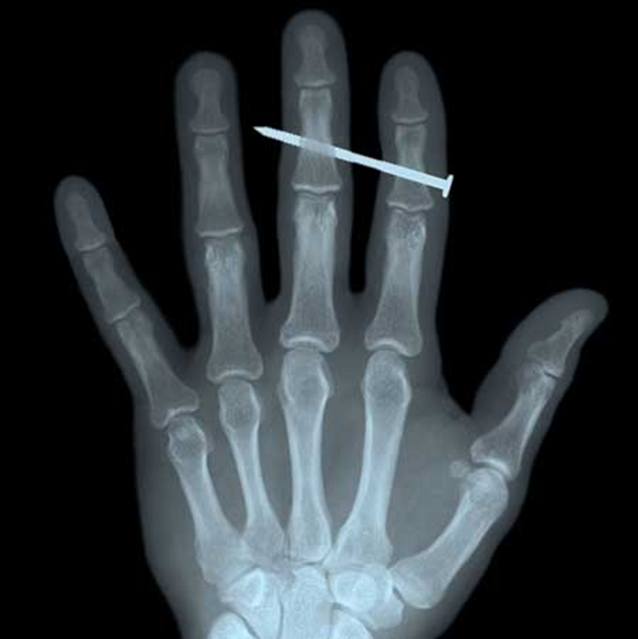
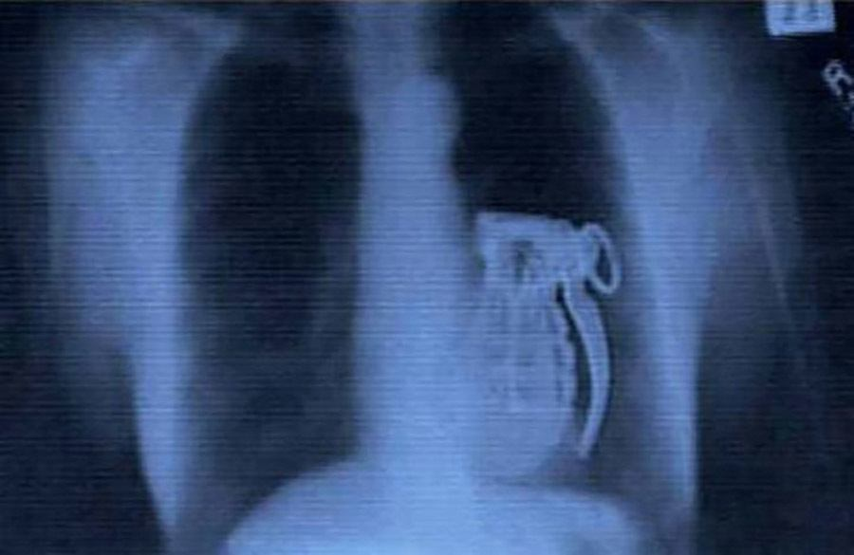
The skeleton is needed for _ _ _ _ _ _ _ _ _ _. It protects your _ _ _ _ _ _ like the _ _ _ _ _
The skeleton is needed for _ _ _ _ _ _ _. It helps to keep the body _ _ _ _ _ _ _
The skeleton is needed for _ _ _ _ _ _ _ _. The muscles pull the _ _ _ _ _ so we can _ _ _ _
Move bones movement protection support upright heart organs
The part of the skeleton which protects the heart is………………………………………………………………………………
…………………………………………………………………………………
X-rays show your bones. What has happened in each of the x-rays?

Slide 12
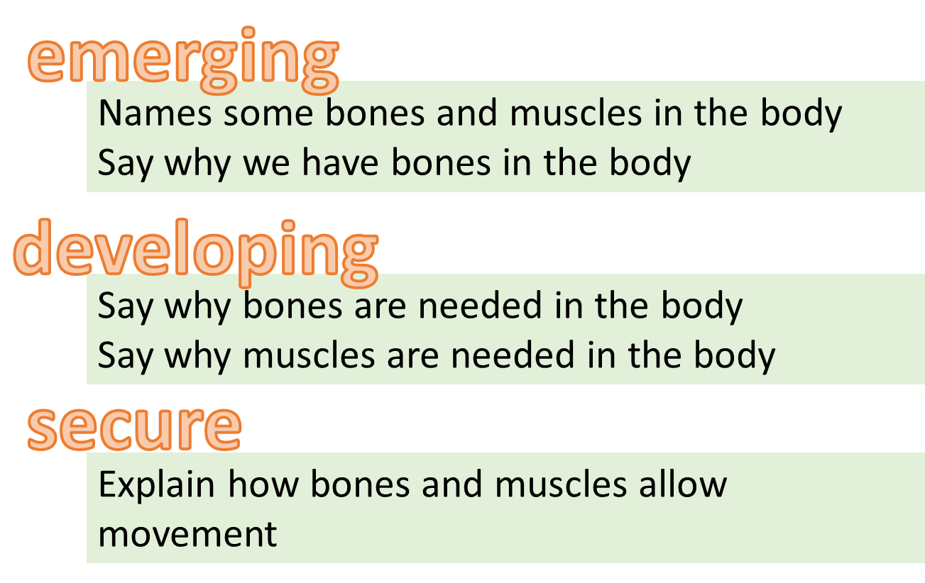
Key words
Bones muscles support protect movement
Bones are important because………………………………………..
……………………………………………………………………………………..
Muscles are important because…………………………………….
……………………………………………………………………………………….
If you had no bones……………………………………………………….
………………………………………………………………………………………
Self assessment:
I think I am ………………….because………………………………………………..
………………………………………………………………………………………………….
To improve I could…………………………………………………………………….
………………………………………………………………………………………………...

Slide 13


